Slide 1
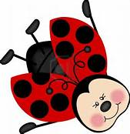
Animals Week 1 Booklet
Living vs. Non-Living
Foss Investigation #7 Insects
Part 1: Structure, Function, Behavior
Part 2: Insect Systems
Not in Foss-
Structures for Defense
1
Classification & Animals Unit

Slide 2
Insect, Classification & Taxonomy Vocabulary
2
Word | Definition
1. Taxonomy | The study of classifying organisms.
2. Taxonomist | Scientist who group organisms.
3. Levels of Classification | Kingdom, phylum, class, order, family, genus, species.
4. Trick To Remember | King Phillip Came Over For Great Spaghetti.
5. The 5 Kingdoms | Plant, Animal, Fungi, Protist, Moneran
6. Divisions (Plant) | Within the plant kingdom, phyla are referred to as this. There are two groups: vascular and non-vascular.
7. Divisions (Animal) | In the animal kingdom, there are 35 different phyla split into two groups: vertebrates and invertebrates.
8. Scientific Name | The first and last name of an organism (genus/species) for example: Pinus taeda (Latin) or the Loblolly Pine (English).
9. Genus | First name of an organism (written in Latin) always CAPITALIZED!
10. Species | Last name of an organism (written in Latin)-NEVER Capitalized!
11. 4 Characteristics of All Living Things | 1. ) obtain and use resources for energy 2.) respond to stimuli 3. ) reproduce 4.) grow and develop
Study 20

Slide 3
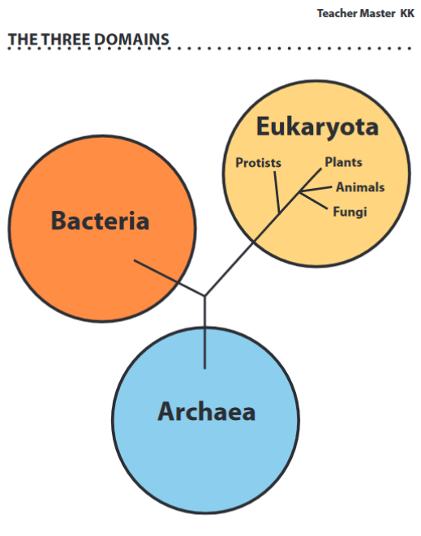
FOSS Investigation #7 Insects LAB: Part 1: Structure, Function, Behavior
What do all of the organisms in the Eukaryota domain have in common?
1.____________________________________
2 .____________________________________
3 .____________________________________
4 .____________________________________
What organisms are found in the Eukaryota domain?
1.____________________________________
2 .____________________________________
3 .____________________________________
4 .____________________________________
3

Slide 4
Focus Question: How do the structures and behaviors of the Madagascar hissing cockroach enable life’s functions?
4
Lab Part 1: Structure, Function, Behavior
Remember that we looked at an animal cell and the differences/similarities to a plant cell. We are going to move from studying plants to studying animals. What are some animals you are familiar with? List as many as you can in 1 minute—Go!
We are going to study the structures and behaviors of a Madagascar hissing cockroach. A structure is a tissue, an organ or other formation made up of different but related parts. A behavior is a manner of acting. A function is the special action of an organ or a body part or the purpose of a behavior. Fill out this chart concerning humans.
Read pages 93-97 in hard back book: “Insects Structures and Functions” and use them to do the lab. Focus on the major sections of the insect body: the head, thorax and abdomen.
Human Structure | Human Function | Human Behavior | Function of the Behavior

Slide 5
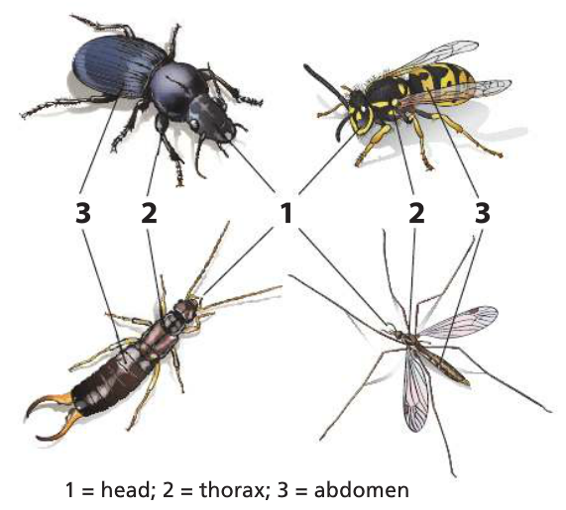
FOSS Investigation #7 Insects
LAB: Part 1: Structure, Function, Behavior
Introducing the hissing cockroaches . . . Remember that cockroaches are living organisms and you need to handle them with care as a family pet.
The cockroaches are hardy organisms.
They do not bite, pinch, or carry diseases.
They can be gently picked up by the sides of their thorax or abdomen and supported from underneath with your hand.
It is all right for the cockroaches to crawl on your hands and arms.
They are sturdy, but if you crack their exoskeleton, they will surely die. ☹ Keep them away from the edges of the tables and do NOT hold them more than a few centimeters above the table.
5
Lab Setup: Have “getters” retrieve a basin with two cockroaches, a ½ L container and lid, and four hand lenses.
First-record where the cockroaches are in the basin.________________________________
Second-remove the cockroaches from the basins carefully, like your pet. Thumbs up!_____
Circle if you have a male or a female? Cockroach #1_______________ #2_______________
What is the distinguishing structure of a male? ____________________________________
Did your cockroach hiss? Circle Yes or No Circle if the hisser was male or female.

Slide 6
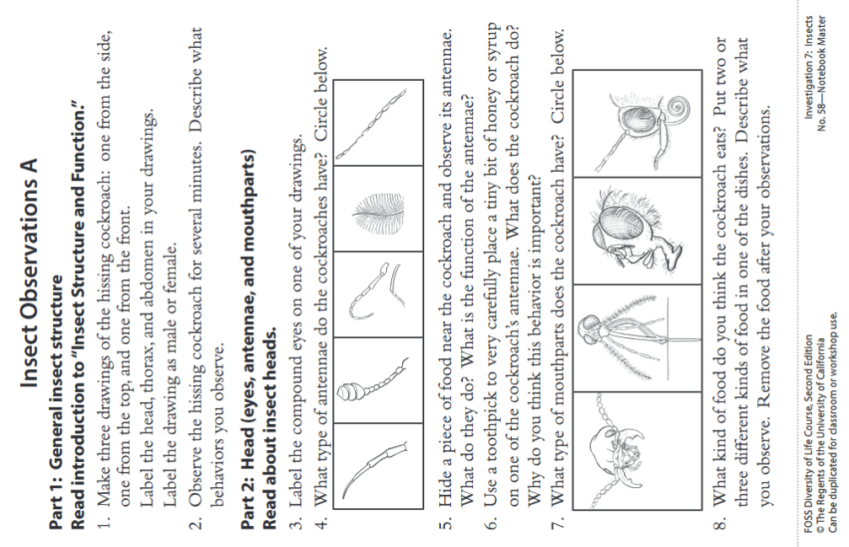
FOSS Investigation #7 Insects LAB: Part 1: Structure, Function, Behavior
6

Slide 7
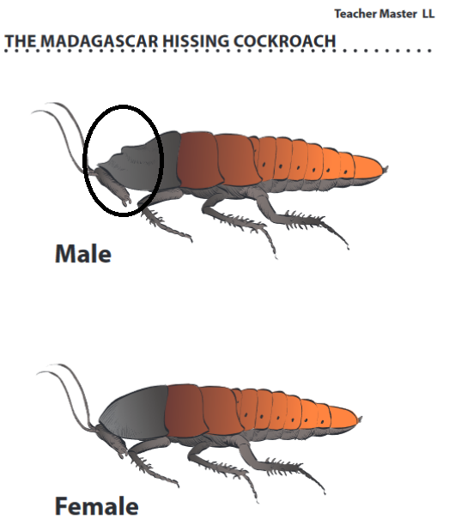
FOSS Investigation #7 Insects LAB: Part 1: Structure, Function, Behavior
Read page 51-58 in hard back book: “Those Amazing Insects” and do the Think Questions.
1. When does a hissing cockroach hiss?
2. How does the hissing benefit the cockroach?
3. The wheat weevil and the drummer wasp may benefit from the activity of humans. Can you think of another insect that may benefit from living around humans? Explain the benefit.
4. If you bother a wasp, you might find yourself pursued by the whole colony. How do you think they communicate to know who to chase?
7

Slide 8
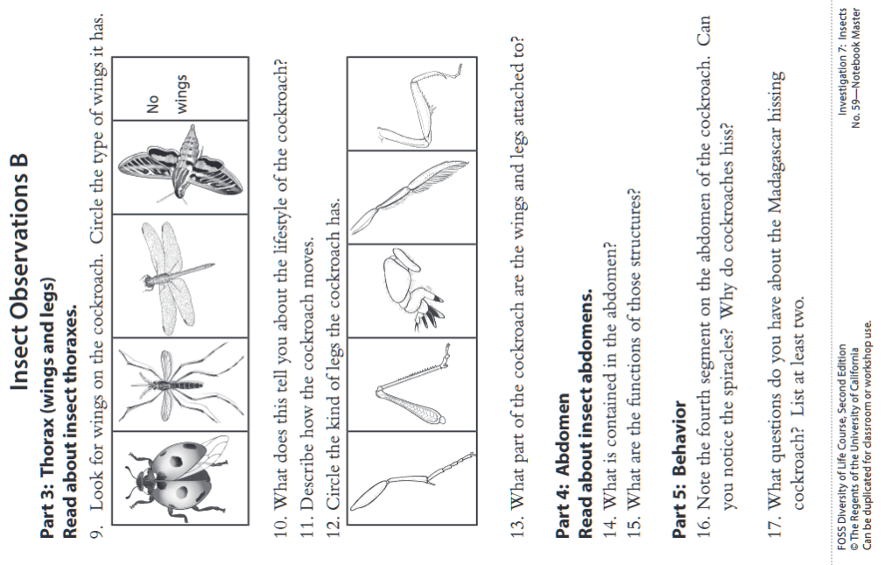
FOSS Investigation #7 Insects LAB: Part 1: Structure, Function, Behavior
8

Slide 9
Focus Question: How do the structures and behaviors of the Madagascar hissing cockroach enable life’s functions?
9
Lab Part 1: Structure, Function, Behavior
How do the structures you observed appear to support the hissing cockroaches’ life processes? Give a specific example.
How do the behaviors you observed appear to support the hissing cockroaches’ life processes?
Revisit the Focus Question: How do the structures and behaviors of the Madagascar hissing cockroach enable life’s functions?
View the Insect Database Collection and compare/contrast the different types of structures of other insects to the Madagascar hissing cockroach and what that might say about their lifestyles. Fill in the chart.
Madagascar Hissing Cockroach | Another Insect: _______________
Similarities:

Slide 10
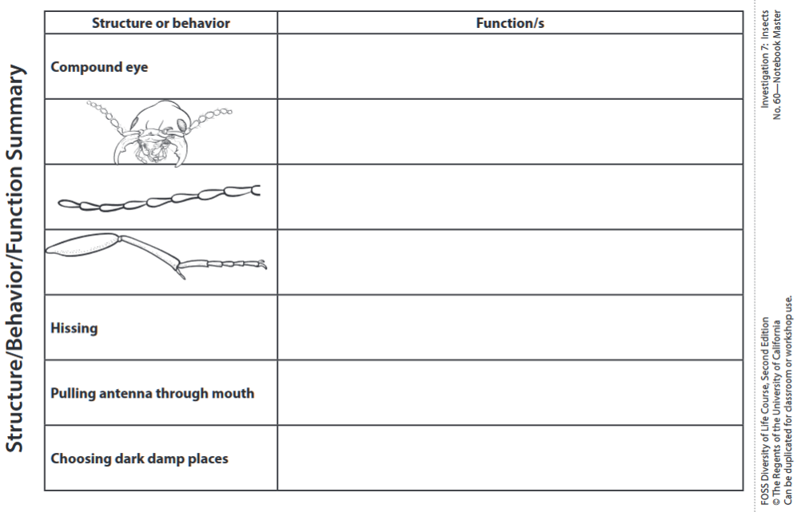
FOSS Investigation #7 Insects LAB: Part 1: Structure, Function, Behavior
10

Slide 11
FOSS Investigation #7 Insects LAB: Part 2: Insect Systems
11
Focus Question: How is the insect transport system like plant and human transport systems and how is it different?
Lab Part 2: Insect Systems
Are Madagascar hissing cockroaches living organisms? Circle Yes or No
What is your evidence?
Are the hissing cockroaches single-celled or multicellular organisms? Circle one.
How does each and every cell in a hissing cockroaches’ body get what it needs to live?
How does each and every cell in a plant get what it needs to live?
Multicellular organisms have organ systems that service the needs of cells. In this session, you will investigate the transport system that insects use to carry substances to and away from cells and how that system is similar to and different from comparable systems in plants and in humans.

Slide 12
FOSS Investigation #7 Insects LAB: Part 2: Insect Systems
12
Lab Part 2: Insect Systems (continued)
View the online activity: Levels of Complexity, notice the list of levels on the left hand side and then select the tissues tab.
Do paramecia have tissues? Circle Yes or No Why or why not? _________________________
What are tissues the building blocks of? ______________________
What are organs the building blocks of? ______________________
What are organ systems the building blocks of? _________________________________
Click the system button and refer to Sheet #61 “Comparing Systems”. You will focus on transport systems, which get substances to the cells and away from cells. There are three systems. Write the names of all three below.
1. Human _________________ 2. Plant ____________________ 3. Insect_________________

Slide 13
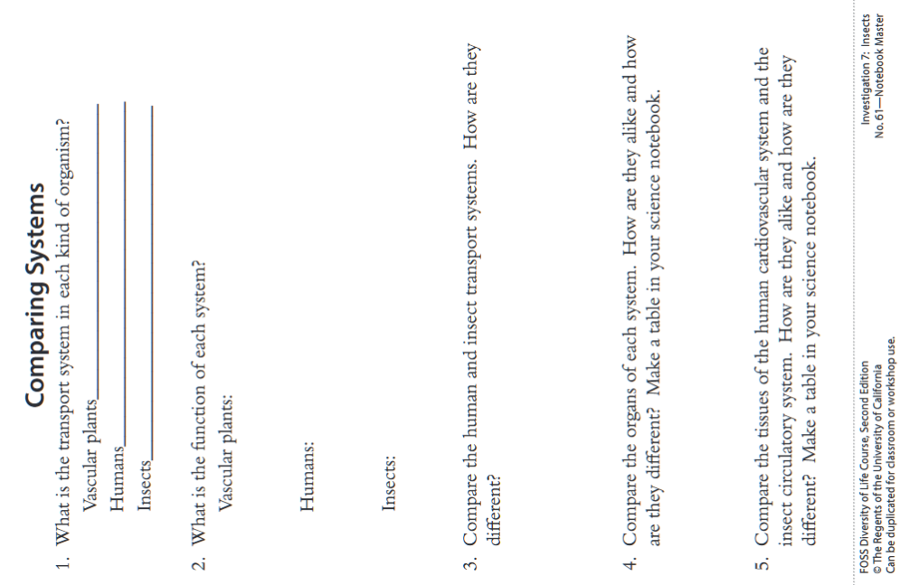
FOSS Investigation #7 Insects LAB: Part 2: Insect Systems
13

Slide 14
FOSS Investigation #7 Insects LAB: Part 2: Insect Systems
14
Teacher Master MM
Answer these questions in your group.
How are multicellular organisms the same as and different than single-celled organisms?
How do the cells in a multicellular organism contribute to the survival of the organism?
Give at least one example to support your response.
Are organs made up of just one kind of tissue? Circle Yes or No Give at least one example to support your response.
Why do you think it is important for multicellular organisms to have tissues, organs, and organ systems as opposed to just having different kinds of cells?
Multicellular Organisms | Single-Celled Organisms
Similarities:

Slide 15
FOSS Investigation #7 Insects LAB: Part 2: Insect Systems
15
Revisit the Focus Question: How is the insect transport system like plant and human transport systems and how is it different?
Plant
Vascular
System
Insect
Circulatory
System
Human
Cardiovascular
System

Slide 16
16

Slide 17
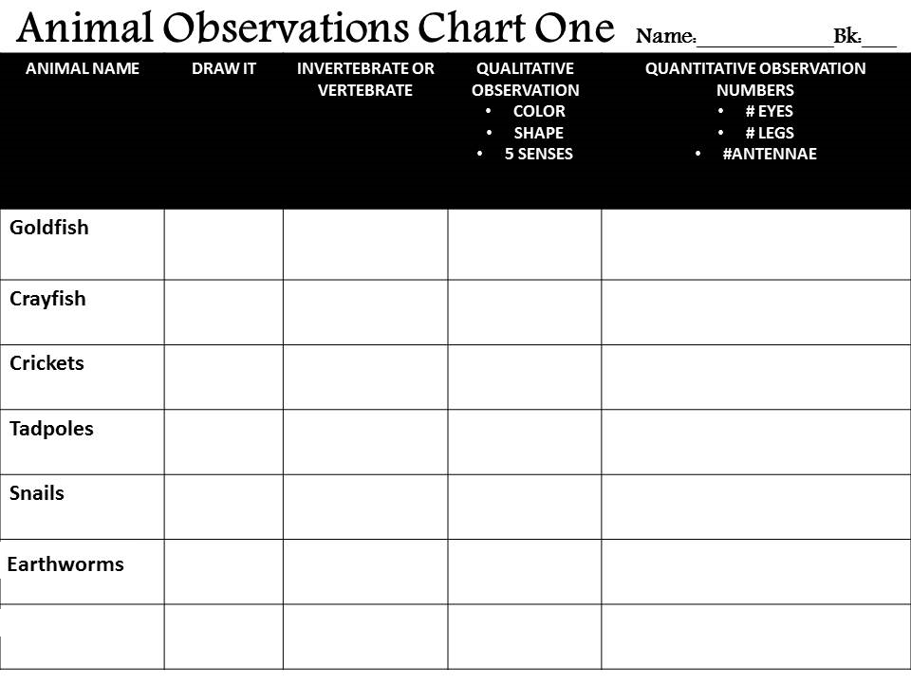
17

Slide 18
18

Slide 19
6.L.4B.1 Analyze and interpret data related to the diversity of animals to support claims that all animals (vertebrates and invertebrates) share common characteristics.
Essential Knowledge It is essential for students to know that the Animal Kingdom is divided into 35 different phyla. ● These phyla can be classified into two groups (vertebrates or invertebrates) based on external and internal physical characteristics. ● However, all animals share several common characteristics: ○ They are multi-cellular. ○ They are heterotrophs (cannot make their own food) and must get their energy by consuming plants or other animals. ○ Their major functions are to obtain food and oxygen for energy, maintain their internal conditions (ex. body temperature), move, and reproduce. Only one phylum of animals is comprised of vertebrates which includes fish, amphibians, reptiles, birds, and mammals. Vertebrates share certain physical characteristics:​ Have a backbone, an internal skeleton (endoskeleton), and muscles attached to their bones. ● Have blood that circulates through blood vessels and lungs or gills for the exchanging of gases (oxygen and carbon dioxide). ● Have a protective skin covering. ● Have legs, wings, or fins for movement. ● Have a nervous system with a brain that processes information from their environment through sensory organs. Vertebrates differ from each other in the way that they control their body temperature. ● Some vertebrates (fishes, amphibians, and reptiles) are ectothermic (cold-blooded).Their body temperature changes in response to temperature changes in their environment.. Other vertebrates (birds and mammals) are endothermic (warm-blooded). Their body temperature remains constant regardless of the temperature of the environment.
19

Slide 20
6.L.4B.1 Analyze and interpret data related to the diversity of animals to support claims that all animals (vertebrates and invertebrates) share common characteristics.
Examples of vertebrates include: Fish ● Are ectothermic, obtain dissolved oxygen in water through gills, most lay eggs, have scales, have fins, and live in water. Amphibians ● Are ectothermic, most can breathe in water with gills as young, go through metamorphosis and breathe on land with lungs as adults, and lay jelly-like eggs. ● Major groups include amphibians are frogs, toads, and salamanders. ● Frogs and salamanders have smooth, moist skin, through which they can breathe and live part of their life in water and part on land. ● Toads have thicker, bumpy skin and live on land. Reptiles ● Are ectothermic, breathe with lungs, most lay eggs, although in some the eggs hatch inside the female, and have scales or plates. Birds ● Are endothermic, breathe with lungs, lay eggs, have feathers, and have a beak, two wings, and two feet. Mammals ● Are endothermic, breathe with lungs, most have babies that are born live, have fur or hair; and produce milk to feed their young. Invertebrates comprise the remaining phyla of the Animal Kingdom. They include sponges, segmented worms, echinoderms, mollusks, and arthropods. Invertebrates share certain characteristics: ● Do not have backbones or internal skeletons. ● Some have external skeletons, called exoskeletons.
20

Slide 21
6.L.4B.1 Analyze and interpret data related to the diversity of animals to support claims that all animals (vertebrates and invertebrates) share common characteristics.
Examples of invertebrates include: Sponges ● Very simple animals that have many pores (holes) through which water flows. ● Water moves into a central cavity and out through a hole in the top. ● Sponges obtain their food and eliminate wastes through this passage of water. ● They have specialized cells for obtaining food and oxygen from the water. Segmented worms ● Have long tube-like bodies that are divided into segments. ● Simplest organisms with a true nervous system and blood contained in vessels. ● A long digestive tube runs down the length of the worm’s inner body. ● Take in dissolved oxygen from the water through their skin. ● Examples of segmented worms may be earthworms and leeches. Echinoderms ● Have arms that extend from the middle body outwards. ● Have tube feet that take in oxygen from the water and spines. ● Examples may be sea stars, brittle stars, sea cucumbers, or sea urchins. Mollusks ● Have soft bodies; most have a thick muscular foot for movement or to open and close their shells. ● Have more developed body systems than sponges or worms. ● Take in oxygen through gills or lungs, and some have shells. ● Examples may be slugs, snails, clams, and octopuses. Arthropods ● Have jointed legs, segmented bodies, and some have wings. ● Have hard outer coverings called exoskeletons. ● Obtain oxygen from the air through gills or air tubes. ● Examples may be insects, arachnids, and crustaceans.
21

Slide 22
6.L.4B.1 Analyze and interpret data related to the diversity of animals to support claims that all animals (vertebrates and invertebrates) share common characteristics.
Extended Knowledge • Students should be able to explain how the different characteristics of the vertebrate groups allowed them to adapt to new environments. • Students can research different animal phyla and describe the characteristics that make that phylum unique. Assessment Guidance The objective of this indicator is to analyze and interpret data to support claims that all animals (vertebrates and invertebrates) share common characteristics. Therefore, the primary focus of assessment should be for students use primary and secondary sources to (1) reveal patterns and construct meaning or (2) support hypotheses, explanations, claims, or designs that all animals share common characteristics despite their diversity. This could include, but is not limited to, students analyzing data about animals and grouping them according to similarities. Based on the patterns this reveals, students should be able to determine the key characteristics of all animals including vertebrates and invertebrates. In addition to analyzing and interpreting data, students should ask questions, plan and carry out investigations, use mathematics and computational thinking, engage in argument from evidence, construct explanations, develop and use models, obtain, evaluate, and communicate information, and construct devices or design solutions.
22

Slide 23
6.L.4B.2 Obtain and communicate information to explain how the structural adaptations and processes of animals allow for defense, movement, or resource obtainment.
Essential Knowledge It is essential for students to know that animals have special structures that enable them to survive in their environment. These structures allow them to defend themselves, to move, and to obtain resources. Structures for defense ● Allow an animal to hide from a predator or warn a predator (Examples: camouflage or mimicry (copying the appearance, actions, or sounds of another animal) ● Allow an animal to make a direct, attack painful (Examples: horns, claws, quills, stingers, or venom) ● Allow an animal to prevent a direct attack (Examples: Mechanisms such as having shells, emitting smells or body fluids (ink) ● Allow an animal to change its size (Examples: puffing up fur, inflating body) ● Allow an animal to flee or hide from predators (Examples: Body design that allows for speed or jumping or wings and light-weight skeletons for flying.)Allow an animal to construct holes or tunnels to run into and hide or to climb (Example: paws, toenails or teeth). Structures for movement ● Allow animals to move to fulfill their needs such as finding food and escaping predators (Examples: legs, feet, arms, tails, fins, wings, , skeleton) Structures to obtain resources ● Allow an animal to chew, tear, and eat its food or drink (Examples: mouthparts including beaks, teeth, flexible jaws, tongues, shape of the mouth) ● Allow an animal to grab and hold its food (Examples: tentacles, pincers, claws, fangs) ● Allow an animal to consume food found in the water (Examples: filtering structures in sponges, clams and baleen whales used for feeding).
23

Slide 24
6.L.4B.2 Obtain and communicate information to explain how the structural adaptations and processes of animals allow for defense, movement, or resource obtainment.
Extended Knowledge • Students can obtain and communicate information that will explain which structures organisms have to obtain resources. • Students can predict what environment an animal lives in based on physical structures and it’s role (niche) in the ecosystem (i.e. a(n) carnivore, herbivore, or an omnivore). Assessment Guidance The objective of this indicator is to obtain and communicate information to explain how the structural adaptations and processes of animals allow for defense, movement, or resource obtainment. Therefore, the primary focus of assessment should be for students to obtain and communicate scientific information (from investigations and primary and secondary sources) to explain how the special structures that animals have enable them to survive in their environment. This could include, but is not limited to, students obtaining, evaluating, and communicating information about specific animals and how they can use their various parts of their bodies for defense, movement, and/or resource obtainment. Students can also create an animal of their own design and describe how each body part can be used for defense, movement, and/or resource obtainment.
24

Slide 25
6.L.4B.3 Construct explanations of how animal responses (including hibernation, migration, grouping, and courtship) to environmental stimuli allow them to survive and reproduce.
Essential Knowledge It is essential for students to know that a complex set of responses to stimuli is called behavior. Behavioral responses refer to how animals cope with changes in their environments. Animals may respond to environmental stimuli through behaviors that include hibernation, migration, defense, and courtship. Hibernation ● As a result of cold, winter weather (stimulus) some animals will hibernate. ● Hibernation is a state of greatly reduced body activity, used to conserve food stored in the body. ● Some animals hibernate for part or all of the winter. ● The animal's body temperature drops, its heartbeat and breathing slow down, and it uses very little energy. ● Examples of hibernating animals may be ants, snakes, black bears, beavers, and ground squirrels. Migration ● Migration is the movement of animals from one place to another in response to seasonal changes. They travel to other places where food is available. ● Migrating animals usually use the same routes year after year. ● The cycle is controlled by changes in the amount of daylight and the weather. ● Examples of animals that migrate are monarch butterflies, orcas, caribou, ducks and salmon
25

Slide 26
6.L.4B.3 Construct explanations of how animal responses (including hibernation, migration, grouping, and courtship) to environmental stimuli allow them to survive and reproduce.
Defense ● Defense mechanisms vary with different types of animals. Some examples are: Camouflage: Some animals have protective coloration to survive changes in its environment. Some animals develop their camouflage in response to the weather. For example, the arctic fox and snowshoe hare develop a white coat for the winter to blend in with the snow and a gray coat in the summer to blend in with the forest. Chameleons and other lizards change colors to blend into the environment to avoid predators. Smells: Skunks use an offensive odor in response to fear. The skunk turns the predator's sense of smell against it by issuing a stream of oily, foul smelling musk. Stingers: Wasps and bees use a stinger for protection when frightened or threatened. Ejection: The black ink cloud of an octopus is a defense mechanism because it gives the animal a chance to escape from a predator. When the horned lizard gets really scared, it shoots blood out of its eyes allowing it time to escape. Mimicry: When a weaker animal copies stronger animals' characteristics to warn off predators. Some animals may look like another more poisonous or dangerous animal that give it protection, such as a “false” coral snake or hawk moth caterpillar that looks like a snake. Certain moths have markings that look like eyes and some flower flies resemble black and yellow wasps that have a powerful sting and use this disguise to ward off predators. Grouping: This social behavior occurs when certain animals travel together in groups to protect individuals within the group or to fool a predator into thinking the group is one large organism. Examples may include herds (buffalo, zebra, cattle), packs (wolves), or schools of fish. Courtship ● Courtship in animals is usually a behavioral process whereby adults of a species try to attract a potential mate. ● Courtship behaviors ensure that males and females of the same species recognize each other. ● Environmental stimuli, such as seasonal changes, will stimulate courtship. ● Often sensory cues such as chemical odor cues, sounds, or color will serve as courtship attractants in animals.
26

Slide 27
6.L.4B.3 Construct explanations of how animal responses (including hibernation, migration, grouping, and courtship) to environmental stimuli allow them to survive and reproduce.
Extended Knowledge • The student should be able to obtain and communicate information that describes why a specific animal’s defense is particularly effective at discouraging the types of predators that animal encounters in its environment. • The student may also construct explanations that show how courtship behaviors can increase the chances an animal gets eaten by a predator. Assessment Guidance The objective of this indicator is to construct explanations of how animal responses to environmental stimuli allow them to survive and reproduce. Therefore, the primary focus of assessment should be for students to construct explanations from primary or secondary sources, predictions based on observations and measurements, and data communicated in graphs, tables, or diagrams that the ways animals respond to their environment enables them to survive and reproduce. This could include but is not limited to students obtaining and evaluating weather data and communicating predictions based upon this evidence of how animals will respond to the changes in the seasons. Students can also analyze collected data, from graphs or data tables, and use this evidence to predict whether the animals will respond by hibernating, reproducing, and/or migrating. ​ In addition to construct explanations, students should ask questions; plan and carry out investigations; engage in argument from evidence; obtain, evaluate and communicate information; develop and use models; and construct devices or design solutions.
27

Slide 28
6.L.4B.4 Obtain and communicate information to compare and classify innate and learned behaviors in animals.
Essential Knowledge It is essential for students to know that a behavior is an activity or action, in response to changes in the environment, which helps an organism survive. Learned behaviors result from direct observations or experiences. ● Imprinting is a behavior in which newborn animals recognize and follow the first moving object they see. Usually, this moving object is the mother. Conditioning (which includes trial-and-error learning) is a behavior in which an animal learns that a particular stimulus and its response to that stimulus will lead to a good or bad result. For example, chimpanzees learn to use small sticks to dig in the soil for insects, or a child learns that touching a hot object will cause pain. Inherited behaviors are passed from the parent to offspring and are with the animal from birth. These are also called instincts. ● The ability to swim is an inherited behavior for whales and fish. ● Crying in human babies is an inherited behavior that is often a response to hunger, thirst, or sleepiness. ● When a snail digs a hole to lay its eggs, a bird builds a special kind of nest, or when a fiddler crab waves its claw to attract a female, the animals are acting on instinct. Extended Knowledge • The students can obtain information about animal behaviors and engage in scientific argumentation from evidence about whether the behavior is inherited or learned and, if it is learned, by what means the animals learns the behavior. • Students should be able to construct explanations as to why some animals have many inherited behaviors while others have many learned behaviors. Assessment Guidance The objective of this indicator is to obtain and communicate information to compare and classify innate and learned behaviors in animals. Therefore, the primary focus of assessment should be for students to obtain and communicate (from investigations and primary and secondary sources) information that supports the claim that animal behaviors can be learned or inherited. This could include but is not limited to students observing an animal’s behavior and arguing from evidence whether the behavior is innate or learned. Students can also use primary and secondary resources to construct explanations to explain why behaviors that are innate in some animals are learned in others (for example, the ability to swim is an innate behavior for animals that are born in water but it is a learned behavior in land animals). In addition to obtain information, students should ask questions; plan and carry out investigations; analyze and interpret data; use mathematics and computational thinking; engage in argument from evidence; construct explanations; develop and use models; and construct devices or define solutions.
28

Slide 29
6.L.4B.5 Analyze and interpret data to compare how endothermic and ectothermic animals respond to changes in environmental temperature.
Essential Knowledge It is essential for students to know the characteristics of endothermic and ectothermic animals and how these animals respond to changes in their environmental temperatures. Animals that are vertebrates differ in their abilities to regulate body temperature. Endothermic (warm-blooded) ● Animals, including birds and mammals, maintain a nearly constant internal temperature and do not change with the temperature of the environment. ● When the outside temperature is too hot, an endothermic animal can cool off by sweating, panting, changing position, or changing location. Sweating and panting generate heat loss through evaporating water. Changing position and location allow the animal to find a cooler environment in the shade or shelter. ● When the outside temperature is too cold, an endothermic animal can generate heat by shivering. ● Endothermic animals must eat much more often than ectothermic animals since it takes energy to maintain a constant body temperature. For example, a lion must eat its weight in food every seven to ten days. Ectothermic (cold-blooded) ● Animals, including fish, amphibians, and reptiles, which have an internal body temperature that changes with the temperature of the environment. ● They must gain heat to perform internal activities such as digestion). ● If the environment is cold, ectothermic animals become slow moving and sluggish. Some animals must bask in the Sun (for example snakes or lizards) or move to a warmer area (for example some fish) before they can move about to hunt for food. ● If the temperature gets too hot, ectothermic animals will need to find a cooler temperature or burrow in the ground to keep its body cool. ● Ectothermic animals take on the temperature of their surroundings and don't use food energy to keep warm. Therefore, they don't have to eat as often as an endothermic animal.
29

Slide 30
6.L.4B.5 Analyze and interpret data to compare how endothermic and ectothermic animals respond to changes in environmental temperature.
30
Extended Knowledge The students can engage in scientific argument from evidence regarding the merits of being an ectotherm and of being an endotherm. The student should be able to obtain and communicate evidence to support the position they take. Assessment Guidance The objective of this indicator is to analyze and interpret data to compare how endothermic and ectothermic animals respond to changes in environmental temperature. Therefore, the primary focus of assessment should be for students to analyze and interpret data from informational texts, observations, measurements, or investigations using a range of methods (such as tabulation, graphing, or statistical analysis) that explain how the different characteristics of endothermic and exothermic animals allow each group of animals to survive temperature changes in their environments. This could include but is not limited to students collecting data regarding the change in activity rate of ectothermic animals in environments of different temperatures; for example, students could observe the breathing rates of goldfish at different temperatures. Students could also explore how endothermic animals maintain their body temperatures in a variety of environments. For example, students could collect quantitative data of how a variety of substances, including lard (animal fat), insulate a thermometer submerged in cold water; they should use this data to construct an explanation of how some animals, like seals, survive in very cold water. In addition to analyze and interpret data, students should ask questions; plan and carry out investigations; use mathematics and computational thinking; engage in argument from evidence; construct explanations; develop and use models; obtain, evaluate, and communicate information; and construct devices or define solutions.

