Slide 1
Animal Warm-Ups 7 Weeks

Slide 2
WARM UP – Week 1
MONDAY
WEDNESDAY
Using the animals booklet 1 page 23 list the 7
structures animals use to help them escape from predators.
Using your Animals Booklet Week 1 page 23, list the 10
structures animals use to obtain resources for energy. ______________________________________________________________________________________________________________________________________________________________________________________________________________________________________
Using your Animals Booklet Week 1 page 23, to list the 18 structures animals can use to defend themselves from predators.
________________________________________________________________________________________________________________________________________________________________________________________________________________________________________________________________________________________________________________________________
TUESDAY
Using your Animals Booklet Week 1 page 23, list the 7
structures for movement animals use to help them escape from predators. ____________________________________________________________________________________________________________________________________________________________________________________
THURSDAY
1. Animals are classified into two main phyla called __________ and ____________.
a. invertebrates and nonvascular
b. invertebrates and vertebrates
5 Vertebrates 5 Invertebrates
F___________ A__________ A___________ M__________ R___________ E__________ M___________ S__________ B___________ S__________
2. The animal kingdom is divided into _______ phyla groups.
3. List the 4 characteristics of all living things. ______________________________
____________________________________________________________________
4. What are the 7 levels of taxonomy and the trick to help you remember them? ________________________________________________________________________________________________________________________________________

Slide 3
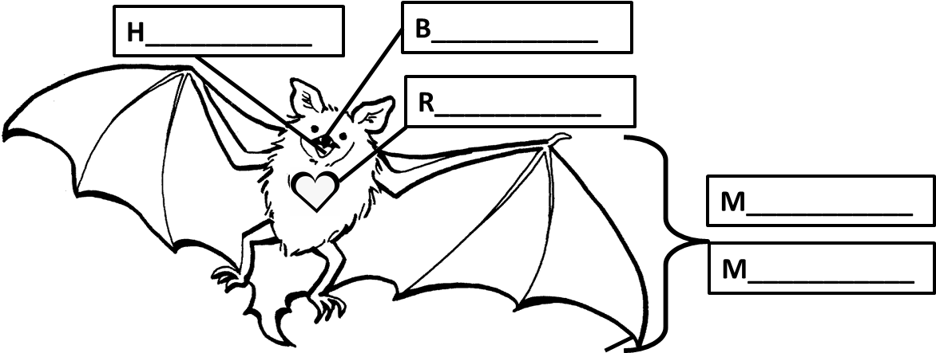
WARM UP – Week 2
MONDAY
WEDNESDAY
Label the characteristics of all animals.
M___________________________
B___________________________
M__________________________
H___________________________
R___________________________
Arthropod Characteristics | Arthropod Groups
 | Crustaceans | Insects | Arachnids
# of body segments
# of legs
# of antennae
Live on land & water
MR.MBH
TUESDAY Fill in the vertebrates chart below.
Characteristics • Soft, moist skin • Go through metamorphosis • Lay jelly-like eggs • Most can breathe in water with gills as young, and breathe on land with lungs as adults • Cold blooded (ectothermic) | Characteristics • Warm blooded (endothermic) • Mothers nurse their young • Breath through lungs • All have hair at some stage in development •Babies born from live birth | Characteristics • Most lay eggs • Cold blooded (ectothermic) • Most have bodies covered in scales • Obtain dissolved oxygen in water through gills | Characteristics • Has 2 legs • Breath through lungs • Warm blooded (endothermic) • Feathers • Lays eggs • Two wings | Characteristics • Most lay eggs • Most have four legs • Breathe with lungs • Cold blooded (ectothermic) • Scales or plates for skin
Examples | Examples | Examples | Examples | Examples
THURSDAY
Arthropods are in the:
C____________________________
_____________________________
A____________________________________

Slide 4
WARM UP – Week 3
MONDAY
WEDNESDAY
A taxonomist uses a scientific name made up of the G___________ and s___________.
Using your digital device, look up the genus and species names for the following animals:
Brown Bear U______________ a___________________
Dog C______________ f___________________
Cat F______________ c___________________
Humans H______________ s___________________
Wolf C______________ l ___________________
Vertebrates (13) Invertebrates (4)
Both (6)
* *
*
TUESDAY Fill in the invertebrates chart below.
Characteristics • Most have an inner and outer shell. • Have soft bodies; most have a thick muscular foot for movement or to open and close their shells. • They have more developed body systems than sponges or worms. • They take in oxygen through gills or lungs, and some have shells. • Examples may be slugs, snails, clams, and octopuses. | Characteristics •It has pores to absorb nutrients and oxygen. •Most live in salt water. •Water moves into a central cavity and out through a hole in the top | Characteristics •Have long tube-like bodies that are divided into segments. • They are the simplest organisms with a true nervous system and blood contained in vessels. • A long digestive tube runs down the length of the worm’s inner body. | Characteristics •It has a hard outer body called an exoskeleton. •It has jointed limbs. • It sheds its outer exoskeleton as it grows. This process is known as molting. •They obtain oxygen from the air through gills or air tubes. • Examples may be insects, arachnids, and crustaceans. | Characteristics •Have arms that extend from the middle body outwards. • They have tube feet that take in oxygen from the water and spines. • Examples may be sea stars, brittle stars, sea cucumbers, or sea urchins.
Examples | Examples | Examples | Examples | Examples
THURSDAY
What are the 4 characteristics of all animals (life)?
1.___________________________________2.___________________________________3.___________________________________4.___________________________________

Slide 5
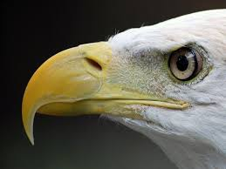
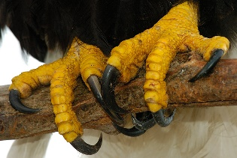
WARM UP – Week 4
MONDAY
Animal | Vertebrate or Invertebrate | Endothermic or Ectothermic | Class (FARM B) or (A MESS)
Flounder
Frog
Alligator
Octopi
Sea Urchin
Leech
Dolphin
Lobster
Mosquito
Carolina Wren
Sponge
Tarantula
Who is this Mystery Invertebrate?
TUESDAY
___________ I have arms that extend out from the middle of my body outwards.
___________ I have jointed legs, segmented body and sometimes wings, get oxygen with gills or air tubes.
___________ I have pores through which water flows through a central cavity where I also eliminate waste.
___________ I have a soft body with a thick muscular foot for movement.
___________ I have a long tube-like body.
WED. & THURS.
Eagle
Duck
Fill in the table using the pictures each day.
WEDNESDAY
THURSDAY

Slide 6
MONDAY
WARM UP – Week 5
Which animals are an invertebrate (I), vertebrate (V), and ectothermic (EC) endothermic (EN)?
List the 5 vertebrate groups and the trick to help remember them.
_________________
_________________
_________________ ______________
_________________
_________________
THURSDAY
Animal | V/I | EC/EN
Shark
Cricket
Salamander
Hissing Cockroach
Leatherback Sea Turtle
Black Widow Spider
Kangaroo
Slug
Emu
Sea Star
Sponge
Earthworm
TUESDAY
List the 5 invertebrate groups and the trick to help remember them.
_________________
_________________
_________________ ______________
_________________
_________________
WEDNESDAY
Structures for Defense, Movement or Obtaining Resources
STRUCTURE | CHARACTERISTIC
 | Allow an animal to hide from a predator.
 | Allow an animal to make an attack painful.
 | Allow an animal to prevent a direct attack.
 | Allow an animal to change its size.
 | Allow an animal to flee or hide from predators.
 | Allow an animal to find food and escape predators.
 | Allow an animal to chew or tear and eat or drink.
Use Week 1 Animal Booklet, page 23 to find Wednesday’s answers.

Slide 7
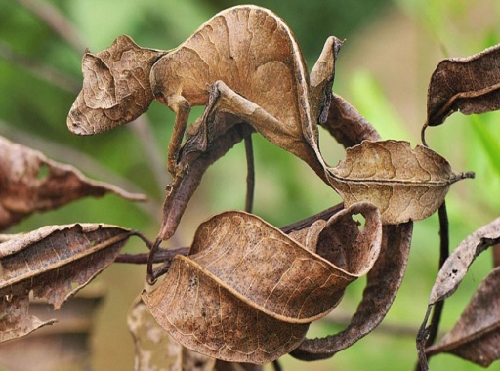
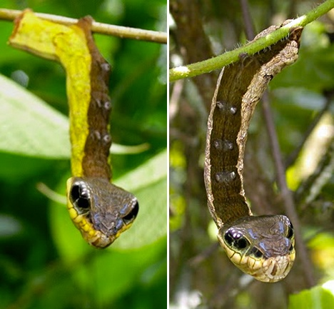
WARM UP – Week 6
MONDAY
BIRD BEAK AND FEET MYSTERY
Defense Mechanism | Example
Camouflage
Smells
Stingers
Ejection
Mimicry
Grouping
Using the word box below, find the advantage of each beak or foot.
BEAK
FEET
__________
_________
__________
_________
WEDNESDAY
TUESDAY
__________
_________
Which below is not an example of an environmental stimuli?
A. Food Gathering B. Shedding
C. Sweating D. Panting
Which below in not an example of a behavioral stimuli?
A. Hibernation B. Migration
C. Shivering D. Courtship
__________
_________
THURSDAY
Beak Advantages
cracking seeds
straining water for food
tearing flesh
probing for insects
Feet Advantages
climbing trees
swimming
grabbing onto animals
perching
Label each of the picture below with camouflage or mimicry.
_______________ _____________

Slide 8
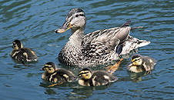
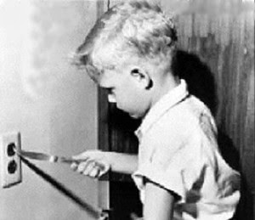
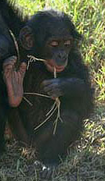
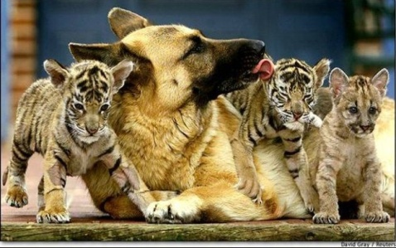
WARM UP – Week 7
WEDNESDAY
MONDAY
Write an LB for learned behavior or IB for inherited behavior next to each behavior.
___________________ __________________
_________________ __________________
Use your Animal Booklet Weeks 5 & 6 page 6 vocabulary to help you write one example of each of the following terms.
Learned Behavior - ________________________
Conditioning - ____________________________
Imprinting - ______________________________
Inherited Behavior - _______________________
Courtship Cue/Behavior | Animal’s Example of This in Nature
Chemical odor
Sounds
Color
Body language
Seasonal changes (environmental stimuli)
TUESDAY
THURSDAY
BABY, IT’S ALL INSTINCT!
Some animal behaviors are passed from the parent to the offspring and are with the animal from birth.
The ability to S________in whales or fish. They do not need to be taught how to do it.
C_______in babies is an inherited behavior that is often a response to hunger, thirst, or sleepiness.
When a snail digs a hole to lay its E______, a bird builds a special kind of N_____, or when a fiddler crab waves its C______to attract a F___________.

