Slide 1
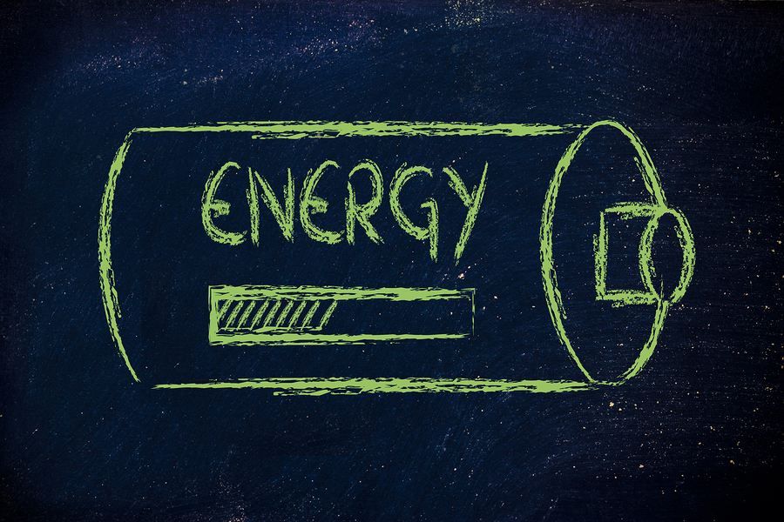
Energy Warm Ups 11 Weeks

Slide 2
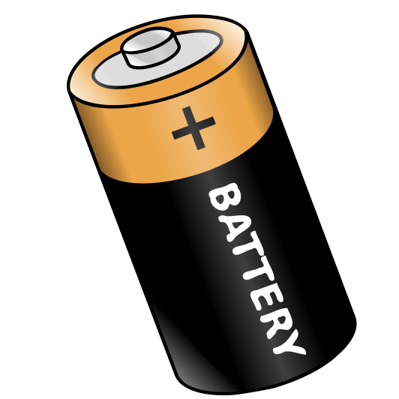
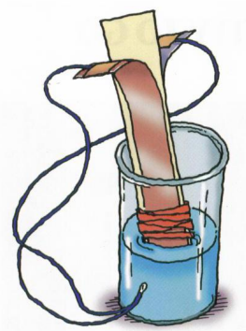
WARM UP-1 LAB SAFETY/BATTERY LAB
MONDAY
WEDNESDAY
What is the #1 Lab Safety Equipment that you should wear?
mask
apron
goggles
glasses
What type of energy is in a battery? What can a battery do?
TUESDAY
What should you do if something spills in the lab?
Tell the teacher immediately.
Clean it up immediately.
Leave it for the next class to clean up.
Just cover it with a paper towel.
_______________________________
_______________________________
_______________________________
THURSDAY
What types of energy transfers occurred in our battery lab?
__________________ → ______________ → _________________
Make Your Own!
Draw a scenario and identify the type of energy transformation involved.

Slide 3
WARM UP-2 FORMS/ENERGY TRANSFORMATIONS
MONDAY
WEDNESDAY
What is the Law of Conservation of Energy?
Energy can disappear.
Energy can neither be created or destroyed it only changes form.
Energy can be created.
Energy can be destroyed.
What types of energy transfers occur within the television?
TUESDAY
Which type of energy has to do with the energy an object has due to the motion of its particles?
Solar Energy
Thermal/Heat Energy
Electrical Energy
Sound Energy
__________________ → _________________
or
__________________ → _________________
THURSDAY
What types of energy transfers occur within a flashlight?
__________________ → ______________ → _________________
Make Your Own!
Draw a scenario and identify the type of energy transformation involved.

Slide 4
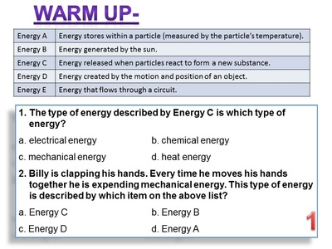
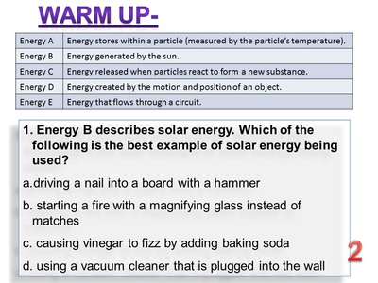
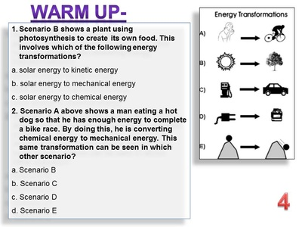
WARM UP-3
MONDAY
TUESDAY
WED.
THURSDAY

Slide 5
WARM UP-4
MONDAY
TUESDAY
WED.
THURSDAY

Slide 6
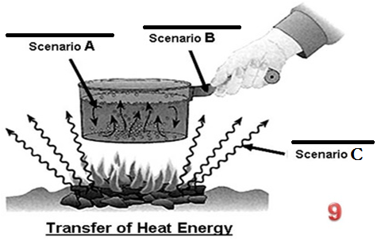
WARM UP-5
TUESDAY
MONDAY- Label each scenario
THURSDAY
WED.

Slide 7
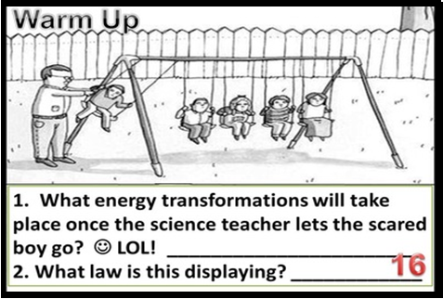
WARM UP-6
MONDAY-
TUESDAY
WED.
THURSDAY

Slide 8
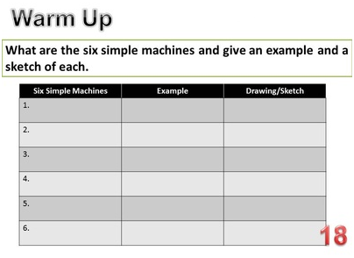
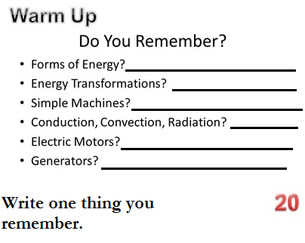
WARM UP-7
TUESDAY
MONDAY
THURSDAY
WED.

Slide 9
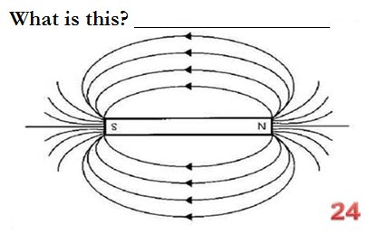
WARM UP-8
TUESDAY
MONDAY
THURSDAY
WED.

Slide 10
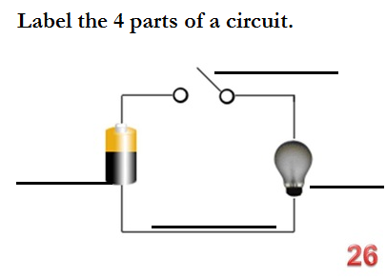
WARM UP-9
TUESDAY
MONDAY
WED.
THURSDAY

Slide 11
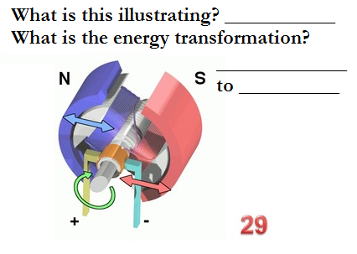
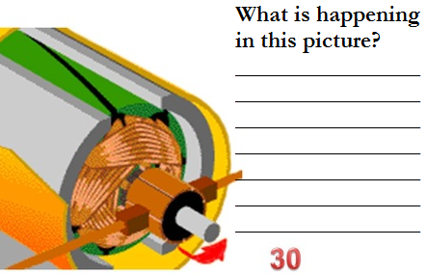
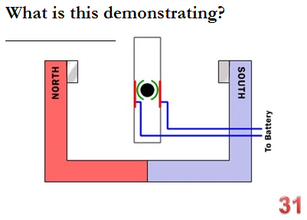
WARM UP-10
TUESDAY
MONDAY
THURSDAY
WED.

Slide 12
WARM UP-11
TUESDAY
MONDAY
THURSDAY
WED.
**Turn to a partner and repeat these phrases.
**Turn to a partner and repeat these phrases.

