Slide 1
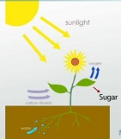
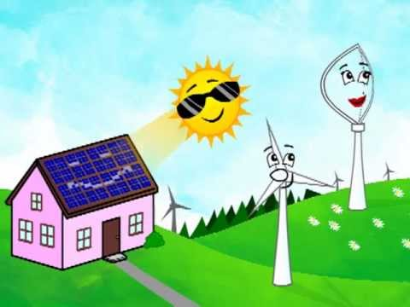
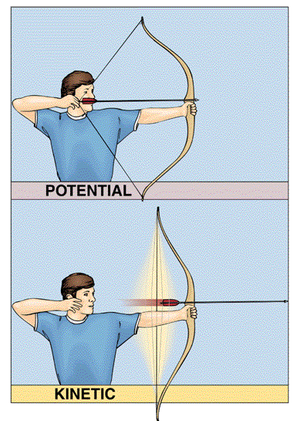
Forms of Energy Foldable
Outside
H
C
S
M
E
Heat
Energy
Chemical Energy
Solar
Energy
Mechanical
Energy
Electrical
Energy
Potential
Kinetic
Elastic

Slide 2
Forms of Energy Foldable
Inside
H
C
S
M
E
Heat
Energy
Chemical Energy
Solar
Energy
Mechanical
Energy
Electrical
Energy
Energy produced by the total energy in the particles of a substance (associated with motion). 3 types of heat transfer
Conduction
Convection
Radiation
Energy produced by eating food or by sugar made through photosynthesis in plants or found in chemicals and batteries.
Energy produced by the sun (original source of all energy)
Potential
Kinetic
Energy that flows through an electric circuit. This produces other forms o f energy (sound, light,
All energy in a moving object is mechanical. Mechanical is the MOTHER of two kids-Potential (couch POTato-stored energy) or Kinetic (kid who is energetic-moving energy).

Slide 3
Forms of Energy Foldable
H
C
S
M
E
Heat
Energy
Chemical Energy
Solar
Energy
Mechanical
Energy
Electrical
Energy
Potential
Kinetic
Elastic

Slide 4
Forms of Energy Foldable
H
C
S
M
E
Heat
Energy
Chemical Energy
Solar
Energy
Mechanical
Energy
Electrical
Energy
Potential
Kinetic
Elastic

Slide 5
Alternate version of the Forms of Energy Foldable

Slide 6
Forms of Energy Foldable
H
C
S
M
E

