Slide 1
The Fungi Kingdom
Mycology -
the study of fungi
fungi - singular
fungus - plural
4 Main Characteristics of Fungi
1) Fungi are eukaryotic
they have a nuclei & mitochondria
2) They are heterotrophs
they depend on other organisms for food
3) They are multicellular
4) They cannot move on their own

Slide 2
The Fungi Kingdom
3 Reasons Fungi Are Different From Plants
1) Fungi lack chlorophyll
2) Fungi do not make their own food through photosynthesis
3) They never reproduce by seeds

Slide 3
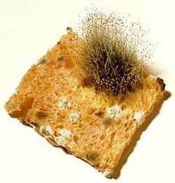
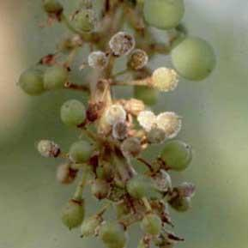
The Fungi Kingdom
Main Types of Fungi:
1.Common molds
Eg: Bread Mold,Peronospore
Bread mold produces spores that stick up above the bread
Spraying with blue
vitriol

Slide 4
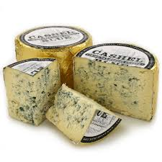
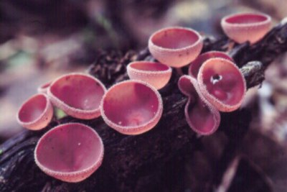
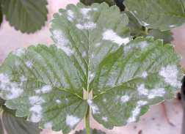
The Fungi Kingdom
Types of Fungi
2. Sac Fungi - produce spores in sac-like structures
Eg: yeasts,cup fungi,powdery mildews,Penicillinum
Notes:
*
www.rainforestventures.com/ fungi.htm

Slide 5
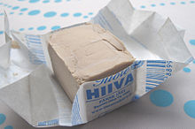
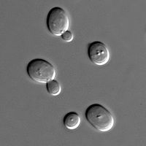
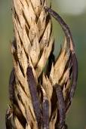
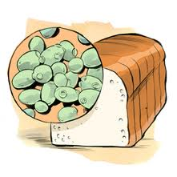
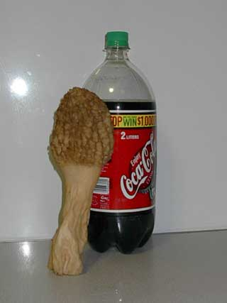
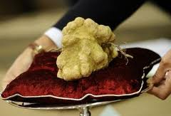
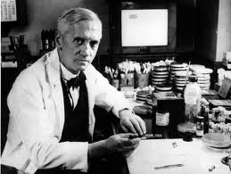
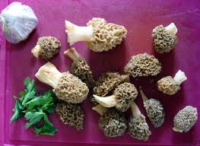
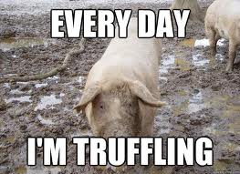
Sac fungi
Unicellular,
reproduces by budding
Ergot
Morels
Sir Alexander Flemming-penicillin

Slide 6
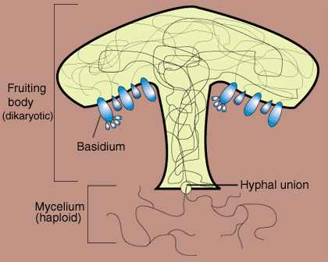
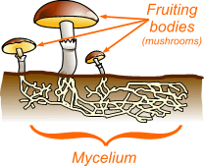
3. Club Fungi
Examples: Mushrooms, toadstools
Most elaborate life cycle of all the fungi

Slide 7
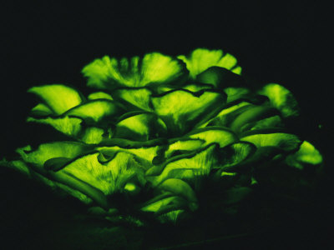
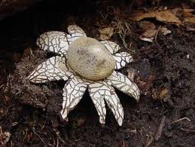
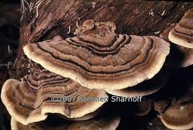
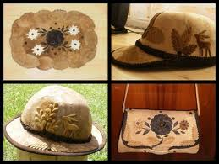
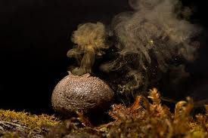
Club fungi
Jack-o’-lantern
Brackets
Earth stars
Puffballs

Slide 8
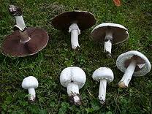
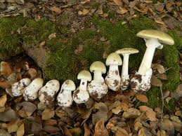
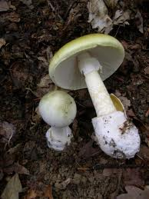
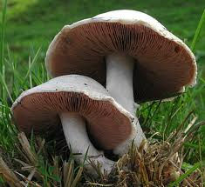
Club fungi
Toadstool
Eg: Death cap
Champignon

Slide 9
Fungi Reproduction:
Fungi are categorized based on their fruiting structures (spores).
The structure of the fungi that you can see, is the part that carries out reproduction
Most fungi reproduce by using spores
Fungi spores are microscopic

Slide 10
Obtaining Energy
Saprophytic-From decaying organic matter
Parasitic-Feed on other living organisms(host) and harm the host.
Symbiotic-Feed on other living organisms(host) and do not harm the host.

Slide 11
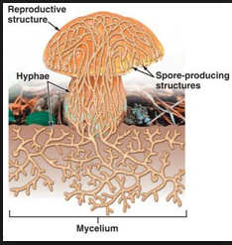
Fungi do not have roots, but instead use hyphae.
Hyphae-long fibrous strands to obtain water and nutrients
Mycelium-a group of hyphae

Slide 12
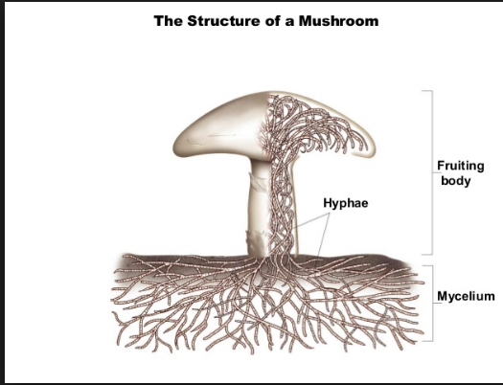
Hyphae will grow towards stimuli, like food and water.

Slide 13
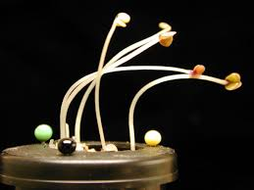
PHOTOTROPISM
Fungi will grow in reponse to light

Slide 14
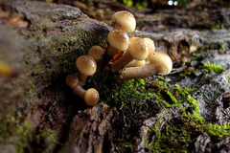
GRAVITROPISM
Fungi will grow will away from gravity, but tend to show negative gravitropism.

Slide 15
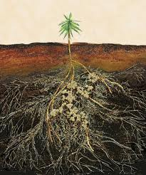
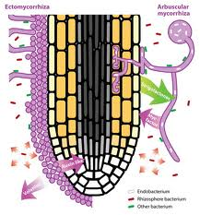
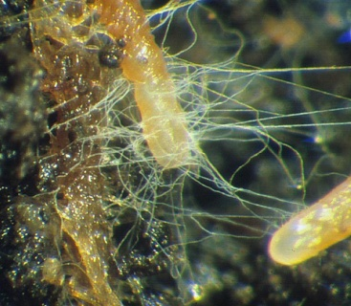
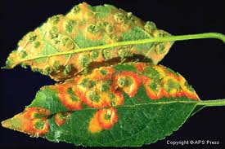
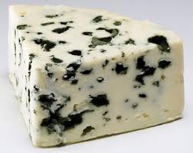
Extra Info-Importance of fungi
-Can cause diseases to plants, to animals or even humans
-Can be edible or poisonous
-Can be useful for alimentary,distilling and pharmaceutical
industry

