Slide 3
climate
hypothesis
energy

Slide 4
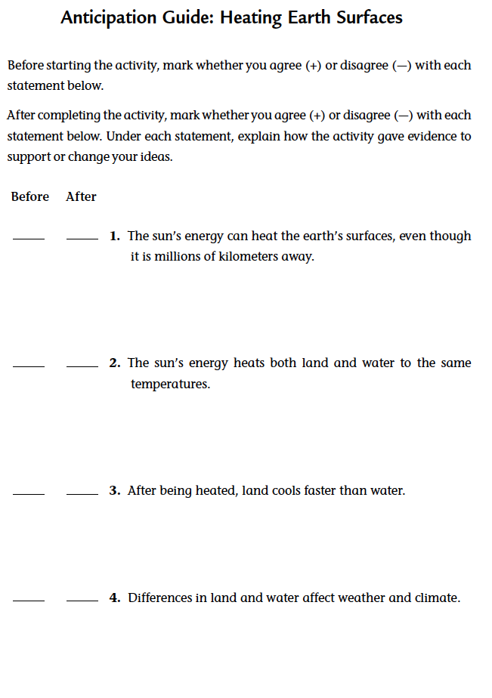
Complete the following:
Complete the “Before” column of Student Sheet 55.1, “Anticipation Guide: Heating Earth Surfaces.”

Slide 5
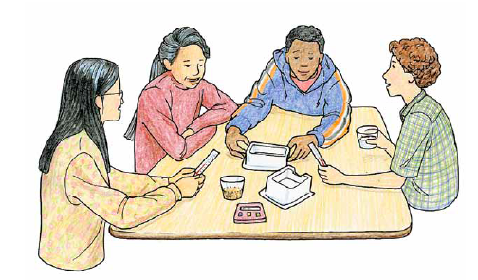
Read the introduction and look for key ideas

Slide 6
How can you design an experiment to investigate how the sun’s energy heats different earth surfaces?

Slide 7
Complete the procedure and record your data

Slide 8
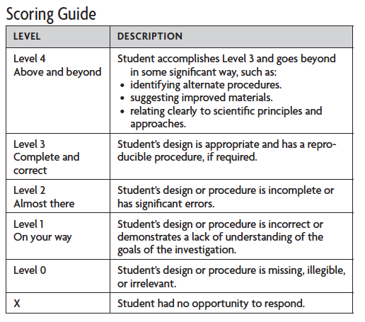
SCORING GUIDE: Designing Investigations

Slide 9
Analysis question 1
a. Create a graph of the data you collected. Remember to label your axes, title your graph, and include a key.
b. Summarize the trends that you see in your graph.

Slide 10
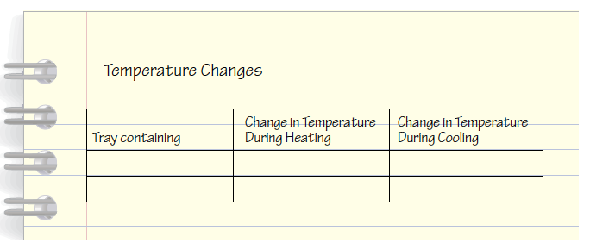
Analysis question 2
Copy the table below. Calculate the changes in temperature for each substance you tested, and fill in the table.

Slide 11
Analysis question 3
What can you conclude about how land and water heat up and cool down? Support your answer with evidence from this activity.

Slide 12
Complete the “After” column of Student Sheet 55.1

Slide 13
Think of different earth surfaces. Based on this investigation, what can you conclude about how the sun heats earth surfaces?
Share your thoughts with the class.

Slide 14
Consider how quickly each substance lost heat. Which do you think is better at retaining heat—oceans or land masses?
Share your thoughts with the class.

Slide 15
Why then do you think the land often feels warmer (for example, when you are standing on a beach and step in the ocean/ lake/river
on a hot day)?
Share your thoughts with the class.

Slide 16
How can you design an experiment to investigate how the sun’s energy heats different earth surfaces?

Slide 17
Key vocabulary definitions
Climate - The average weather for a place over a long period of time (usually at least 30 years).
Hypothesis - A possible explanation of some phenomena, based on observations, and which suggests a means of being tested.

Slide 18
Key vocabulary definitions
Energy - The ability to cause motion. Energy comes in many forms and is measured in joules.

Slide 19
Design an Investigation
Design an experiment to further investigate how different surfaces on the earth are heated by the sun’s energy and then cool. You may want to investigate if the amount of land or water or different types of soil affect heating and cooling. Use these or other questions to design and conduct your own investigation.

