Slide 3
clouds
condensation
evaporation
model
organisms
precipitation
water cycle
water vapor

Slide 4
Water cycle
Use Student Sheet 62.1, “Anticipation Guide: Traveling on the Water Cycle” to label all the places that contain water. Draw arrows showing the water’s possible movements.

Slide 5
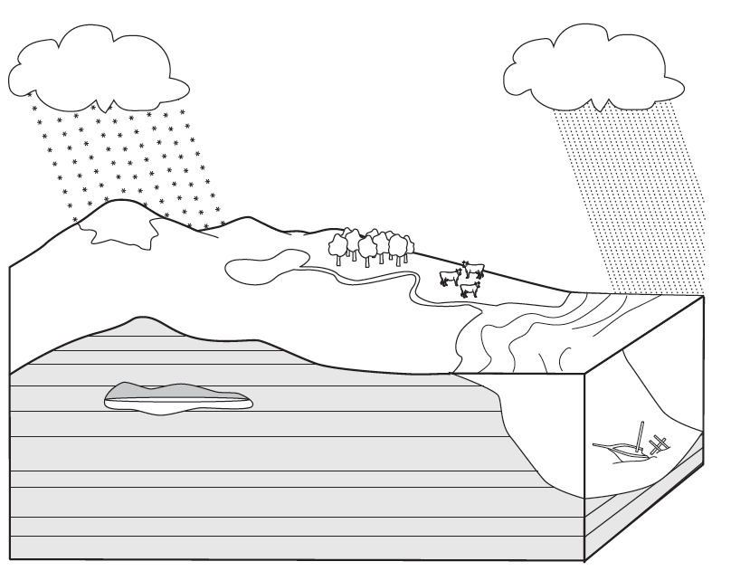
Water cycle

Slide 6
What are the different forms of water found on earth?
Share your thoughts with the class.

Slide 7
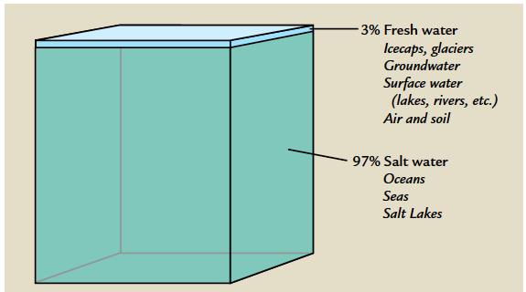
Read the introduction and look for key ideas

Slide 8
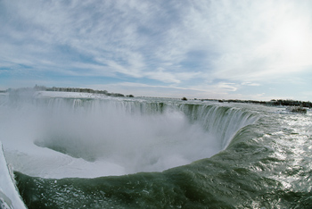
How does water move from place to place?
Which parts of the water
cycle can you see in this
photograph?

Slide 9
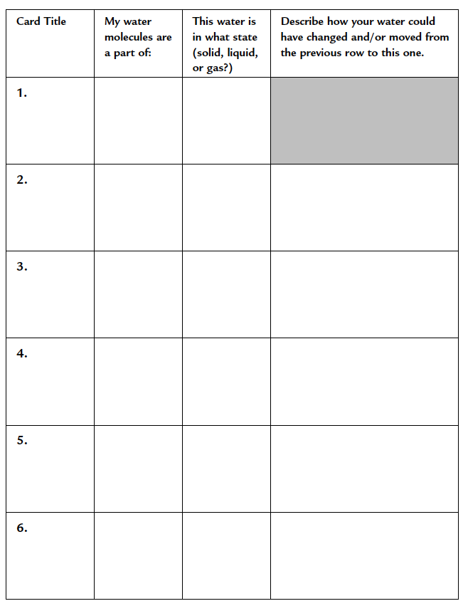
Complete the procedure
Use Student Sheet 62.2, “My Water Cycle Story,” to record where your water molecule travels.

Slide 10
Analysis question 1
On Student Sheet 62.1, you recorded your initial ideas about the water cycle. To complete Student Sheet 62.1:
a. Use the following words to identify where water can be found in the picture:
atmosphere | organisms | ocean
land | groundwater | precipitation

Slide 11
Analysis question 1
b. Draw at least six arrows showing the movement of water from one place to another.
c. Label places where each of the following is occurring:
condensation | evaporation
freezing | melting

Slide 12
Analysis question 1
d. What changes did you have to make to your student sheet so that you could complete it?

Slide 13
Analysis question 2
The term “water cycle” is used to describe the movement of water on the earth. Do you think that your diagram on Student Sheet 62.1 is a good summary of the water cycle? Why or why not?

Slide 14
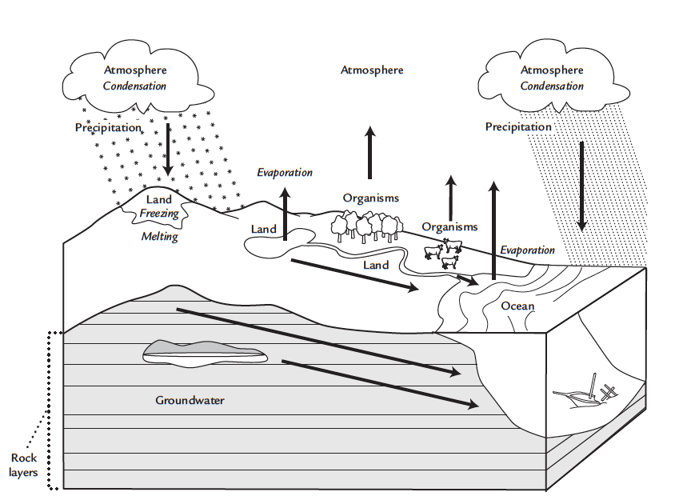
Sample response to analysis question 2

Slide 15
How does water move from one place to another?
Share your thoughts with the class.

Slide 16
Analysis question 3
In this activity, you used cards and number cubes to model the water cycle. Do you think that this activity was a good model of the water cycle? Why or why not?

Slide 17
Did the number and location of the different water cycle cards reflect the fact that the majority of the world’s water is found in the ocean?
Did the roll of the number cube place you in the ocean more than in other places?
Share your thoughts with the class.

Slide 18
Analysis question 4
Expand your notes from Student Sheet 62.2 into a story that describes the journey of your water molecules. Your story should follow your water through at least five places. Be as creative and scientifically accurate as you can! Be sure to:
Describe or draw how your water molecules moved from one place to another.
Identify any changes in state (solid, liquid, gas) that occur.

Slide 19
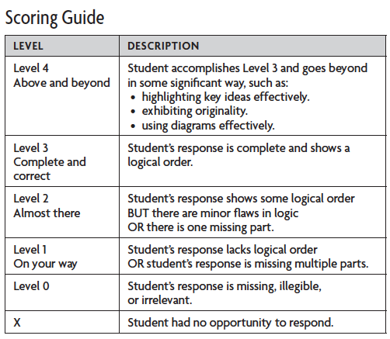
SCORING GUIDE: Organizing Scientific Ideas

Slide 20
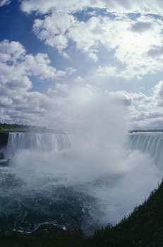
How does water move from place to place?
Which parts of the water
cycle can you see in this
photograph?

Slide 21
Key vocabulary definitions
Cloud - A visible collection of water droplets in the atmosphere. Clouds usually form hundreds of meters above Earth’s surface but fog is a cloud formed near Earth’s surface.
Condensation - The process of change in state from gas to liquid, or the droplets of liquid formed from this process.

Slide 22
Key vocabulary definitions
Evaporation - The process of change in state from a liquid to a gas.
Model - Any representation of a system, or its components, to help one study and understand how it works.

Slide 23
Key vocabulary definitions
Organism - A living thing, capable of independent existence and characterized by organs or organ-like objects separate in function, but mutually dependent. Plants, animals, bacteria, and fungi are examples of organisms.

Slide 24
Key vocabulary definitions
Precipitation - The movement of water, in solid or liquid form, from the atmosphere back to the surface of the earth. Rain, snow, sleet, and hail are examples.

Slide 25
Key vocabulary definitions
Water cycle - The movement of water from one state to another as it circulates through the earth’s crust, oceans, and atmosphere. Water evaporates from the surface, rises and cools at higher elevations, condenses as rain or snow,
and falls to the surface where it collects in lakes, oceans, soil, and rocks underground.

Slide 26
Key vocabulary definitions
Water vapor - Water in a gaseous state.

