Slide 3
atmospheric scientist
climatologist
organism

Slide 4
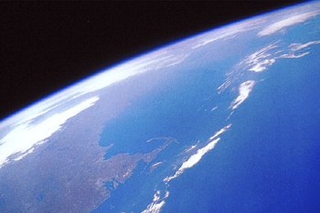
Read the introduction and look for key ideas

Slide 5
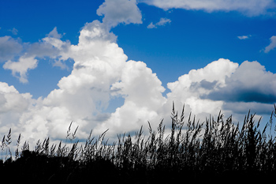
Has the earth’s atmosphere always been the same as it is today?

Slide 6
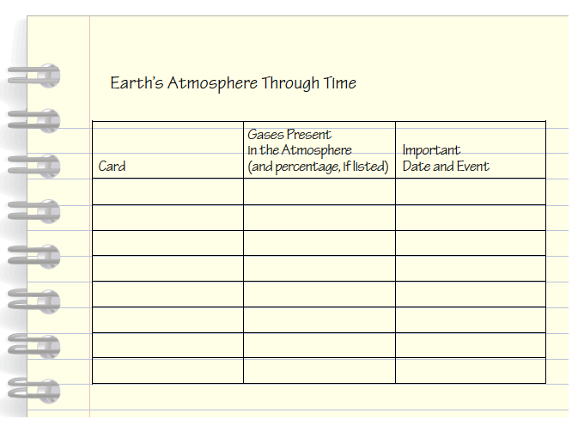
Complete the procedure and record your data

Slide 7
Has the earth’s atmosphere always been the same as it is today?
Share your thoughts with the class.

Slide 8
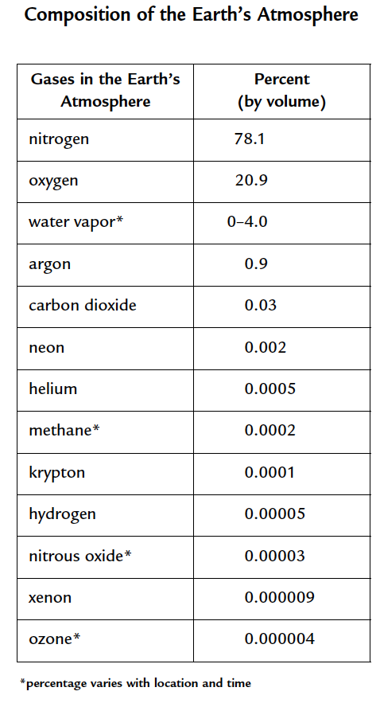
Composition of earth’s atmosphere

Slide 9
What are some of the major trends you observed from the atmosphere cards?
Share your thoughts with the class.

Slide 10
Analysis question 1
Look carefully at your completed table.
a. How has the amount of carbon dioxide gas in the atmosphere changed over the earth’s history?
b. How has the amount of oxygen gas in the atmosphere changed over the earth’s history?

Slide 11
Analysis question 2
What effect have living organisms (including people) had on the composition of the earth’s atmosphere? Support your answer with examples from this activity.

Slide 12
Analysis question 3
Reflection: Do you think that the atmosphere will have different amounts of oxygen and carbon dioxide in the future? Explain your reasoning.

Slide 13
Has the earth’s atmosphere always been the same as it is today?

Slide 14
Key vocabulary definitions
Atmospheric scientist - Scientist who studies the atmosphere.
Climatologist - Scientist who studies the earth’s climates.

Slide 15
Key vocabulary definitions
Organism - A living thing, capable of independent existence and characterized by organs or organ-like objects separate in function, but mutually dependent. Plants, animals, bacteria, and fungi are examples of organisms.

