Slide 1
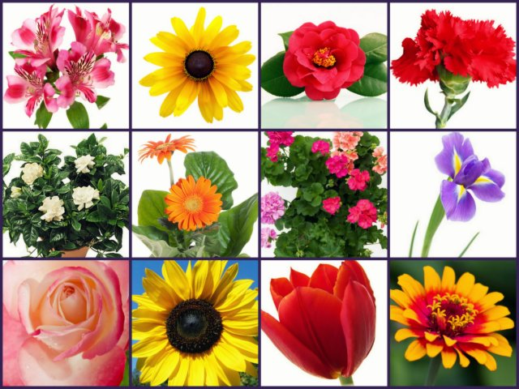
Protists, Fungi & Plant Warm-Ups 10 Weeks

Slide 2
WARM UP - 1
MONDAY
WEDNESDAY
What is the difference between living and non-living things/objects?
Living:_____________________________________________________________________________
Nonliving:__________________________________________________________________________
Living Organisms share these characteristics:
O_________________ R_____________ (food, oxygen and water), which provide r_________ energy to perform the b__________ processes of ________, such as g______________ and d_______________ or r_______________ injured parts.
A________________-make their own _________ through a process called P__________________.
H________________-must find their own food (hunter, gatherer, predator, prey, animals, fungi).
E______________ is r___________ from food in most organisms through this process.
TUESDAY
The Four Characteristics of Living Organisms are:
O_________ and use R__________ for E_________
R_____________________ to S_____________
R______________
G___________ and D___________________
THURSDAY
Which statement is true about what a stimulus is?
a. A change in an organism’s respiration that causes it to gain energy.
b. A change in an organism’s surroundings that causes it to do nothing.
c. A change in an organism’s life cycle.
d. A change in an organism’s surroundings that causes it to react.
Reproduction Word Box:
2-----mixed-----identical-----1
Asexual=
____ parent(s) _________ offspring
Sexual= egg + sperm
____ parent(s) _________ offspring
Which statement is true about what a response is? (circle all that apply)
a. A change in an organism’s respiration that causes it to gain energy.
b. An action performed by the organism.
c. A change in an organism’s life cycle.
d. A behavior performed by the organism.

Slide 3
WARM UP - 2
MONDAY
WEDNESDAY
Kingdom, phylum, class, order, family, genus, species
The study of classifying organisms.
35 (vertebrates and invertebrates).
Genus/species
Scientist who groups organisms.
2 (vascular and nonvascular).
Plant, Animal, Fungi, Protist, Moneran
First name of an organism, written in Latin and always capitalized.
Last name of an organism, written in Latin and never capitalized.
What is the difference between growth and development?
Growth:___________________________________________________________________________
Development:______________________________________________________________________
___ Taxonomy
___ Taxonomist
___ Levels of Classification
___ 5 Kingdoms
___ Animal Phyla
___ Plant Phyla
___ Scientific Name
___ Genus
___ Species
TUESDAY
What do all organisms require to grow and develop?
E__________
All organisms are made up of C_____________.
All organisms need F____________ and W________.
All organisms need a way to dispose of W__________.
All organisms need an E___________ in which they can live.
THURSDAY
An organism is placed in a __________ group and then placed into a more specific group bases on its __________?
a. broad, structures
b. broad, life cycle
c. structures, broad
d. broad, cell membrane
An organism is placed in a kingdom based on their:
A__________ to make F__________.
N___________ of C________ in their body.
Species consists of organisms of the:
S__________ T___________
Able to B________ and P________ young of the same kind.
The more classification levels an organism shares with another, the more ____________________ they have in common.

Slide 4
WARM UP - 3
MONDAY
WEDNESDAY
Directions: Circle the right answer.
Most Protists are (uni-cellular/multi-cellular).
Eukaryotic means it has (a nuclei/no nuclei).
Prokaryotic means it (lacks a nuclei/has a nuclei).
Protists can either be plant like or animal like:
Animal like are (autotrophs/heterotrophs) who need to eat other organisms.
Plant-like are (autotrophs/heterotrophs) and use sunlight to produce food.
What is the proper way to write an organism’s genus/species? Write an example:
____________________________________________________________________________Example: ______________________________
TUESDAY
What is the difference between:
Uni-cellular/multi-cellular? __________________________________________________________________________________________________________
Eukaryotic/Prokaryotic? __________________________________________________________________________________________________________
THURSDAY
What is the #1 thing about Fungi that separates them from plants?
Fungi are autotrophs and produce their own food.
Fungi are heterotrophs and must absorb other plants or organisms (living or dead) to stay alive.
Complete the names of the 3 Main Types of Fungi and match how they get their nutrients.
S___________
P___________
S___________
Get energy from decaying organic matter.
Feed on other living organisms (host), but do not harm the host.
Feed on other living organisms (host) and harm the host.

Slide 5
MONDAY
WARM UP - 4
Draw and label a Protists 2-D Model: Euglena
WEDNESDAY
Digests cellular waste and merges with a food vacuole to digest food.
Stores water and other substances, provides structure and support for the plant cell.
Contains the cell’s genetic material (DNA), which determines the nature of cell structures and substances.
An organelle containing chlorophyll, found in plant cells and some protists that converts the Sun’s energy into food (sugars).
An organelle found mostly in protists that collects extra water in a cell and expels it.
Makes proteins. (Found either free or bound to the surface of the endoplasmic reticulum.)
A membranous structure that assembles proteins and parts of the cell membrane.
A semi-rigid structure that surrounds cells of plants, fungi and bacteria and provides shape.
Converts the energy in food into usable energy for the cell.
The boundary between a cell and its environment that controls what enters and exits the cell.
Stores food and merges with a lysosome to digest food.
Internal fluid that contains the cells structures.
___ cell membrane
___ cell wall
___ cytoplasm
___ endoplasmic reticulum
___ mitochondrion
___ nucleus
___ ribosomes
___ central vacuole
___ lysosome
___ food vacuole
___ contractile
vacuole
___ choloroplast
TUESDAY
Circle its distinguishing characteristic: flagellum/cilia/false foot (psuedopod)
Draw and label a Protists 2-D Model: Paramecium
THURSDAY
Circle its distinguishing characteristic: flagellum/cilia/false foot (psuedopod)
Draw and label a Protists 2-D Model: Amoeba
Circle its distinguishing characteristic: flagellum/cilia/false foot (psuedopod)

Slide 6
WARM UP - 5
WEDNESDAY
MONDAY
Protists have three main ways to move (locomotion). What are they?
_____________________________
_____________________________
_____________________________
Who are these? (chose from: Paramecium, Amoeba or Euglena)
Animal-like Protists=__________________
Plant-like Protists=____________________
Fungus-like Protists=__________________
Autotrophic & Heterotrophic Protists=____________________________
In most cases, fungi are not able to do what?
Move or have locomotion.
To be stationary.
Protists are usually:
S________-celled O_________________
L____________ in M__________ environments.
V_________ in the ways they M_________ and obtain E___________.
TUESDAY
Fungi can be categorized based on what characteristics? (Circle all that apply).
Their fruiting structure of seed dispersal.
Their fruiting structure of apples.
Their fruiting structure of reproduction.
Their fruiting structure of spore dispersal.
THURSDAY
Fungi, like plants respond to stimuli from their environment to ensure survival of the organism. Which of the following are stimuli that fungi respond to? (circle all that apply)
a. gravitropism or response to gravity (specifically negative gravitropism)
b. hydrotropism or response to water
c. phototropism or response to light
d. thigmotropism or response to touch
e. toward reproductive units of other fungi
Fungi don’t have a root system to obtain water/nutrients, they have long fibrous strands called: H______________________
The plural of this is a:
M_____________________

Slide 7
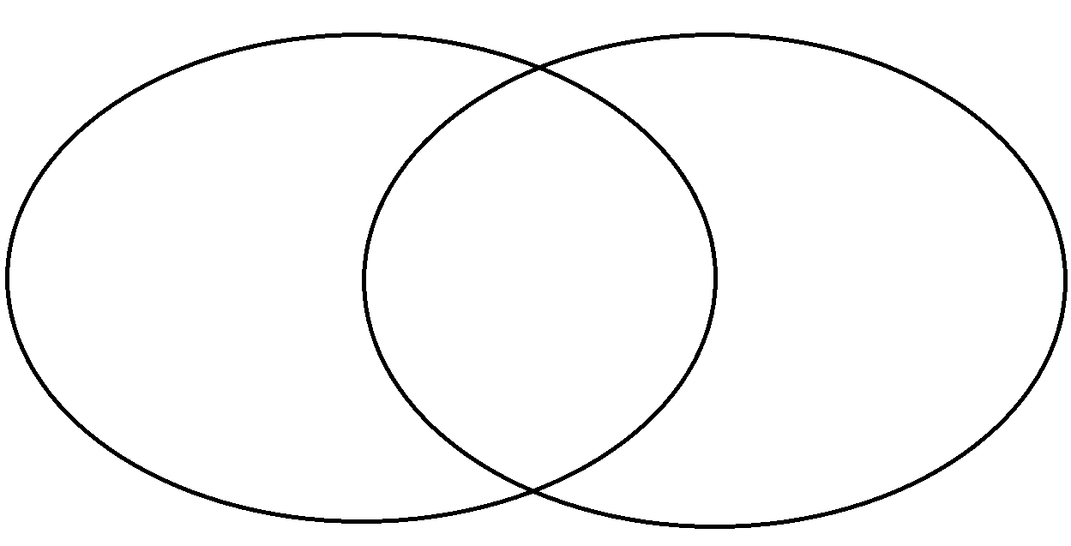
WARM UP - 6
MONDAY
WEDNESDAY
Draw and label a 2-D Model demonstrating xylem and phloem and their transport of water, nutrients and sugar in a plant structure.
X_______transports W_________and N_________ UP through the plant.
P___________transports S________ (glucose) that is produced from P______________ DOWN from the L________ to the rest of the plant.
TUESDAY
The main difference of nonvascular plants compared to vascular plants is that nonvascular plants _____________.
Transport and pass food and water from leaf to leaf.
Transport and pass food and water from root to root.
Transport and pass food and water from cell to cell.
Transport and pass food and water from flower to flower.
THURSDAY
VASCULAR NONVASCULAR

Slide 8
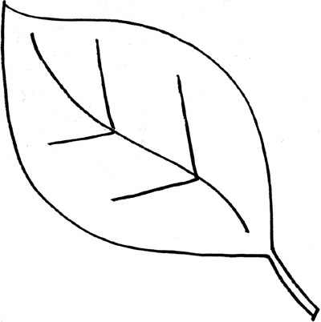
MONDAY
WARM UP - 7
WEDNESDAY
P________________ is the process where plants make their own S___________ (glucose) and release O__________ gas (O2) by using the following ingredients:
1. S______________
2. C______________ D_______________ (CO2)
3. W_____________ (H20)
Label a 2-D Model demonstrating a leaf and the process of PHOTOSYNTHESIS including the reactants (what goes in) and the products (what comes out or is produced).
Label a 2-D Model demonstrating a leaf and the process of RESPIRATION including the reactants (what goes in) and the products (what comes out or is produced).
TUESDAY
C___________________ a G____________ pigment that absorbs energy from the S_____.
C_____________ D____________ is taken in through openings or pores in the leaves called S______________ and this is where a plant also releases W________ V_______ into the water cycle. W__________ is absorbed through a plant’s R_______.
THURSDAY
PHOTOSYNTHESIS RESPIRATION
Challenge Question
Can you write the formula for
Photosynthesis including the
reactants and the products?
_____________ + __________
+ ____________→
____________________
+ ____________

Slide 9
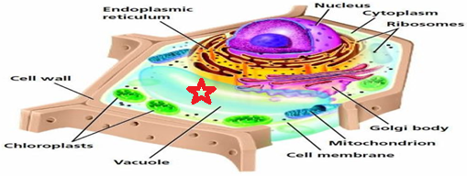
WARM UP - 8
Transpiration: Some of the W_______ taken in through the R______ of plants is used in the process of P____________. Plants store water inside of their C_____. Plants L______ water through their L_______. This process is called T___________. Without a way to control transpiration, plants would wither up and D___.
WEDNESDAY
Draw and label a 2-D Model demonstrating guard cells opening and closing the stomata on the underside of a leaf. Make sure to demonstrate their release of oxygen and water vapor and intake of carbon dioxide.
MONDAY
TUESDAY
Select all of the following statements that characterize respiration.
Glucose from photosynthesis is used to provide energy to the plant to perform life processes such as growth/repair.
Cells require glucose and oxygen gas to undergo respiration.
Oxygen and water are formed during respiration.
Plants and animals undergo respiration.
THURSDAY
Why do you think that plant cells have much larger vacuoles than animal cells?

Slide 10
WARM UP - 9
Structural Adaptations for Defense of a Plant:
T____________- defend the plant from being eaten by some animals.
F___________ and L___________ with poisons so that they are not eaten by animals.
A_________ to close their leaves when touched (T___________________).
WEDNESDAY
Leaves are the site for three very important functions for plants. Draw a 2-D Model of a leaf and indicate these functions.
MONDAY
Stems do two of the following (select both from the choices).
Function as the site of photosynthesis.
Support the plant.
Function as the site of transpiration.
Hold the plant up to the light.
Seeds have specialized structures that allow
them to be dispersed by:
1. W_________ 2. W________ 3. A_________
Seed Coats protect the seed from:
1. I___________ 2. D_________ O_____.
TUESDAY
THURSDAY
There are two types of roots. What are they and explain their characteristics in a 2-D Model!
Root Type #1: Root Type #2:
Examples: Examples:

Slide 11
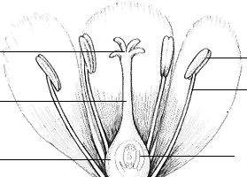
WARM UP - 10
Draw a 2-D Model of what happens to the ovary after the ovule is fertilized?
WEDNESDAY
MONDAY
TUESDAY
Chose P for Pistil or S for Stamen
____ Contains the style, which is a stalk down which the pollen tubes will grow after pollination has taken place.
____ Has an anther that produces pollen (contains the sperm cells).
____Female reproductive organ of the flower.
____Contains the stigma, which has a sticky top for pollen grains to land.
____ Male reproductive organ of a flower.
____ Has a filament (stalk) that supports or holds up the anther.
____Contains the ovary, which contains the ovules where the egg cells are produced.
Write how plants respond to changes in temperature:
Day Length -
Bulb Plants -
Day/Night -
Dormancy -
THURSDAY
Plant Tropism Stimulus Response
Phototropism
bends to light
Gravitropism
Hydrotropism
water
Thigmotropism

