Slide 1
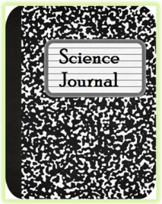
SEP S.1A.7 Construct and analyze scientific arguments to support claims, explanations, or designs using evidence
from observations, data, or informational texts.
SCIENTIFIC ARGUMENT:
Make a claim about human impact on the atmosphere and support your idea. Have evidence to back it up. Explain how the evidence proves your claim.
MY CLAIM /EXPLANATION/OR DESIGN:
__________________________________________________________________________________________________________________________________________________________________________________________________________________________________________________________________________________________________________________
MY EVIDENCE-TO SUPPORT MY CLAIM:
__________________________________________________________________________________________________________________________________________________________________________________________________________________________________________________________________________________________________________________
(Observations, data, or informational texts)
_____________________________________________________________________________________________________________________________________________________________________________________________________________________________________________________________________________________________________________________________________________________________________
MY REASONING-EXPLAIN BASED ON MY EVIDENCE:

