Slide 1
Vascular vs. Nonvascular
Xylem vs. Phloem
Seeds vs. Spores
Root Types

Slide 2
Vascular Plants
largest group
well-developed system for transporting water and food; they have true roots, stems, and leaves.
help circulate water and food throughout the plant.
Xylem transport water and minerals from the roots up to the rest of the plant.
Phloem transport food from the leaves down to the rest of the plant.
Examples:
woody stems- trees & bushes
herbaceous stems- grasses

Slide 3
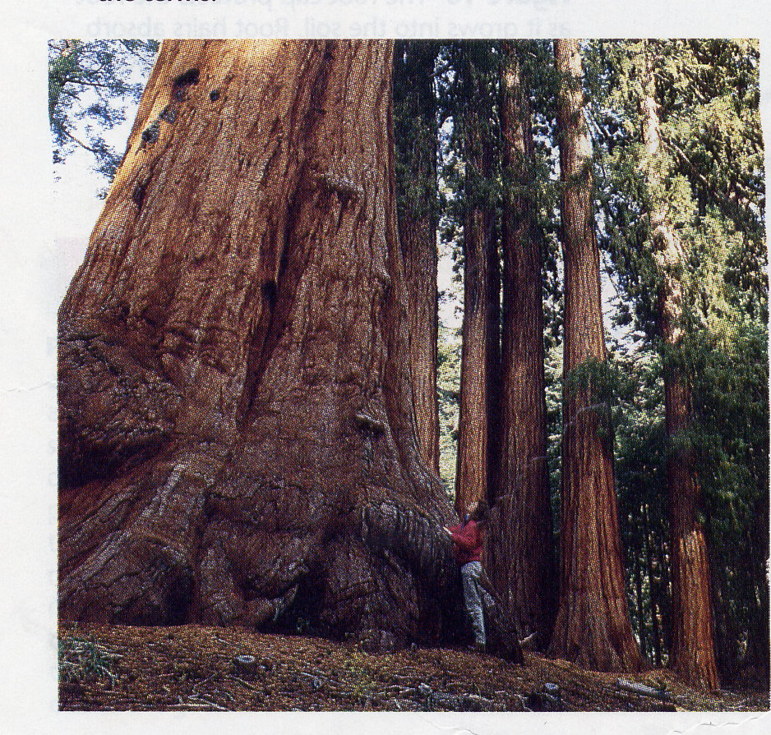
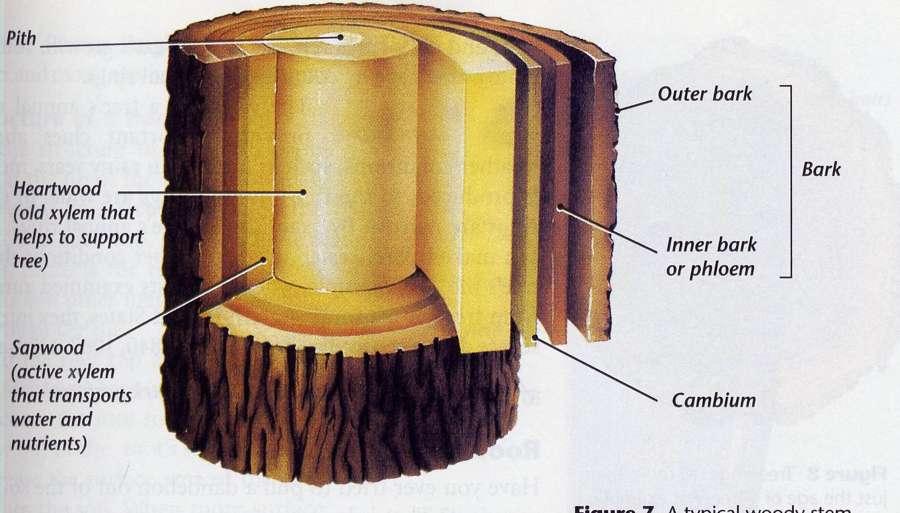
Vascular Plants

Slide 4
Non-Vascular Plants
Plants do not have a well-developed system for transporting water and food; do not have true roots, stems, or leaves.
They must obtain nutrients directly from the environment and distribute it from cell to cell
throughout the plant. This usually results in these plants being very small in size.
Examples: mosses, liverworts, and hornworts.

Slide 5
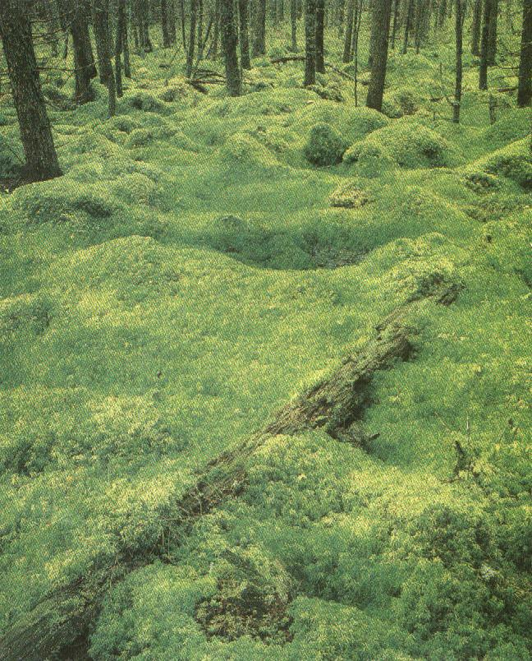
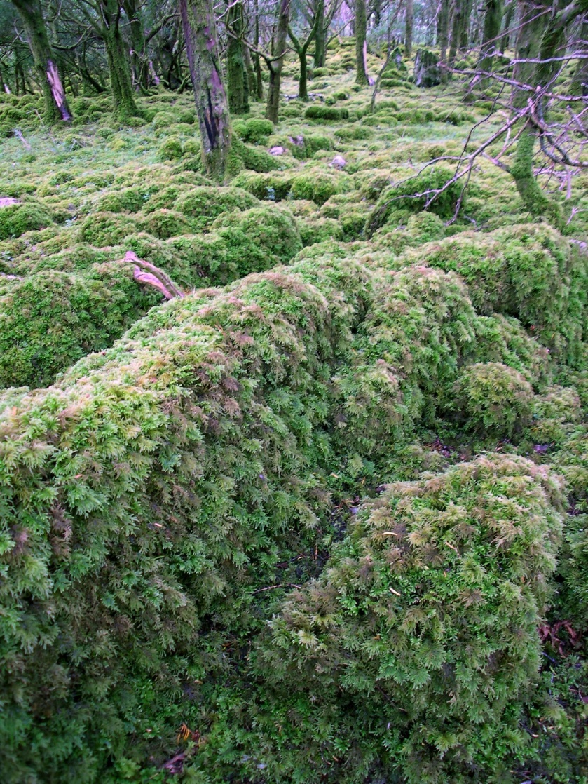
Non-Vascular Plants
Mosses

Slide 6
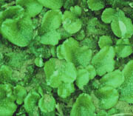
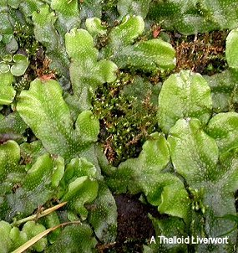
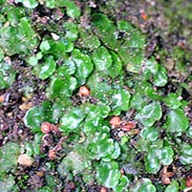
Non-Vascular Plants
Liverworts

Slide 7
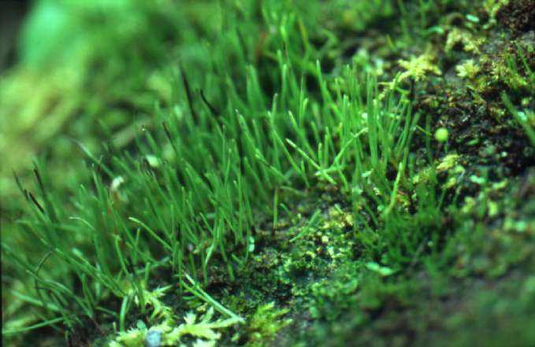
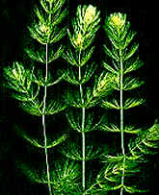
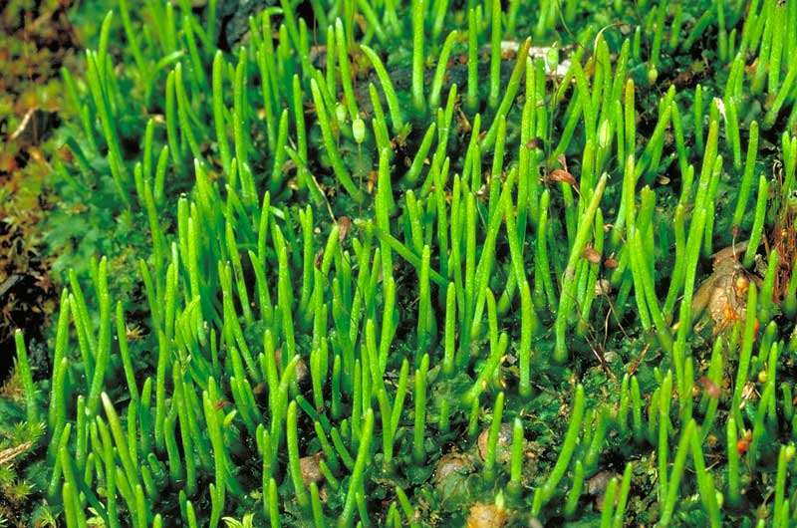
Non-Vascular Plants
Hornworts

Slide 8
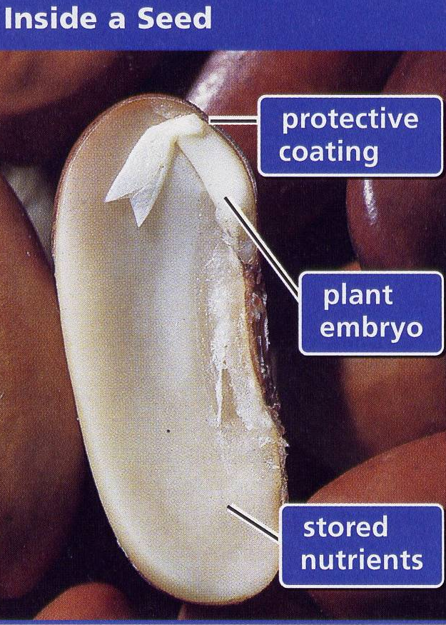
Seed Producing Plants
Seeds contain the plant embryo (the beginnings of roots, stems, and leaves) and stored food
(cotyledons) and are surrounded by a seed coat. From those seeds, new plants grow.
There are two major groups of seed-producing plants: cone-bearing plants and flowering
plants.

Slide 9
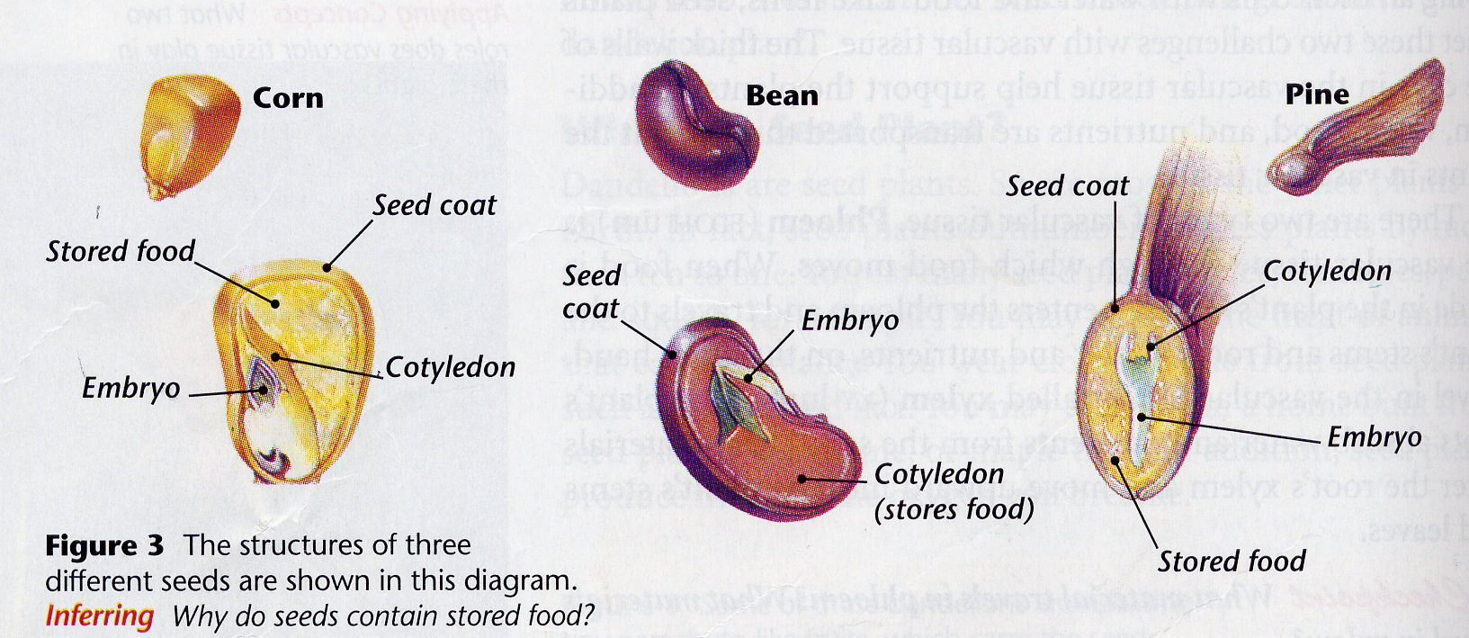
Types of seeds

Slide 10
Spore Producing Plants
Spores are much smaller than seeds.
Almost all flowerless plants produce spores.
Examples- mosses and ferns
Flowering Plants
Flowering plants differ from conifers because they grow their seeds inside an ovary, which is embedded in a flower.
The flower then becomes a fruit containing the seeds.
Examples include most trees, shrubs, vines, flowers, fruits, vegetables, and legumes.

Slide 11
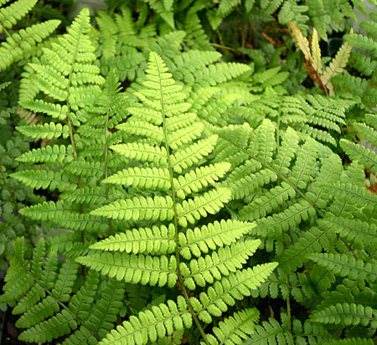
SPORE PRODUCING PLANTS
moss
ferns

Slide 12
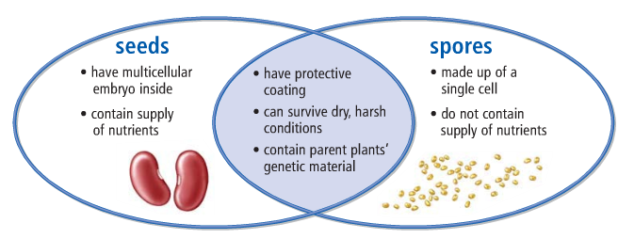
Seeds vs. Spores

Slide 13
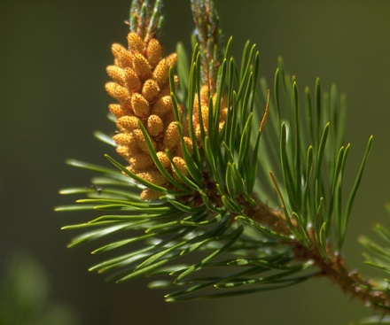
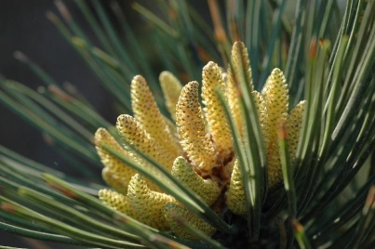
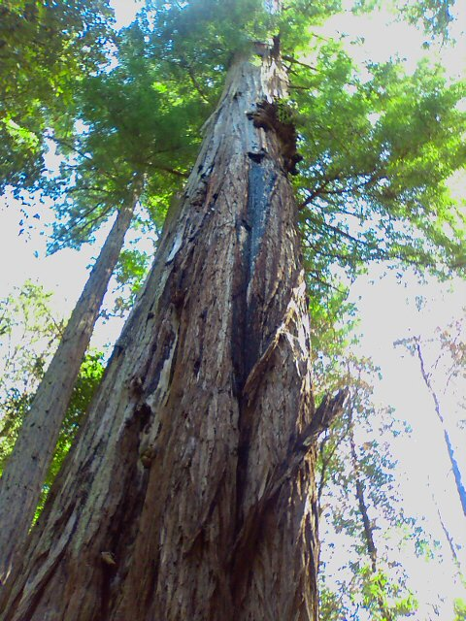
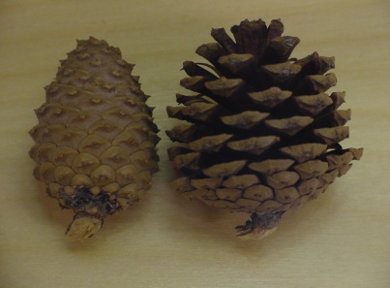
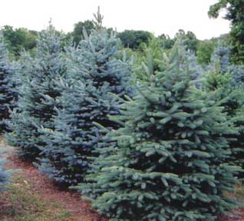
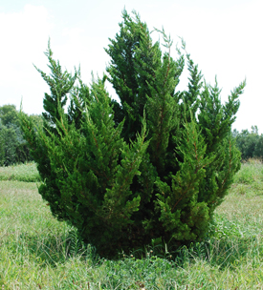
Cone Bearing Plants
Most cone-bearing plants are evergreen with needle-like leaves.
Conifers never have flowers but produce seeds in cones.
Examples- pine, spruce, juniper, redwood, and cedar trees.
Male cones
Female cones
Red wood
Spruce
Juniper

Slide 14
Monocots
A seed with one food storage area is called a monocotyledon, or monocot.
Flowers of monocots have either three petals or multiples of three.
The leaves of monocots are long and slender with veins that are parallel to each other.
The vascular tube structures are usually scattered randomly throughout the stem.
Examples-include grass, corn, rice, lilies, and tulips.

Slide 15
Dicots
A seed with two food storage areas is called a dicotyledon, or dicot.
Flowers of dicots have either four or five petals or multiples of these numbers.
The leaves are usually wide with branching veins.
The vascular tube structures are arranged in circular bundles.
Examples- roses, dandelions, maple, and oak trees.

Slide 16
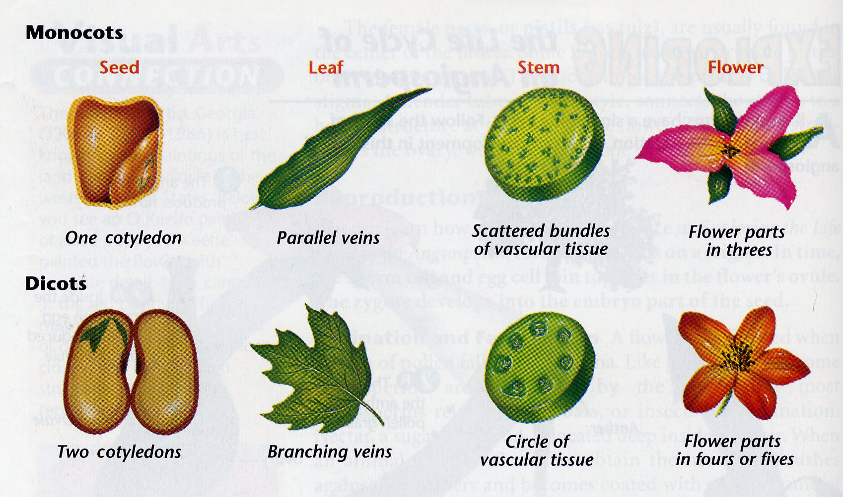
MONOCOTS VS. DICOTS

Slide 17
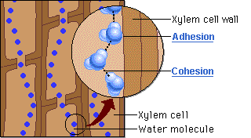
STEMS
Stems support the plant and hold the leaves up to the light. Stems also
function as food storage
sites.
The xylem in the stems
transports water from the
roots to the leaves and
other plant parts.
The phloem in the stems transport food made in the leaves to growing parts of the plant.

Slide 18
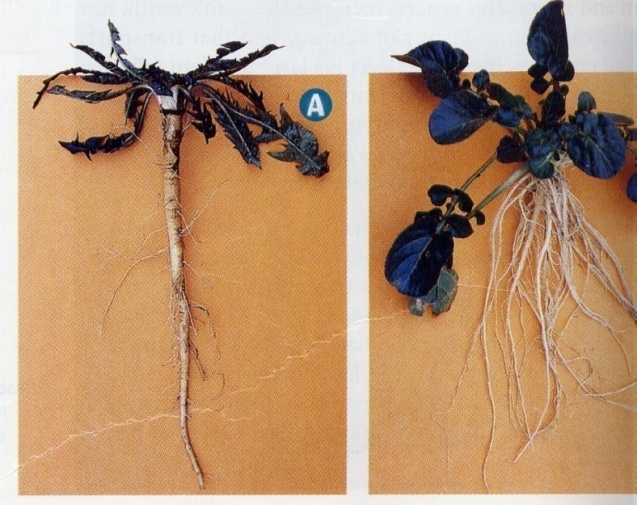
STEMS
anchor the plant
absorb water and nutrients from
soil
store extra food for the plants.
increase surface area to absorb
more water and nutrients
Root hairs help to increase this surface area.
There are two types of roots:
1. Fibrous roots consist of several main roots that branch off to form a mass of roots.
Examples- grass, corn, and some trees.
2. Taproots consist of one large, main root with smaller roots branching off. Examples-carrots, dandelions, or cacti.
taproot
fibrous

