Slide 1
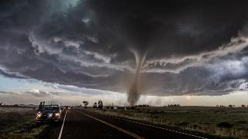
Weather Warm Ups 10 Weeks

Slide 2
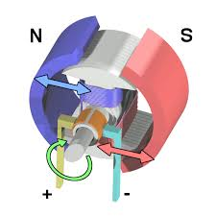
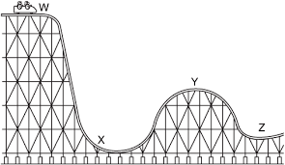
WEATHER WARM UP WEEK 1
MONDAY
WEDNESDAY
What is the energy associated with the motion of particles?
thermal/heat
kinetic
potential
chemical
What type of energy transformation occurs in the picture at the right?
TUESDAY
A type of energy is a tightly stretched rubber band?
kinetic
thermal/heat
potential
Light/radiant
__________________________→
__________________________
THURSDAY
Study the image of the rollercoaster what energy is mostly mechanical kinetic energy?
W
X
Y
Z

Slide 3
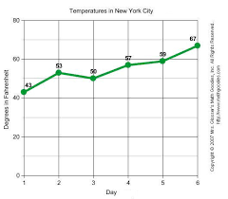
WEATHER WARM UP WEEK 2
MONDAY
WEDNESDAY
In a graph, the y-axis is labeled?
manipulated independent variable
dependent respondent variable
title
nothing
In the Law of Conservation of Energy what happens to the total amount of energy?
It’s increased.
It remain the same.
It’s decreased.
Nothing happens to the energy.
TUESDAY
In a graph the x-axis is called the ________?
manipulated independent variable
dependent respondent variable
title
nothing
THURSDAY
Which of the following statements describes the job of simple machines?
Simple machines decrease the amount of force needed.
Simple machines increase the amount of force needed.
Simple machines keep the amount of force needed the same.
Simple machines don’t change the amount of force needed.

Slide 4
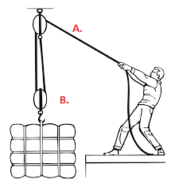
WEATHER WARM UP WEEK 3
MONDAY
WEDNESDAY
Which of the following statements describes the job of a spring scale?
____________________
____________________
What simple machine is a screw most closely related to?
What simple machine is a wedge most closely related to?
Spring scales measure the amount of work in joules.
Spring scales measure the amount of force in joules
Spring scales measure the amount of work in Newtons.
Spring scales measure the amount of force in Newtons.
TUESDAY
What is the device that changes electrical energy to mechanical energy?
generator
electric motor
battery
electromagnet
THURSDAY
What simple machine is a screw most closely related to
Which pulley changes the direction only?
____________________________________________
Which pulley changes the direction and the effort force?
____________________________________________

Slide 5
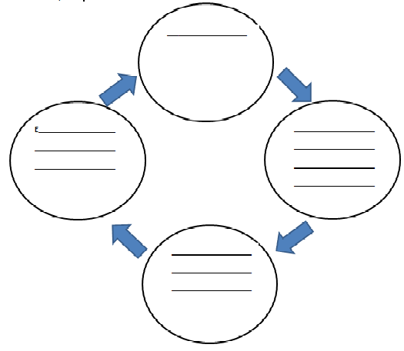
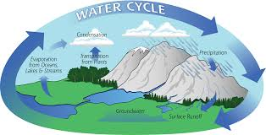
WEATHER WARM UP WEEK 4
MONDAY
WEDNESDAY (Put the water cycle in the
correct order).
Any type of solid or liquid water that falls to Earth?
precipitation
condensation
evaporation
transpiration
Which of the following can be described freezing ice pellets while falling through the cold air?
a. rain b. freezing rain c. sleet d. hail
TUESDAY
Write the key words for each part of the water cycle.
Condensation =
Dew =
Evaporation =
Frost =
Ground Water =
Precipitation =
Run-Off =
Surface Water =
Transpiration =
THURSDAY
precipitation, run-off, surface water
condensation, dew, evaporation, frost,
ground water, transpiration
__ A. Condensation 1. Water vapor changes to water droplets.
__ B. Dew 2. Water vapor condenses onto a surface.
__ C. Evaporation 3. Water droplets fall in various forms.
__ D. Frost 4. Water sinks in the porous ground.
__ E. Ground Water 5. Water enters the atmosphere as water vapor.
__ F. Precipitation 6. Precipitation that falls back to sea level.
__ G. Run-Off 7. Water vapor that changes directly to ice crystals on a surface.
__ H. Surface Water 8. Plants release water vapor.
__ I. Transpiration 9. Water collects on top of surfaces and the ground.

Slide 6
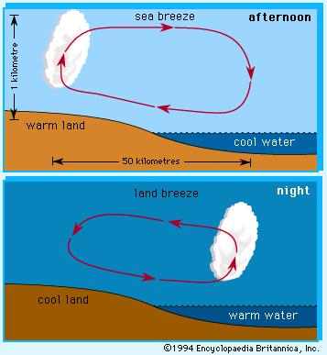
WEATHER WARM UP WEEK 5
MONDAY
WEDNESDAY
Match the scientist with their job description.
__ 1. Atmospheric Scientist A. Scientist who studies water.
__ 2. Climatologist B. Scientist who studies the atmosphere.
__ 3. Hydrologist C. Scientist who studies Earth’s weather over time.
__ 4. Meteorologist D. Scientist who studies the weather.
What is the percentage of land and water on Earth?
Land = _____% Water = _____%
Where is most of the water on Earth’s surface? _________________________________
Explain why hurricanes form over warm water temperatures of 80⁰F (20 ⁰C).
__________________________________________________________________________________________________
TUESDAY
Write what these weather instruments measure:
Anemometer = ____________________________
Barometer = ______________________________
Rain Gauge = ______________________________
Sling Psychrometer = ________________________
Thermometer = ____________________________
Wind Vane = _______________________________
THURSDAY
Describe the pictures to the left.

Slide 7
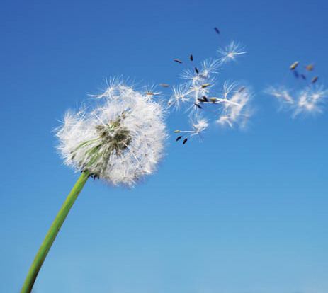
WEATHER WARM UP WEEK 6
MONDAY
WEDNESDAY
How does the Gulf Stream affect climate (tell your shoulder partner and then write your answer below).
________________________________________________________________________________________________________________________
What three factors affect climate?
________________________________________________________________________________________________________________________
Is air a substance or just empty space explain your reasoning below?
TUESDAY
____________________________________
____________________________________
____________________________________
____________________________________
Air pressure ________ as molecules of gas get ________ apart.
This gas makes of 78% of the atmosphere? ____________
This gas makes up 21% of the atmosphere? ____________
This gas makes up about 1% of the atmosphere? ________
THURSDAY
Match the layers with their objects.
___ 1. Exosphere A. airplanes, people, & weather
___ 2. Ionosphere B. ozone layer
___ 3. Mesosphere C. meteors & coldest layer
___ 4. Stratosphere D. hottest layer
___ 5. Thermosphere E. Aurora Borealis (pretty lights or ions)
___ 6. Troposphere F. space ships, satellites, space station, & space

Slide 8
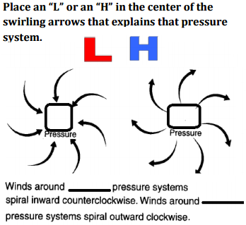
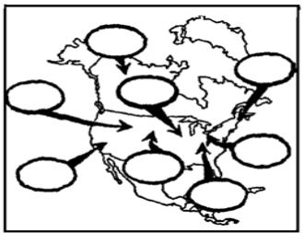
WEATHER WARM UP WEEK 7
TUESDAY
WEDNESDAY
MONDAY
(Draw symbols
Label the air masses with their abbreviations.
and write the words).
Area where two air masses meet? ____________________________
Area where warm air mass slides over a cold air mass? ________________
Area where a cold air mass pushes under a warm air mass? ______________
Area where a cold air mass is caught between two cold air masses? __________
Area where warm air mass and cold air mass meet and stay for a while? ___________________________
THURSDAY
A barometer measure _______________ and it’s units are ____________ or _______________.
A rising barometer is an ______________ in air pressure. The weather associated with __________ air pressure is _____________________________________.
A falling barometer is a _______________ in air pressure. The weather associated with ___________ air pressure is ___________________________________________.

Slide 9
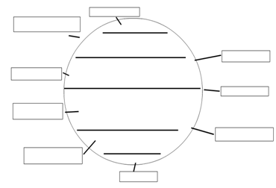
WEATHER WARM UP WEEK 8
MONDAY
WEDNESDAY
J______ S________: This is a column of air riding in the sky _______the earth. It affects weather. Moves weather in U.S. from ______to_______. T_______ W______move hurricanes from ___________to _______.
Label the Global Winds.
Global winds are caused by the
__________ of the _________.
TUESDAY
Winds ________and ________because of the ________causing Trade, Westerlies and Prevailing Winds, __________Effect, Coriolis Effect! Winds will blow from _______to ______.
THURSDAY
Explain convection currents and label which current is low and high pressure.
________________________________________
________________________________________
________________________________________
Water
or Land
_______holds heat longer.
_______heats up faster.

Slide 10
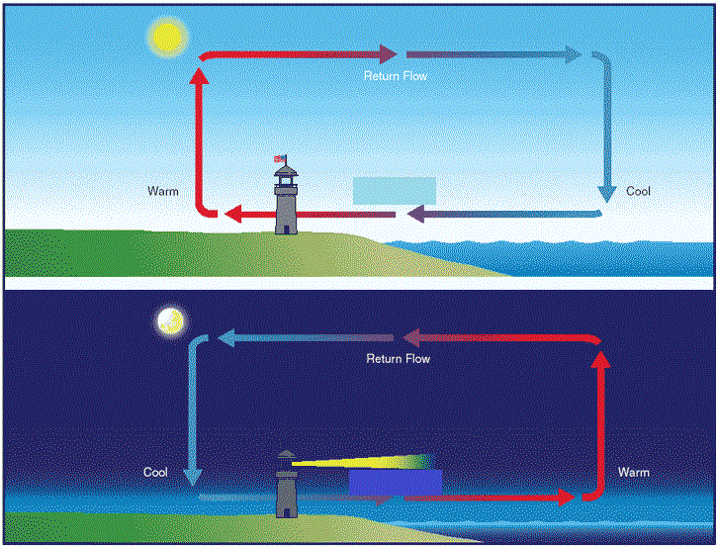
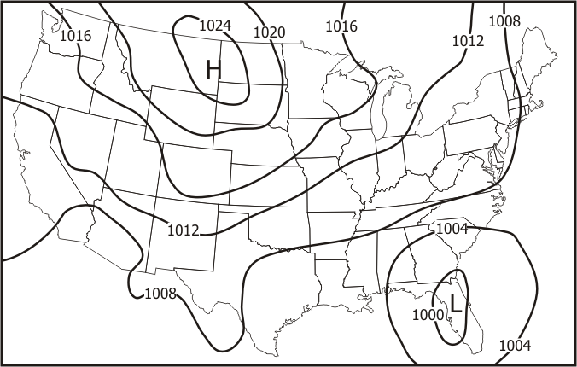
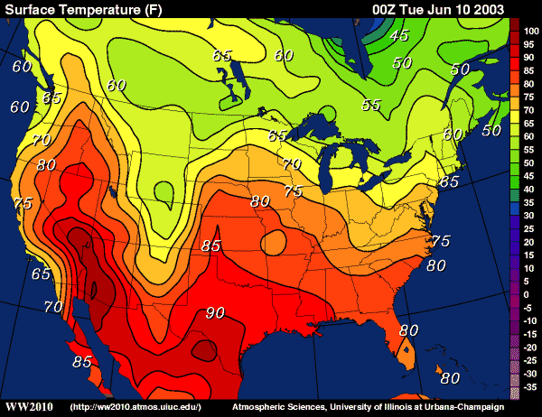
WEATHER WARM UP WEEK 9
MONDAY
WEDNESDAY
The _________ __________Current brings _________ ocean waters to the East Coast (South Carolina).
The _______________ Current brings ___________ _ ocean waters to the West Coast (California).
Current Tricks: ______________ ________________
Label Land and Sea Breeze.
TUESDAY
Label which one is an isotherm map and a isobar map.
THURSDAY
This is a picture of the __________________ Effect
The ______ drives the greenhouse effect. The heat transfer that is trapped is _____________.
_____% of the radiation is absorbed.

Slide 11
WEATHER WARM UP WEEK 10: SCIENTIFIC ARGUMENTS, CLAIMS, EXPLANATIONS, DESIGNS
MONDAY-FILL IN SEP S.1A.7
WEDNESDAY-MY EVIDENCE
C____________ and a______________ scientific a________________to support c__________, explanations, or d________________ using e________________from observations, data, or i_________________ texts.
Write one observation, data (graph) or informational text that proves how you claim that humans have impacted the atmosphere?
TUESDAY-MY CLAIM
What is one thing that you have learned about how humans impact the atmosphere?
Based on your evidence above, give your reasoning behind your argument claiming that humans have impacted the atmosphere. Example: Based on my graph explaining carbon dioxide released, I feel validated in my claim that humans added to the pollution adding to climate change over time.
THURSDAY-
MY REASONING

