Slide 1
Plants Week 1 Booklet
Living vs. Non-Living
The 4 Characteristics of Living Organisms
Foss Investigation 1 What is Life?
Part 1: Living or Nonliving
1
Protists, Fungi & Plants Unit

Slide 2
Drawing to Learn (D2L’s)
Vocabulary Word | Define | Draw a Picture Representation
dead
dormant
evidence
habitat
living
nonliving
organism
2

Slide 3
Investigation 1: What is Life?
3
What is life?__________________________________
All organisms exhibit four (4) common characteristics, what are they? #1___________________________________________________#2___________________________________________________#3___________________________________________________#4___________________________________________________
Something can only be dead if it was once ____________.
Some organisms can become _____________ to survive an unsuitable environment.
How do you classify organisms based on the 5 Kingdoms of Life?
_______________________________________________________________________________________________________________________________________________________________

Slide 4
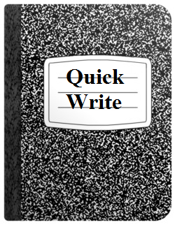
Quick Write Date: ________
How do you know if something is living?
________________________________________________________________________________________________________________________________________________________________________________________________________________________________________________________________________________________________________________________________________________________________________________________________________________________________________________________________________________________________________________________________________________
4
Draw your LINE OF LEARNING here. Date when your ideas have changed. Date: ____

Slide 5
Speak Like a Scientist with Sentence Frames
5
• I think ______________, because _____________ .
• I predict _________, because ______________ .
• I claim __________; my evidence is ________________ .
• I agree with that _____________________.
• My idea is similar/related to <name of classmate>’s idea.
• I learned/discovered/heard that ____________.
• __________________explained to me that _________.
• __________________shared with me that _________.
• We decided/agreed that _________________ .
• Our group sees it differently, because ______________.
• We have different observations/results. Some of us found that __________________________ .
One group member thinks that _________________.
• We had a different approach/idea/solution/answer: ___

Slide 6
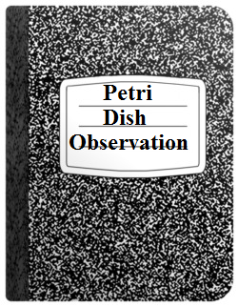
Observation Date: ________
Observe the petri dish for one (1) minute.
Write down everything you observe happening.
____________________________________________________________________________________________________________________________________________________________________________________________________________________________________________________________________________________________________________________________________________________________________________________________________________________________________________________________________________________________________
How can you explain what you have observed?
6
Circle if you think the material is living or nonliving.
What is the Evidence of Life to support your claim?
Draw you LINE OF LEARNING here. Date when your ideas have changed. Date: ____
Ex. I used to think ___________, but now I think _______________________.

Slide 7
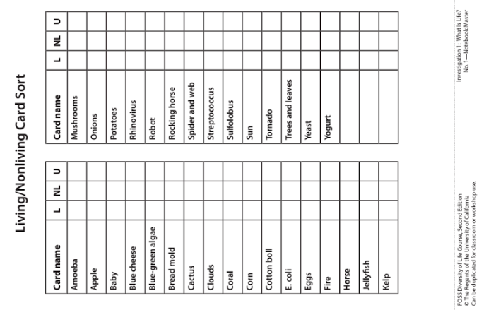
LAB: Living/Nonliving Card Sort
7

Slide 8
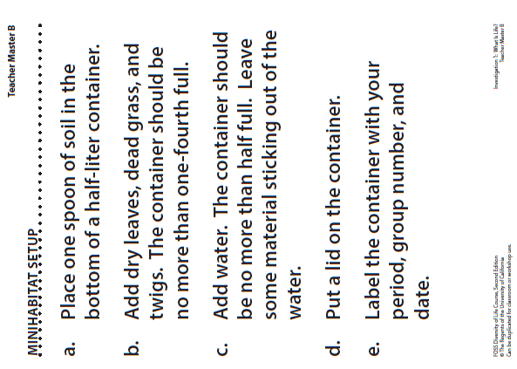
LAB: Mini-habitat Setup
8

Slide 9
Living vs. Non-Living
9
Conceptual Understanding
6.L.4A. Conceptual Understanding: Life is the quality that differentiates living things (organisms) from nonliving objects or those that were once living. All organisms are made up of cells, need food and water, a way to dispose of waste, and an environment in which they can live. Because of the diversity of life on Earth, scientists have developed a way to organize groups of organisms according to their characteristic traits, making it easier to identify and study them.
Performance Indicator
6.L.4A.1 Obtain and communicate information to support claims that living organisms:
obtain and use resources for energy
respond to stimuli
reproduce
grow and develop
All Organisms are:
M___________ up of c___________.
N_____________ food & w_________.
A way to d___________ of w__________.
L______ in an e________________.

Slide 10
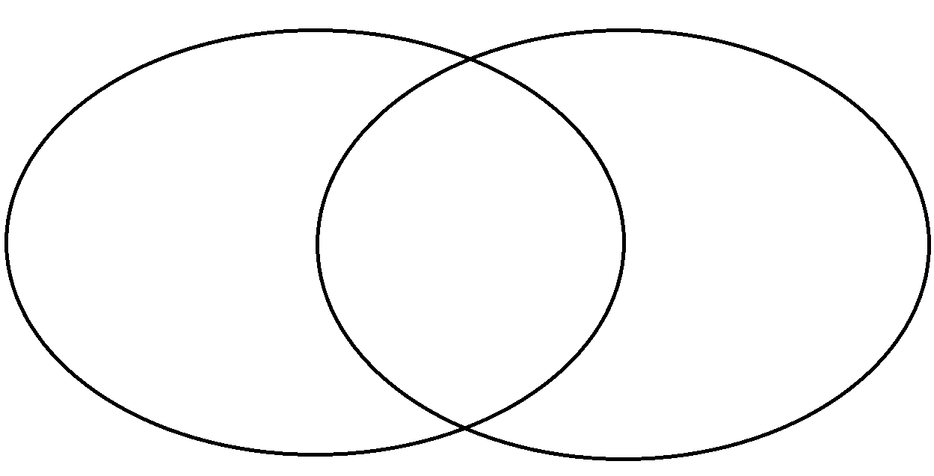
Living vs. Non-Living
10

Slide 11
Essential Knowledge
It is essential for students to know the characteristics that separate living organisms from nonliving things. All living organisms share the following characteristics:
1. They obtain and use resources for energy
● All organisms must obtain resources, such as food, oxygen, and water, which provide required energy to perform the basic processes of life, such as growing and developing, or repairing injured parts.
● Autotrophs (for example plants) provide their own food for energy through the process of photosynthesis, while heterotrophs (for example animals) must find an external source for food.
● Energy is released from food in most organisms through the process of respiration.
2. They respond to stimuli
● A stimulus is any change in an organism’s surroundings that will cause the organism to react.
● Examples of environmental stimuli may be changes in the following: amount of light, temperature, sound, amount of water, space, amounts or types of food, or other organisms present.
● The reaction to the stimulus is called a response. It can be an action or behavior performed by the organism.
11

Slide 12
3. They reproduce
● Organisms have the ability to reproduce, or produce offspring that have similar characteristics as the parent(s). There are two basic types of reproduction: ○ Asexual reproduction - a process that involves only one parent and produces offspring that is identical to the parent.
○ Sexual reproduction - a process that involves two parents. The egg (female reproductive cell) and sperm (male reproductive cell) from these two parents combine to make an offspring that has characteristics of both parents.
4. They grow and develop
● Growth is the process whereby the organism becomes larger (has an increase in height, mass, and/or overall size).
● Development is the process that occurs in the life of the organism that results in the organism becoming more complex structurally.
● Organisms require energy to grow and develop.
12

Slide 13
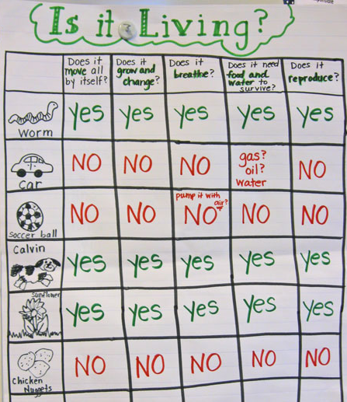
Scientific Argument: Claim, Evidence, Reasoning
6.E.2A.2
Using the chart, use your scientific argument skills to make a claim, find evidence and reasoning about the concept of living, nonliving, dead, and or dormant.
Claim:_____________________________________________________
Evidence: _________________________________________________________________________________________________________________________________________________
Reasoning: _________________________________________________________________________________________________________________________________________________
Find a fact: Which three organisms/things reproduce according to this graph?
Answer:_____________________
13

Slide 14
Review
14
A. dead
B. dormant
C. evidence
D. habitat
E. living
F. nonliving
G. organism
Characteristics of All Living Things
Use the vocabulary on the right to match with the definitions below.
______1. Referring to something that has never been alive.
______2. Information gathered by observation or experimentation.
______3. No longer alive.
______4. An individual living thing, such as a plant, animal, fungus, bacterium, archaeon, or protist.
______5. A state of suspended activity. Alive, but inactive.
______6. A specific place where an organism lives.
______7. The condition of being alive.

