Slide 1
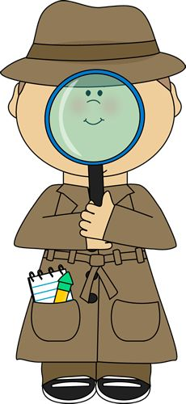
Plants Week 4 Booklet
Living vs. Non-Living
Foss Investigation #3 The Cell
Part 2: Paramecia
Part 3: Microworlds
Not in Foss-
Protists
1
Protists, Fungi & Plants Unit

Slide 2
Plant, Protists & Fungi Cell Vocabulary
2
Word | Definition
1. cell membrane | The boundary between a cell and its environment that controls what enters and exits the cell.
2. cell wall | A semi-rigid structure that surrounds cells of plants, fungi and bacteria and provides shape.
3. chloroplasts | An organelle containing chlorophyll, found in plant cells and some protists that converts the Sun’s energy into food (sugars).
4. cytoplasm | All of the interior fluid of a cell outside of a nucleus that contains the cell structures.
5. endoplasmic reticulum | A membranous structure that assembles proteins and parts of the cell membrane.
6. mitochondrion | Converts the energy in food into usable energy for the cell.
7. nucleus | Contains the cell’s genetic material (DNA), which determines the nature of cell structures and substances.
8. ribosomes | Makes proteins. (Found either free or bound to the surface of the endoplasmic reticulum.)
9. central vacuole | Stores water and other substances, provides structure and support for the plant cell.
10. lysosome | Digests cellular waste and merges with a food vacuole to digest food.
11. food vacuole | Stores food and merges with a lysosome to digest food.
12. contractile vacuole | An organelle found mostly in protists that collects extra water in a cell and expels it.

Slide 3
Protist Vocabulary
3
Word | Definition
1. heterotroph | Need to eat other organisms to get energy.
2. autotroph | Plants who make their own food (sugar/glucose) through photosynthesis using sunlight.
3. eukaryotic | Cells that have a nucleus.
4. prokaryotic | Cells that do not have a nucleus.
5. unicellular | Single-celled organism.
6. multicellular | More than one celled organism.
7. fungi | Live in moist environments include microorganisms such as yeasts, molds as well as multicellular organisms such as mushrooms. Heterotrophs that obtain energy in three ways: saprophytic, parasitic, symbiotic.
8. Three types of protists | Flagellum (flagella) use a long whip-like tail used to move and/or catch food. Ex. Euglena Cilia-small hair-like projections on the surface (cell membrane) of the cell used to sweep food into mouth-like structures and/or beat them in rhythm to move. Ex. Paramecium Pseudopods-a false foot/finger-like projection of the cell membrane and cytoplasm used to catch food and/or movement. Ex. Amoeba

Slide 4
FOSS INVESTIGATION #3.2, 3.3
FOCUS QUESTIONS
4
Is there life in the mini-habitats? If so, where did it come from?
What microscopic structures make up organisms such as humans (you)?
What are the characteristics of these three types of protists (euglena, paramecium, amoeba)?
How do they obtain food?

Slide 5
Quick Write Date: ________
Focus Question: How are elodea and the paramecium alike, how are they different?
________________________________________________________________________________________________________________________________________________________________________________________________________________________________________________________________________________________________________________________________________________________________________________________________________________________________________________________________________________________________________________________________________________
5
Draw your LINE OF LEARNING here. Date when your ideas have changed. Date: ____

Slide 6
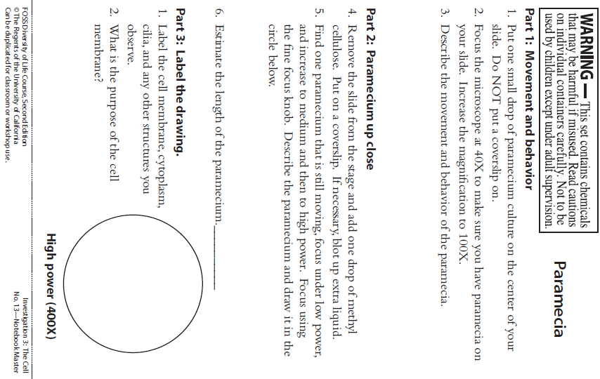
FOSS INVESTIGATION #3.2-Paramecia
Lab
6

Slide 7
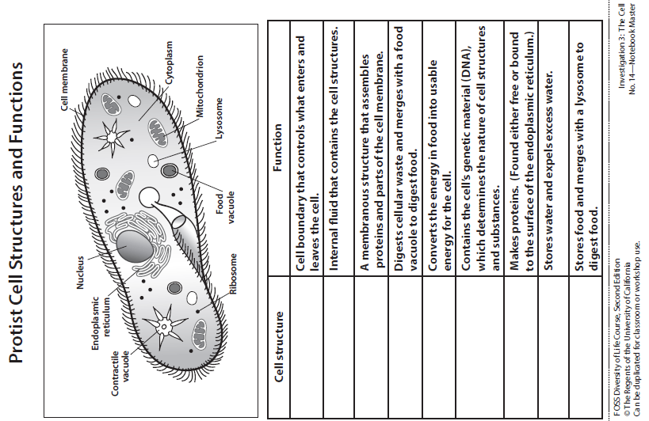
FOSS INVESTIGATION # 3.2-Paramecia
Lab
7

Slide 8
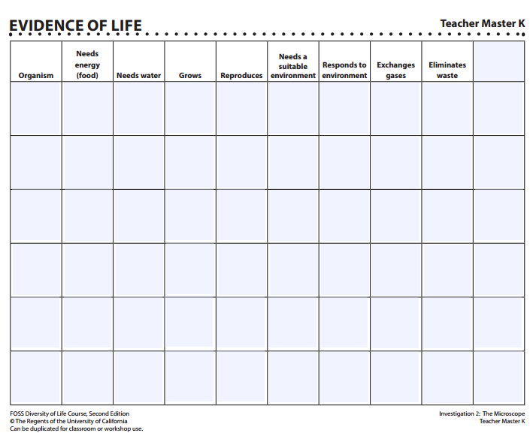
FOSS INVESTIGATION EVIDENCE OF LIFE CHART TO REVISIT
Lab
8

Slide 9
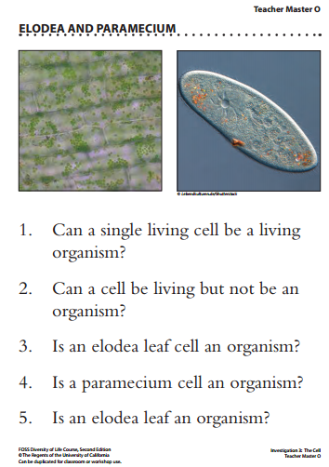
FOSS INVESTIGATION # 3.2-Paramecia
Lab
9

Slide 10
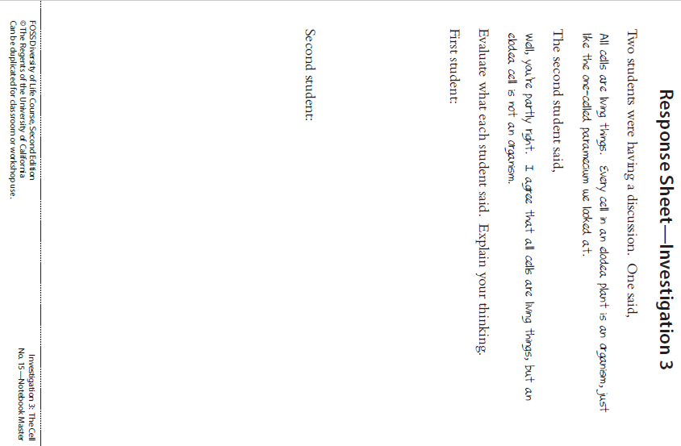
FOSS INVESTIGATION # 3.2-Paramecia
Lab
10

Slide 11
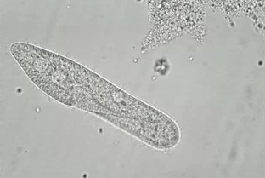
FOSS INVESTIGATION #3.2 Paramecia
STUDYING PARAMECIA
CLICK TO WATCH THE MOVEMENT OF THE PARAMECIA
11
Observe how the paramecium moves, bumping off of objects, twisting and turning. Scientific Name: Paramecium sp. Natural History: Paramecium are ciliates. They have rows of cilia that allow them to move and feed. They are single-celled, free-swimming organisms.

Slide 12
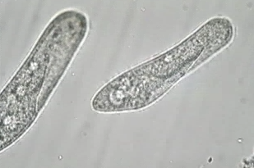
FOSS INVESTIGATION #3.2 Paramecia
STUDYING PARAMECIA
CLICK TO WATCH THE MOVEMENT OF THE PARAMECIA
12
Paramecia live in most bodies of freshwater and in soil. 200X Scientific Name: Paramecium sp. Natural History: Paramecium are ciliates. They have rows of cilia that allow them to move and feed. They are single-celled, free-swimming organisms.

Slide 13
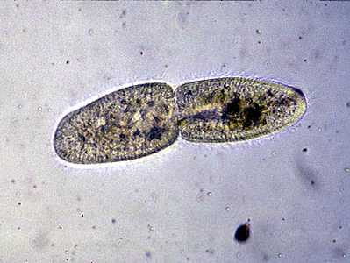
FOSS INVESTIGATION #3.2 Paramecia
STUDYING PARAMECIA
PARAMECIA REPRODUCE BY BINARY FISSION
EVIDENCE OF ASEXUAL REPRODUCTION
13
This paramecium is reproducing by binary fission (cell division). Scientific Name: Paramecium sp. Natural History: Paramecium are ciliates. They have rows of cilia that allow them to move and feed. They are single-celled, free-swimming organisms.

Slide 14
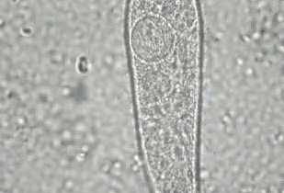
FOSS INVESTIGATION #3.2 Paramecia
STUDYING PARAMECIA
CLICK TO WATCH THE EMPTYING OF
THE CONTRACTILE VACUOLE
14
Carefully observe as the paramecium expels excess water. 400X Scientific Name: Paramecium sp. Natural History: Paramecium are ciliates. They have rows of cilia that allow them to move and feed. They are single-celled, free-swimming organisms.

Slide 15
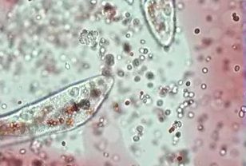
FOSS INVESTIGATION #3.2 Paramecia
STUDYING PARAMECIA
CLICK TO WATCH THE FOOD VACUOLE FORMATION
15
Notice the food vacuoles in this paramecium. 100X Scientific Name: Paramecium sp. Natural History: Paramecium are ciliates. They have rows of cilia that allow them to move and feed. They are single-celled, free-swimming organisms.

Slide 16
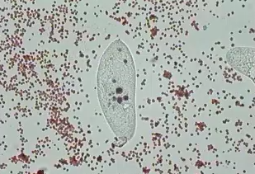
FOSS INVESTIGATION #3.2 Paramecia
STUDYING PARAMECIA
CLICK TO WATCH THE STAINED FOOD VACUOLES
16
Notice the food vacuoles in this paramecium. 100X Scientific Name: Paramecium sp. Natural History: Paramecium are ciliates. They have rows of cilia that allow them to move and feed. They are single-celled, free-swimming organisms.

Slide 17
FOSS INVESTIGATION #3.2 PARAMECIUM
READ BOOK PAGES 10-13 AND DO THE THINK QUESTIONS
1. Why is the cell membrane important?
2. What are the two functions of the cilia?
3. What are the functions of the contractile vacuole?
4. What would happen to the paramecium if the contractile vacuoles stopped working?
17

Slide 18
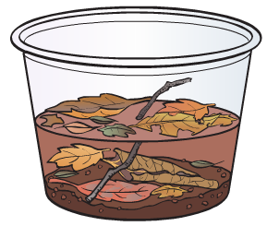
Quick Write Date: ________
FOSS #3.3 MICROWORLDS
Focus Question: Is there life in your
Mini-habitat? If so, where did it come from?
________________________________________________________________________________________________________________________________________________________________________________________________________________________________________________________________________________________________________________________________________________________________________________________________________________________________________________________________________________________________________________________________________________
18
Draw your LINE OF LEARNING here. Date when your ideas have changed. Date: ____

Slide 19
FOSS INVESTIGATION #3.3 MICROWORLDS
MINIHABITATS REVISITED
Is a twig a living thing? Circle Yes or No Is dirt a living thing? Circle Yes or No View your mini-habitat with your naked eyes is anything alive in them? Circle Yes or No
View your mini-habitat on a slide under the microscope. How are the organisms different from the paramecium we observed?
What in addition to size makes you think these organisms are multicellular?
What organism that we have looked at more closely resembles this new multicellular organism?
19

Slide 20
FOSS INVESTIGATION #3.3 MICROWORLDS
MINIHABITATS REVISITED
5. Did you see anything alive when you first set up
your mini-habitat? Circle Yes or No
6. Where do you think all of those organisms came from?
7. How did they get in your container?
8. What other 2 organisms that we have observed in lab that may have been in a state of dormancy?
What do you think will happen to these organisms if the water evaporates?
When we are through investigating our mini-habitats, how should we dispose of them?
20

Slide 21
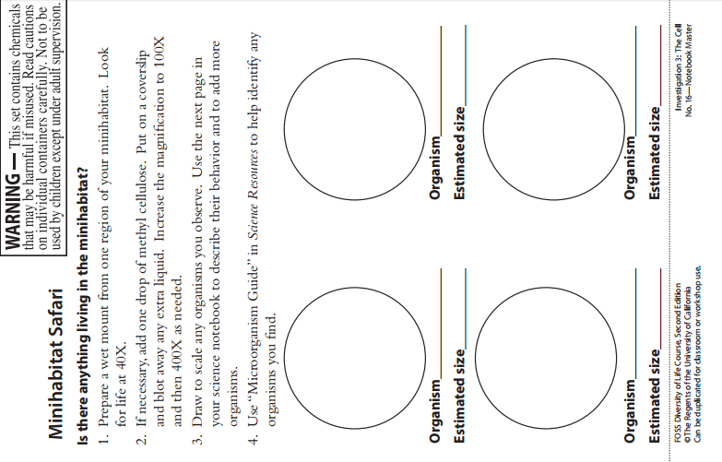
21

Slide 22
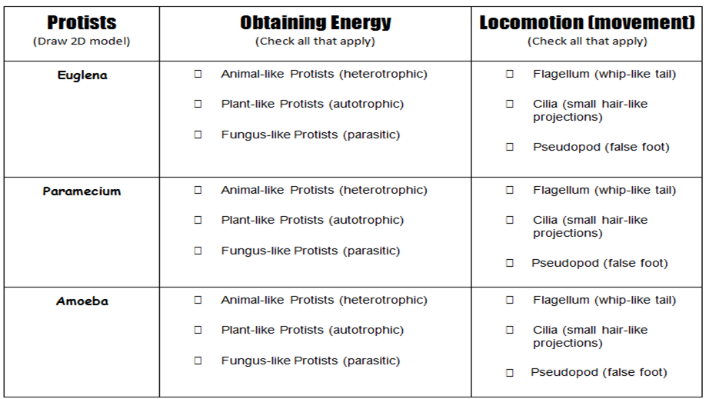
PROTISTS-411
22
Protists are usually _____________ -______________ organisms.
Live in ______________ environments.
Vary in the ways they ____________ and __________ ____________.

Slide 23
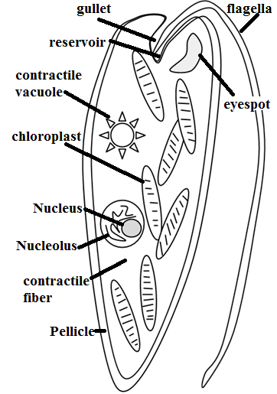
PROTISTS-411-The Euglena Informational Text and Coloring Activity
Euglena are unicellular organisms classified into the Kingdom Protista, and the Phylum Euglenophyta. All euglena have chloroplasts and can make their own food by photosynthesis. They are not completely autotrophic though, euglena can also absorb food from their environment; euglena usually live in quiet ponds or puddles.
Euglena move by a flagellum (plural ‚ flagella), which is a long whip-like structure that acts like a little motor. The flagellum is located on the anterior (front) end, and twirls in such a way as to pull the cell through the water. It is attached at an inward pocket called the reservoir. Color the reservoir grey and the flagellum black.
The Euglena is unique in that it is both heterotrophic (must consume food) and autotrophic (can make its own food). Chloroplasts within the euglena trap sunlight that is used for photosynthesis, and can be seen as several rod like structures throughout the cell. Color the chloroplasts green. Euglena also have an eyespot at the anterior end that detects light, it can be seen near the reservoir. This helps the euglena find bright areas to gather sunlight to make their food. Color the eyespot red. Euglena can also gain nutrients by absorbing them across their cell membrane, hence they become heterotrophic when light is not available, and they cannot photosynthesize.
The euglena has a stiff pellicle outside the cell membrane that helps it keep its shape, though the pellicle is somewhat flexible and some euglena can be observed scrunching up and moving in an inchworm type fashion. Color the pellicle blue.
In the center of the cell is the nucleus, which contains the cell's DNA and controls the cell's activities. The nucleolus can be seen within the nucleus. Color the nucleus purple, and the nucleolus pink.
The interior of the cell contains a jelly-like fluid substance called cytoplasm. Color the cytoplasm light yellow. Toward the posterior of the cell is a star-like structure: the contractile vacuole. This organelle helps the cell remove excess water, and without it the euglena could take in some much water due to osmosis that the cell would explode. Color the contractile vacuole orange.
Color the Euglena according to the directions. Organelles can be identified based on their descriptions and locations .
Answer the following questions:
1. Are euglena unicellular or multicellular?________________________________________________
2. What Kingdom do euglena belong to? What Phylum? Kingdom_________________ Phylum ________________
3. What organelle carries out photosynthesis? ______________________________
4. On which end is the flagellum located? ______________________________
5. Define autotrophic. __________________________________________________________________
6. Define heterotrophic. ________________________________________________________________
7. Describe the two ways in which the euglena get their nutrients. 1) __________________ 2)_________________
8. What is the eyespot used for? ______________________________
9. What is the function of the nucleus? ______________________________
10. What is the function of the contractile vacuole? ______________________________ 11. What would happen if the cell did not have this organelle (contractile vacuole)? _________________________
23

Slide 24
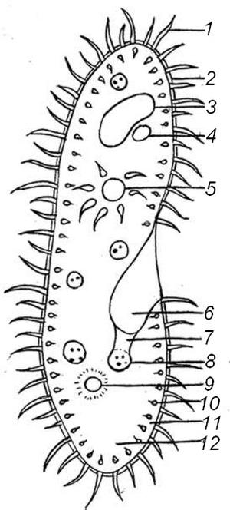
PROTISTS-411
PROTISTS-411-The Parmecium Informational Text and Coloring Activity
Paramecium are unicellular protozoans classified in the phylum Ciliophora (pronounced sill-ee-uh-FORE-uh), and the Kingdom Protista. They live in quiet or stagnant ponds and are an essential part of the food chain. They feed on algae and other microorganisms, and other small organisms eat them. All members of the Phylum Ciliophora move by tiny hair-like projections called cilia. Color all cilia black.The paramecium cannot change its shape like the amoeba because it has a thick outer membrane called the pellicle. The pellicle surrounds the cell membrane. Color the pellicle light blue. There are two types of nuclei (plural of nucleus). The large nucleus is called the macronucleus which controls cell activities such as respiration, protein synthesis and digestion. Color the macronucleus red. The much smaller micronucleus is used only during reproduction, color the micronucleus pink. Reproduction in paramecium involves the exchanging of DNA within the micronucleus. In order to do this, two paramecium lie side by side and join at the mouth pore. This process is called conjugation and is a method of sexual reproduction in other microorganisms.
Contractile vacuoles are used in animal cells to remove the excess water. The contractile vacuole is shaped like a star - Color the contractile vacuole dark green. Paramecium are heterotrophs, meaning they must consume food for their energy. Food enters the paramecium through the mouth pore (color orange) and goes to the gullet (color dark blue). The area of the paramecium appears pinched inward and is called the oral groove, cilia sweep food into this area. At the end of the gullet, food vacuoles are formed. Food vacuoles then remain in the cytoplasm until the food is digested. Color all food vacuoles light brown. Undigested food particles are eliminated through the anal pore (color dark brown). Paramecium can respond to temperature, food, oxygen and toxins and have a very simple defense mechanism. Just inside the pellicle are threadlike organelles called trichocysts. The paramecium can shoot tiny threads out of the cell to entangle a predator or to make themselves appear bigger. Color the trichocysts purple. Paramecium are also known to exhibit avoidance behavior. This is where the paramecium will move away from a negative or unpleasant stimulus. There are 2 kinds of cytoplasm in the paramecium. The cytoplasm around the edges is clear and is called ectoplasm. Leave the ectoplasm clear. The rest of the cytoplasm is more dense and appears darker. This is called the endoplasm. Remember that the word "ecto" means outside, and the word "endo" means inside. Color the endoplasm yellow. Color the Paramecium according to the directions. Organelles can be identified based on their descriptions and locations.
Answer the following questions:
1. Is the paramecium a unicellular or multicellular organism?_______________________________
2. To what Phylum and Kingdom do paramecium belong?__________________________________
3. Define heterotroph. _____________________________________________________________
4. What do paramecium eat? ________________________________________________________
5. How do all members of the Phylum Ciliophora move? __________________________________
6. Why can't the paramecium change shape like the amoeba? ______________________________
7. What do the macronucleus and micronucleus do? _____________________________________
8. Define conjugation.______________________________________________________________
9. What is the function of the contractile vacuole? _______________________________________
10. What is the oral groove? _________________________________________________________
11. Wastes exit the paramecium through what structure? _________________________________
12. Where do paramecium live? ______________________________________________________
1. Cilia
2. Pellicle
3. Macronucleus
4. Micronucleus
5. Contractile Vacuole 6. Mouth Pore
7. Gullet
8. Food Vacuole 9. Anal Pore
10. Trichocysts
11. Ectoplasm
12. Endoplasm
24

Slide 25
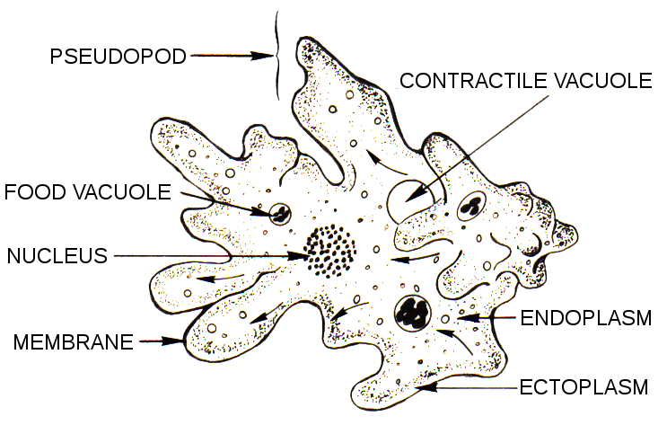
PROTISTS-411
PROTISTS-411-The Amoeba Informational Text and Coloring Activity
The amoeba is a protozoan that belongs to the Kingdom Protista. The name amoeba comes from the Greek word amoibe, which means change. (Amoeba is also spelled amoeba.) Protists are microscopic unicellular organisms that don't fit into the other kingdoms. Some protozoans are considered plant-like while others are considered animal-like. The amoeba is considered an animal-like protist because it moves and consumes its food. Protists are classified by how they move, some have cilia or flagella, but the amoeba has an unusual way of creeping along by stretching its cytoplasm into fingerlike extensions called pseudopodia. (The word "pseudopodia" means "false foot".) On the coloring sheet, there are several pseudopodia, use a yellow highlighter or pencil to highlight each of them (color around the outside of them). When looking at amoeba under a microscope, an observer will note that no amoeba looks the same as any other, the cell membrane is very flexible and allows for the amoeba to change shape. Color the cell membrane red. Amoebas live in ponds or puddles, and can even live inside people. There are two types of cytoplasm in the amoeba, the darker cytoplasm toward the interior of the protozoan is called endoplasm, and the clearer cytoplasm that is found near the cell membrane is called ectoplasm. (On the coloring, the endoplasm is indicated by the dotted area, and the ectoplasm by the white area.) Color the endoplasm blue, and leave the ectoplasm uncolored. By pushing the endoplasm toward the cell membrane, the amoeba causes its body to extend and creep along. It is also by this method that the amoeba consumes its food. The pseudopodia extend out and wrap around a food particle in a process call phagocytosis. The engulfed food then becomes a food vacuole. There are several food vacuoles on the drawing – color each brown. The food will eventually be digested by the cell’s lysosomes. Also visible in the amoeba is the nucleus, which contains the amoeba's DNA. Color the nucleus purple. In order to reproduce the amoeba goes through mitosis, where the nucleus duplicates its genetic material and the cytoplasm splits into two new daughter cells, each identical to the original parent. This method of reproduction is called binary fission. Another structure easily seen in the amoeba is the contractile vacuole, whose job is to pump out excess water so that the amoeba does not burst. Color the contractile vacuole orange. During unfavorable conditions, the amoeba can create a cyst, this hard-walled body can exist for a long period of time until conditions become favorable again. At this point it opens up and the amoeba emerges. Often cysts are created during cold or dry periods where the amoeba could not survive in its normal condition. Color the cyst green. Amoebas can cause disease. A common disease caused by the amoeba is called Amebic Dysentery. A person becomes infected by drinking contaminated water. The amoeba then upsets the person's digestive system and causes cramps and diarrhea. A person is most likely to be infected in countries where the water is not filtered or purified.
CYST
Answer the following questions:
How does an amoeba move? __________________________
What structure contains the amoeba's DNA? _______________
How does an amoeba reproduce?______________________
During unfavorable conditions, an amoeba forms a _________.
Fingerlike extensions of the amoeba's cytoplasm are called ___________________.
What disease is caused by the amoeba? ____________________________
To what Kingdom does the amoeba belong? ________
How are protozoans classified? _________________
25

Slide 26
Revisit the Focus Question: How are elodea and the paramecium alike, how are they different?
CHARACTERISTIC | PARAMECIUM | ELODEA
Cellular Structure
Kingdom
Vacuoles
Movement
Size
Color
Chloroplasts?
How does it eat?
Shape
How are they alike?
26

Slide 27
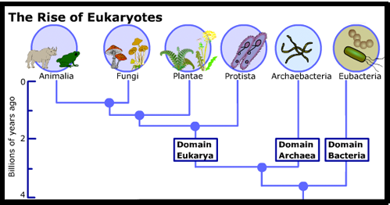
Scientific Argument: Claim, Evidence, Reasoning
6.E.2A.2
Using the graph, use your scientific argument skills to make a claim, find evidence and reasoning about the concept of living, nonliving, dead, and or dormant.
Claim:_____________________________________________________
Evidence: _________________________________________________________________________________________________________________________________________________
Reasoning: _________________________________________________________________________________________________________________________________________________
Find a fact: Which organisms are in the Eukarya (Eukaryotic) group?
Answer:_____________________
27

Slide 28
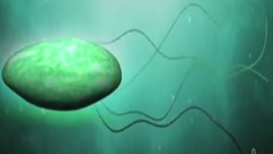
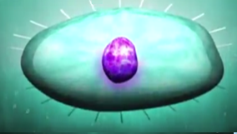
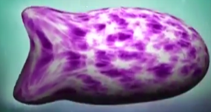
What kind of protist am I based on my locomotion/movement?
Protist Name:
Protist Name:
Protist Name:
Example:
Euglena
Example: Paramecium
Example:
Amoeba
Characteristics:
Characteristics:
Characteristics:
28

Slide 29
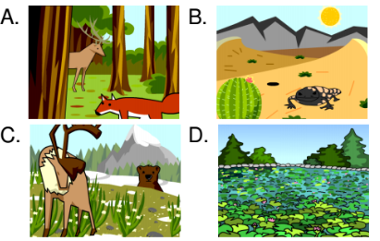
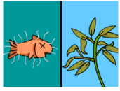
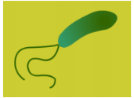
Protists Review
6. Which of the following is an example of a fungus-like protist?
A. Algae
B. Amoeba
C. Slime mold
D. Flagellate
7. Downy mildew and water mold can both be classified as:
A. Parasites
B. Protozoans
C. Pseudopods
D. Plant-like protists
8. The main functions of the vacuoles found inside protozoans are:
A. Digestion and excretion
B. Locomotion and respiration
C. Reproduction and cell division
D. Photosynthesis and metabolism
9. What can you infer about protozoans from the fact they are single-celled organisms?
A. They are probably unable to make humans sick
B. They probably have no DNA in their cells
C. They are probably poorly adapted to their environments
D. They probably can't be seen without a microscope
10. How does an amoeba move?
A. It uses cilia
B. It uses a flagellum
C. It uses pseudopods
D. It cannot move
1. If you wanted to find a colony of protists, where might you look?
2. What do all protists have in common?
A. Their cells have nuclei
B. They can make their own food through photosynthesis
C. They live in saltwater environments
D. They are single-celled organisms
3. Which term best describes algae?
A. Predatory
B. Single-celled
C. Plant-like
D. Prokaryotic
4. What might happen if a protist was missing its flagellum?
A. It wouldn't be able to digest food
B. It wouldn't be able to move
C. It wouldn't be able to reproduce
D. It wouldn't be able to breathe
5. Where might a parasitic protozoan live?
A. On the ocean floor
B. Inside a pig's intestines
C. On the surface of a pond
D. In the mud of a riverbank
29

Slide 30
This ones for them protists, In Kingdom Protista
I’m talking bout, euglena, paramecium, amoeba
In loco-motion, trying to explore
Gotta obtain that energy, I mean we all need that for sure
Who knew that? Yes ma’am
That protists are single celled
Who knew that? Yes ma’am
Protists live in moist environments
Who knew that? Yes ma’am
How I move can tell you who I am
Who knew that? Yes ma’am
Just trying to find that energy
Break it down,
Euglena whipping that flagella Whoa
Paramecium hairy cilia Whoa
Pseudopods are false feet on amoeba Whoa
Are you getting what I’m saying to you
Are you getting what I’m saying to you
Are you getting what I’m saying to you
Raise your hand and tell if you’re not and if you
Don’t believe me just watch…come on
Stop! Wait a minute!
Bout to put another Kingdom in it
Fungi, like yeast and mold, mushrooms, don’t forget
Saprophytic, Parasitic, Symbiotic as well
Are three ways they get energy, they gotta live on something else
Who knew that? Yes ma’am That fungi are heterotrophs
Who knew that? Yes ma’am They reproduce using spores
Who knew that? Yes ma’am My Fruiting body tells you who I am
Who knew that? Yes ma’am Just trying to find that energy
Break it down,
Decaying matter saprophytic Whoa
If you harm the host its parasitic Whoa
If you help the host its symbiotic Whoa
Are you getting what I’m saying to you
Are you getting what I’m saying to you
Are you getting what I’m saying to you
Raise your hand and tell if you’re not and if you
Don’t believe me just watch…come on
Protists & Fungi Rap
30
Thank you to Danielle Watson for the great rap! ☺

Slide 31
6.L.5A.1 Analyze and interpret data from observations to compare how the structures of protists (including euglena, paramecium, and amoeba) and fungi allow them to obtain energy and explore their environment.
Essential Knowledge Fungi Fungi are classified into the Kingdom Fungi. This includes microorganisms such as yeast and molds as well as multicellular organisms such as mushrooms. There are three main ways Fungi obtain energy: ● Saprophytic - Fungi that get their energy from decaying organic matter. ● Parasitic - Fungi that feed on other living organisms (host) and harm the host. ● Symbiotic - Fungi that feed on other living organisms (host) but do not harm the host. In many cases the host benefits from the fungi. In most cases, fungi are not mobile organisms. Fungi can be categorized based on their fruiting structures (structures for reproduction and spore dispersal). Extended Knowledge • There are many other examples of protists that use the various methods mentioned above to move or obtain energy. Euglena, paramecium, and amoeba are only a small sample. • In order to observe the movement and structure of protists, students could be introduced to basic microscopy and observe the organisms first-hand. • Other cells outside of Protista that have flagellum (many bacteria or sperm cells), cilia (cells in the trachea), and pseudopods (white blood cells). • Fungi are a very diverse group of organisms. Students may develop and use models that show the methods of fungal reproduction and spore dispersal. Assessment Guidance The objective of this indicator is to analyze and interpret data from observations to compare how the structures of protists (including euglena, paramecium, and amoeba) and fungi allow them to obtain energy and explore their environment. Therefore, the primary focus of assessment should be for students to analyze and interpret data from informational texts, observations, measurements, or investigations that supports the claim that protists and fungi have specialized structures that allow them to obtain energy and explore their environment. This could include, but is not limited to, students observing videos of protists and constructing 2-D models to explain how the specialized structures of protists that allow for movement and obtaining energy. Students can also analyze informational text and use that as evidence to argue whether a sample fungus is saprophytic, parasitic, or symbiotic. These fungal examples can be diagrams, images, or live specimens. ​In addition to analyze and interpret data, students should ask questions; plan and carry out investigations; use mathematics and computational thinking; engage in argument from evidence; construct explanations; develop and use models; obtain, evaluate, and communicate information; and construct devices or define solutions.
31

Slide 32
6.L.5A.2 Analyze and interpret data to describe how fungi respond to external stimuli (including temperature, light, touch, water, and gravity).
Essential Knowledge It is essential that students understand that fungi are able to respond to information from their environment to ensure survival of the organism. Fungi, like plants, respond to stimuli from the environment. ● In early development, many species will grow in response to light (phototropism) or away from gravity (gravitropism/geotropism). However, as the fungal species mature, they tend to display negative gravitropism. Because fungi lack a root system, they use hyphae. ● Hyphae are long fibrous strands that allow the fungus to obtain water and nutrients. ● Hyphal growth is greatly influenced by stimuli and will grow toward a food source, water, or even toward reproductive units of other fungi. ● Collectively, a mass of hyphae are referred to as a mycelium. Extended Knowledge • Students can explore how tropisms in fungi and plants are similar and obtain, evaluate, and communicate information regarding how these two different kingdoms have similarities in early development and growth. • Students may also develop and use models to explain how various types of fungi reproduce. Assessment Guidance The objective of this indicator is to analyze and interpret data to describe how fungi respond to external stimuli. Therefore, the primary focus of assessment should be for students to analyze and interpret data from informational texts, observations, measurements, or investigations that supports claims that fungi are able to respond to stimuli from their environment. This could include but is not limited to students analyzing informational text and using that as evidence to argue whether a sample fungus has grown in response to light (phototropism) or away from gravity (gravitropism/geotropism). These fungal examples can be diagrams, images, or live examples. Students can also use a variety of resources to explain how the hyphae, although not easily observed, are present and how the mycelium is helping the fungus to survive. In addition to analyze and interpret data, students should ask questions; plan and carry out investigations; use mathematics and computational thinking; engage in argument from evidence; construct explanations; develop and use models; obtain, evaluate, and communicate information; and construct devices or define solutions.
32

