Slide 1
Plants Week 7 Booklet
Living vs. Non-Living
Foss Investigation #5 The Vascular System
Part 3: Transpiration & Photosynthesis
Not in Foss-
Photosynthesis, Respiration, Transpiration
1
Protists, Fungi & Plants Unit

Slide 2
Photosynthesis, Respiration & Transpiration
2
Word | Definition
1. chlorophyll | A green pigment found in plant cells that absorbs light energy from the sun.
2. chloroplasts | Parts of the plant cells that contain chlorophyll.
3. xylem | Vascular tissue that transports water and minerals from the roots up to the rest of the plant.
4. phloem | Vascular tissue that transports food from the leaves down to the rest of the plant.
Photosynthesis (only plants) | Process plants use to make sugar (glucose) this requires carbon dioxide, water and sunlight. 6CO2 + 6H2O + energy → C6H12O6 + 6O2
respiration (plants/animals) | Process in which organisms obtain energy from the food it produces (plants) or consumes (animals) to perform life functions such as growth or repairing. C6H12O6 + 6O2 → 6CO2 + 6H2O + energy
Transpiration (only plants) | Water loss (evaporation) through leaves that allows water to travel up the plant against the pull of gravity.
8. stomata | Pores (holes) that allow CO2 in and H2O vapor and Oxygen (O2) out of leaves.
9. root hairs | Tiny extensions of plant roots that increase the surface area of the roots to allow more water and nutrients to be absorbed.
guard cells | Cells that open and close the stomata to allow or prevent water loss from leaves.

Slide 3
Focus Question: How is water transported through a plant?
3
Lab Part 3: Transpiration & Photosynthesis
Collect your bags from outside that were wrapped around a tree or your bag over a plant in the classroom. The bags should be removed carefully and held shut as to not lose any water.
What do you observe?
The leaves were dry when the bag was put over the branch. Where did the water come from?
Where is the water that came out of all of the other leaves on the plant/tree you used for the experiment?
Compare the amount of water collected in your bag in milliliters using a graduated cylinder.
Define transpiration-
Even large trees manage to pull water up from their roots. They may lift as much as ______L (Liters) or ______ gal (gallons ) of water every day!
Group 1 | Group 2 | Group 3 | Group 4 | Group 5 | Group 6 | Group 7 | Group 8 | Class Average

Slide 4
Part 3: Transpiration & Photosynthesis (continued)
Think back to our celery stalks and the water loss experiment. Why did the celery stalks with more leaves lose more water?
4
Multicellular Levels of Complexity Questions
Online Activity: Plant Vascular System (sign in to Fossweb.com to view)
How do single-celled organisms get the water that they need to live?
Are all of the cells in the multicellular celery and tradescantia (Wandering Jew) plants living?
Circle Yes or No
How do all of those cells: the guard cells, the leaf cells, the cells in the stalks and stems get the water they need?
In what part of the plant is xylem tissue found?

Slide 5
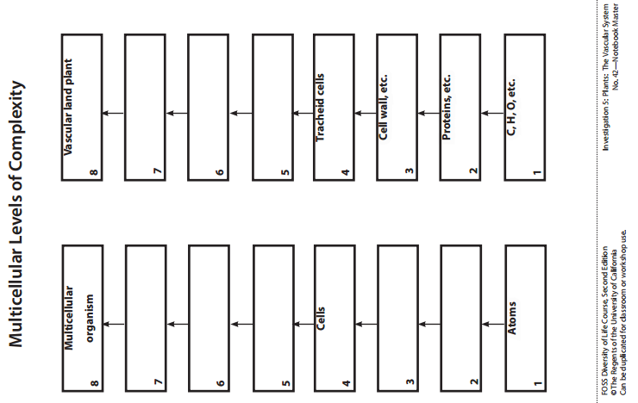
Part 3: Transpiration and Photosynthesis
Online Activity: Plant Vascular System (sign in to Fossweb.com to view)
5

Slide 6
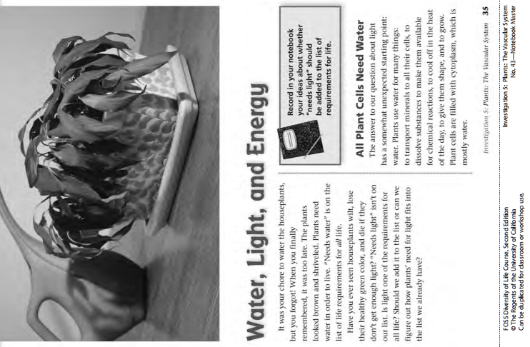
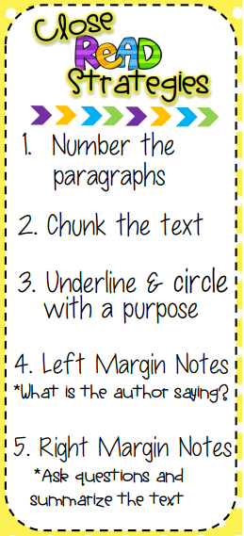
LAB: Part 3: Transpiration and Photosynthesis Book p. 43-47
Use your close reading skills as you read.
6

Slide 7
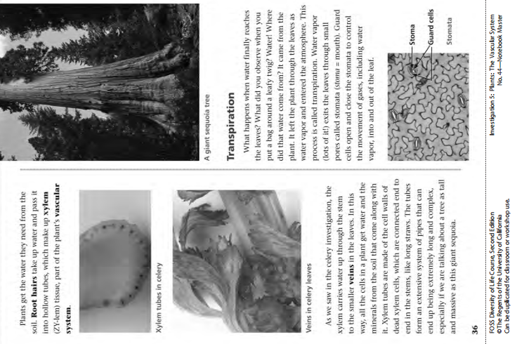
LAB: Part 3: Transpiration and Photosynthesis
7

Slide 8
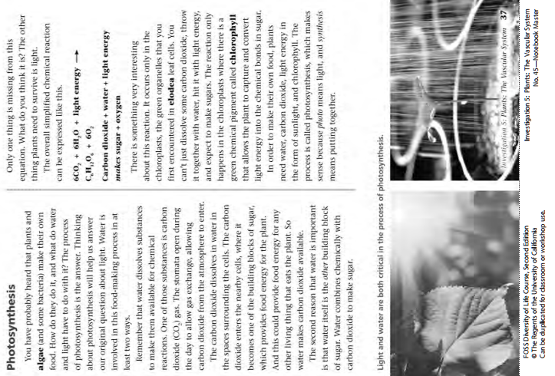
LAB: Is Anything Alive in Here?
8

Slide 9
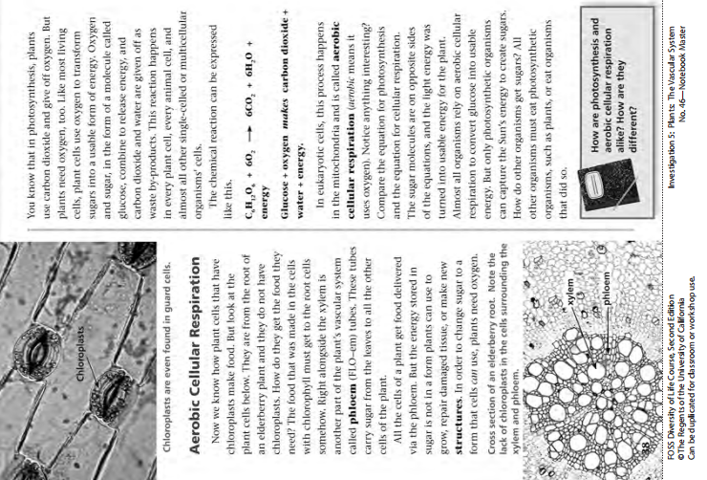
9

Slide 10
10

Slide 11
Think Questions after Reading
1. Explain why water is necessary for plants to make food?
2. How do all the cells in a plant get the water they need? Explain.
3. Do all plant and animal cells photosynthesize? Circle Yes or No
Explain.
4. Do all animal and plant cells use aerobic respiration? Circle Yes or No
Explain.
5. Is light a requirement for life? Circle Yes or No
Explain.
11

Slide 12
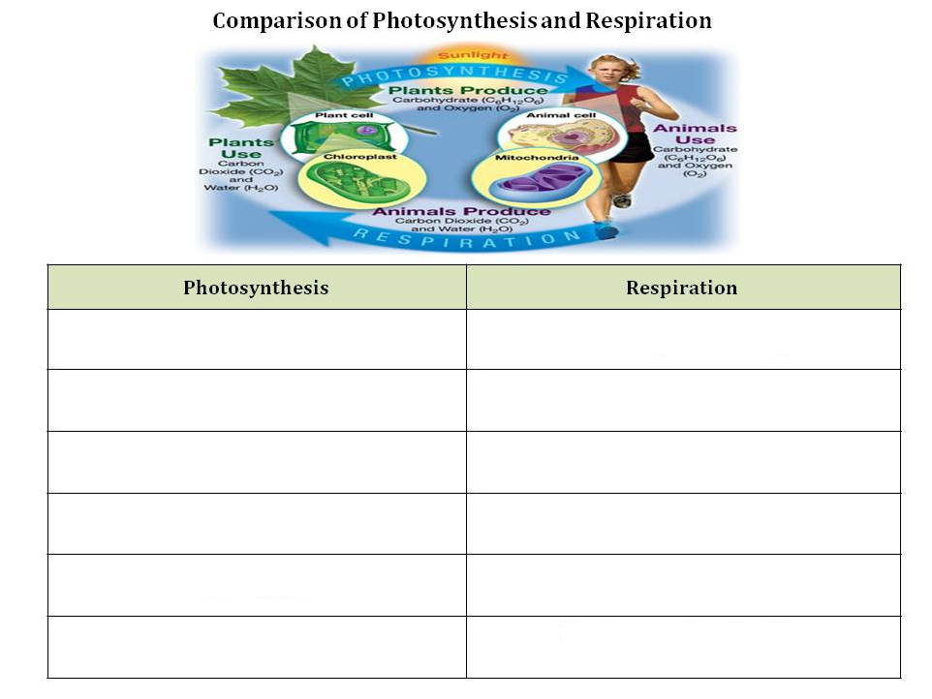
12

Slide 13
Photosynthesis, Respiration & Transpiration
13
Video

Slide 14
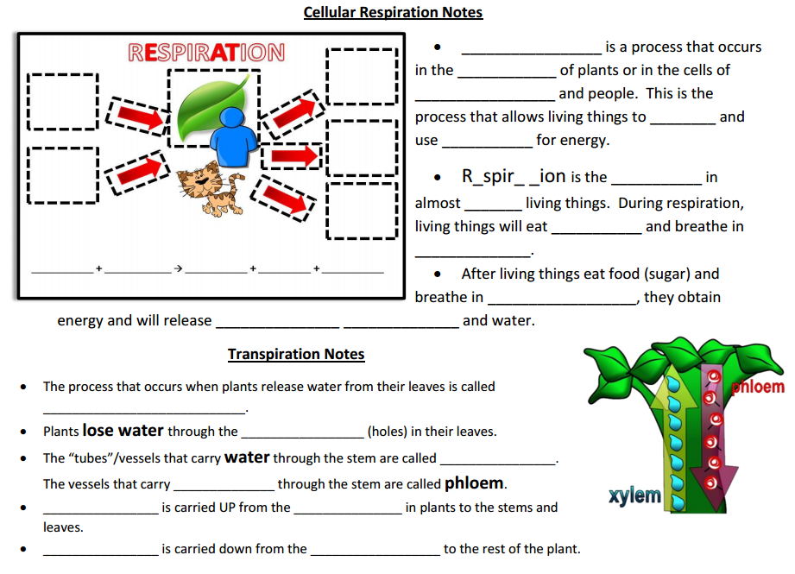
Photosynthesis, Respiration & Transpiration
14

Slide 15
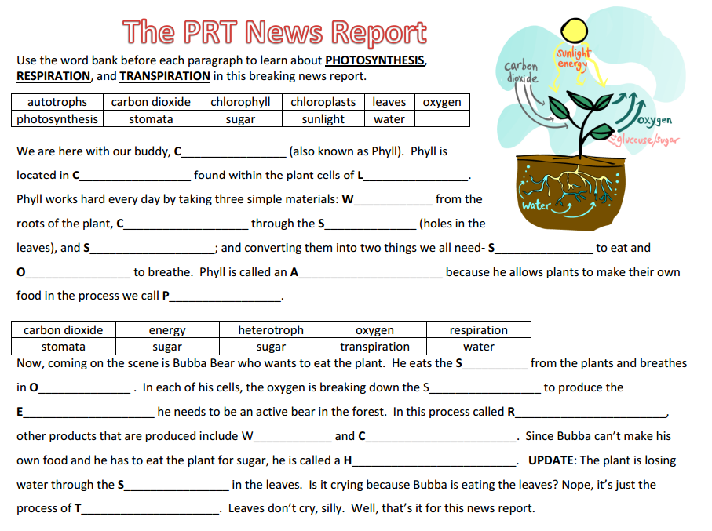
Photosynthesis, Respiration & Transpiration
15

Slide 16
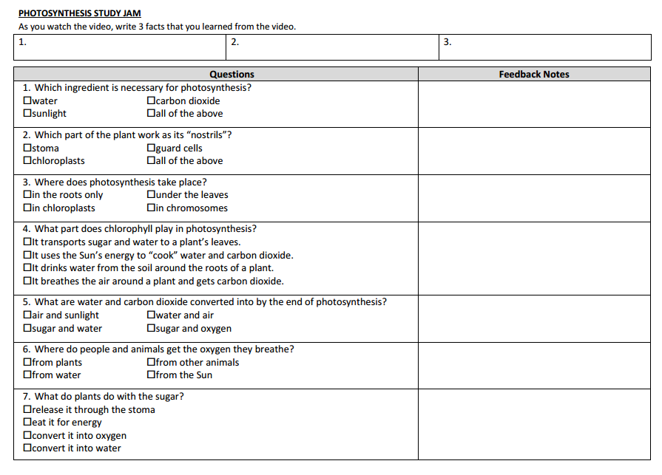
Photosynthesis, Respiration & Transpiration
16
Teacher Video Student Video for iPad

Slide 17
Review
A green pigment found in plant cells that absorbs light energy from the sun.
Tiny extensions of plant roots that increase the surface area of the roots to allow more water and nutrients to be absorbed.
Process plants use to make sugar (glucose) this requires carbon dioxide, water and sunlight. 6CO2 + 6H2O + energy → C6H12O6 + 6O2
Cells that open and close the stomata to allow or prevent water loss from leaves.
Vascular tissue that transports water and minerals from the roots up to the rest of the plant.
Process in which organisms obtain energy from the food it produces (plants) or consumes (animals) to perform life functions such as growth or repairing. C6H12O6 + 6O2 → 6CO2 + 6H2O + energy
Parts of the plant cells that contain chlorophyll.
Pores (holes) that allow CO2 in and H2O vapor and Oxygen (O2) out of leaves.
Vascular tissue that transports food from the leaves down to the rest of the plant.
Water loss (evaporation) through leaves that allows water to travel up the plant against the pull of gravity.
1. ____ chlorophyll
2. _____ chloroplasts
3. _____ xylem
4. _____ phloem
5. _____ photosynthesis
6. _____ respiration
7. _____ transpiration
8. _____ root hairs
9. _____ stomata
10. _____ guard cells
17

Slide 18
First let me start with pho-to-syn-thesis
If you don’t have a clue, just listen to this
Heterotrophs gotta find food to eat
But autotrophs can make their own treats
Get it, Got it, Good!
Plants take in CO2 through stomata in the leaves
Chlorophyll absorbs the light, that’s what makes a plant green
The roots take up the water, and that’s the recipe
They make food for the plant and oxygen for you and me.
Get it, Got it, Good!
How does the plant break down the food for energy?
A process called Respiration babe!
Transpiration is water loss through the leaves
But guard cells open and close the stomata when they please.
Get it, Got it, Good!
A quick recap, just so you don’t forget,
Photosynthesis is a plants food making process
Respiration takes that food and breaks it down for energy
But avoid transpiration, water loss through the leaves.
Get it, Got it, Good!
Processes in the Leaves Rap
18
Thank you to Danielle Watson for the great rap! ☺

Slide 19
Rap Questions
Living organisms that must hunt, find food to eat, or can’t make their own food are known as _______________.
autotrophs
heterotrophs
producers
protists
Living organisms that can make their own food are called ____________.
autotrophs
heterotrophs
consumers
monerans
Which of the following is correct?
Both plants and animals are autotrophs
Both plants and animals are heterotrophs
Plants are heterotrophs and animals are autotrophs
Plants are autotrophs and animals are heterotrophs
What is the name of the process where plants use CO2, water and light to make oxygen and food?
photosynthesis
respiration
transpiration
Precipitation
Plants take in CO2 through tiny holes in the leaves called ______________?
stomata
chloroplast
openers
closers
The green pigment found in the chloroplast that helps the plant to absorb light for photosynthesis is called the __________________.
stomata
chlorophyll
guard cell
closers
The process where plants and animals break down food for energy is called ____________________________.
photosynthesis
respiration
transpiration
Precipitation
The process where water is lost or evaporated through the leaves of a plant is called _____________________.
photosynthesis
respiration
transpiration
Precipitation
The stomata has ______________ to help it open and close to prevent water loss through the leaves.
stomata
chlorophyll
guard cell
Closers
Which of the following does NOT belong?
grass
mosquito
sunflower
blue green algae
19

Slide 20
PHOTOSYNTHESIS SORT MAT
20
Reactants → Products
6CO2 + 6H2O + energy →C6H12O6 +6O2
AFTER YOU ARE DONE SORTING THE SORT MAT WITH YOUR TABLE GROUP, FILL IN THIS SORT MAT TO STUDY!

Slide 21
RESPIRATION SORT MAT
21
Reactants → Products
C6H12O6 +6O2 → 6CO2 + 6H2O + energy
AFTER YOU ARE DONE SORTING THE SORT MAT WITH YOUR TABLE GROUP, FILL IN THIS SORT MAT TO STUDY!

Slide 22
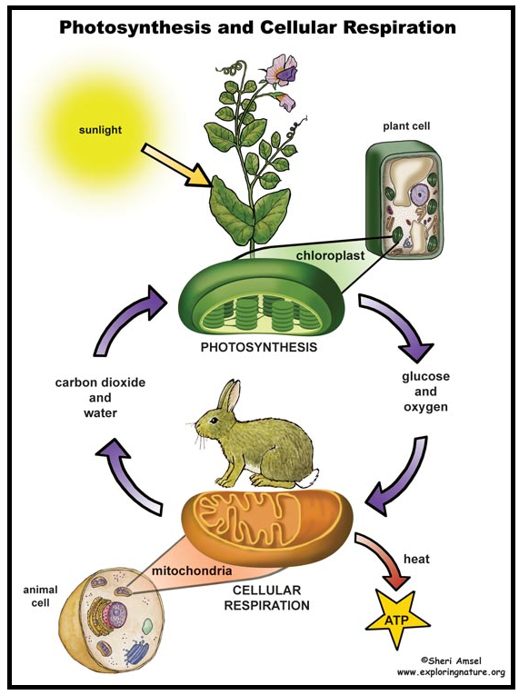
Scientific Argument: Claim, Evidence, Reasoning
6.E.2A.2
Using the graphic, use your scientific argument skills to make a claim, find evidence and reasoning about the concepts of photosynthesis, respiration and transpiration.
Claim:_____________________________________________________
Evidence: _________________________________________________________________________________________________________________________________________________
Reasoning: _________________________________________________________________________________________________________________________________________________
Find a fact: According to this Photosynthesis and Cellular Respiration Graphic, the graphic is evidence that plants and animals both complete what process?
22

Slide 23
How to Solve One-Step Dimensional Analysis Problems
The distance from North Myrtle to Surfside is 26 miles. What is the distance in cm?
Conversion
1 mi= 160,934.4 cm
23

Slide 24
Photosynthesis, Respiration & Transpiration
24
6.L.5B.2 Analyze and interpret data to explain how the processes of photosynthesis, respiration, and transpiration work together to meet the needs of plants. ​
Essential Knowledge It is essential for students to know that plants are organisms that perform certain processes necessary for survival. Photosynthesis ● Plants are organisms that make their own food, a simple sugar, for survival. ● The process by which they make this sugar is called photosynthesis. ● Plant cells require sunlight, carbon dioxide and water to undergo photosynthesis. ● Chloroplasts, found in the cells of the leaf, contain chlorophyll, a green pigment that absorbs light energy from the sun. ● Carbon dioxide is taken in through openings, or pores, in the leaf called stomata and water is absorbed through the roots. ● Simple sugar (glucose) and oxygen gas are produced. The plant uses the glucose for food and the oxygen gas released into the air through the stomata. Photosynthesis provides the oxygen gas in the atmosphere that most living organisms need.

Slide 25
Photosynthesis, Respiration & Transpiration
Respiration ● The glucose created through photosynthesis is used to provide energy needed by the plants to perform life functions such as growing and repairing. ● To obtain the energy from the food it produces, plants must break down the sugar in the cells throughout the plant in a cellular process called respiration. ● Cells require glucose and oxygen gas to undergo respiration. ● Oxygen gas from the air (taken in through the stomata) combines with the glucose, which is then broken down producing carbon dioxide and water. ● During this process, energy is released. This energy will be used by the plant to perform life functions such as growth and repair. ● The carbon dioxide gas and water that are formed are then given off through the stomata in the leaves. Note: All organisms undergo respiration to release energy from food. Transpiration ● Some of the water taken in through the roots of plants is used in the process of photosynthesis. ● Plants store water inside of their cells. ● Plants lose water through the leaves. This process is called transpiration. ● Without a way to control transpiration, plants would wither up and die. ● Guard cells, mostly on the underside of the leaf, open and close the stomata and allow plants to control transpiration. ● When the stomata are closed, water cannot escape from the leaf.
25

Slide 26
Photosynthesis, Respiration & Transpiration
26
Extended Knowledge • The chemical equation for photosynthesis is 6CO2 + 6H2O + energy → C6H12O6 + 6O2. • The chemical equation for respiration is C6H12O6 + 6O2 → 6CO2 + 6H2O + energy. • Photosynthesis and respiration are chemical reactions that have chemical equations. • The reactants are at the beginning of the reaction (left side of the arrow) and the products are the substances that are formed (right side of the arrow). • Students may want to analyze the overall chemical equations for photosynthesis and cellular respiration so they are able to see the complementary relationship between the two processes. Assessment Guidance ​The objective of this indicator is to analyze and interpret data to explain how the processes of photosynthesis, respiration, and transpiration work together to meet the needs of plants. Therefore, the primary focus of assessment should be for students to analyze and interpret data from informational texts, observations, measurements, and investigations to support claims that photosynthesis, transpiration, and respiration are processes that are necessary for plants to survive. This could include but is not limited to students using data from informational texts to describe how photosynthesis and respiration are inverse processes that help to ensure survival of the plant. Students can also conduct experiments in order to collect data that shows that photosynthesis or respiration are occurring (increasing amounts of carbon dioxide for photosynthesis or the presence of water for transpiration). Students to should use this data to show how these processes are helping the plant to survive. In addition to analyze and interpret data, students should ask questions; plan and carry out investigations; use mathematics and computational thinking; engage in argument from evidence; construct explanations; develop and use models; obtain, evaluate, and communicate information; and construct devices or define solutions.

