Slide 1
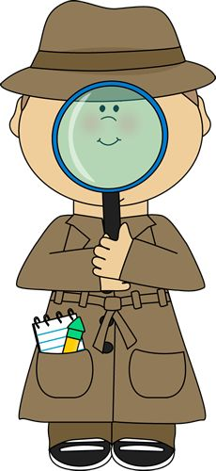
Plants Week 9 Booklet
Living vs. Non-Living
Foss Investigation #6 Plant Reproduction & Growth
Part 4: Flowers & Pollinators
Not in Foss-
Plant Defenses
Plant Review
1
Protists, Fungi & Plants Unit

Slide 2
Flower Flashcards
Flower Parts & Plant Defenses Vocabulary
2
Word | Definition
1. Stamen | The male organ of a flower that has an anther on a stalk (filament).
2. Pollen | Contains the sperm cells.
3. Anther | Produces the pollen that contains the sperm cells.
4. Filament | A long stalk that supports the anther on the male stamen.
5. Stigma | The sticky top where pollen grains land.
6. Style | A stalk down which the pollen tube grows after pollination has taken place on the female pistil.
7. Ovules | Fancy word for eggs.
8. Ovary | The fertilized egg (embryo) from which new plants are formed are found here. Contains the ovules where the egg cells are produced.
9. Sepal | The part of the flower that protects the bud before the flower blooms (often green and leaf-like) that enclose a developing bud.
10. Petal | Attracts pollinators to the flower with color and scent.
11. Pollen Tubes | Long tubes that allow the pollen to travel from the stigma to the ovary.
12. Pistil | The female organ of the flower that contains the stigma, style, ovary and ovules.
13. Germination | When a seed pops out and begins to grow.
14. Pollination | When pollen is carried to the sticky stigma by pollinators.
15. Fertilization | When sperm cells enter an egg creating an embryo.
16. Plant Defenses | Poisonous fruit and leaves, thorns and thigmotropism (plant responds to touch).
17. Fruit | Fertilized eggs become seeds and are protected in the ovule which becomes this later until seeds can be dispersed.
Study 20

Slide 3
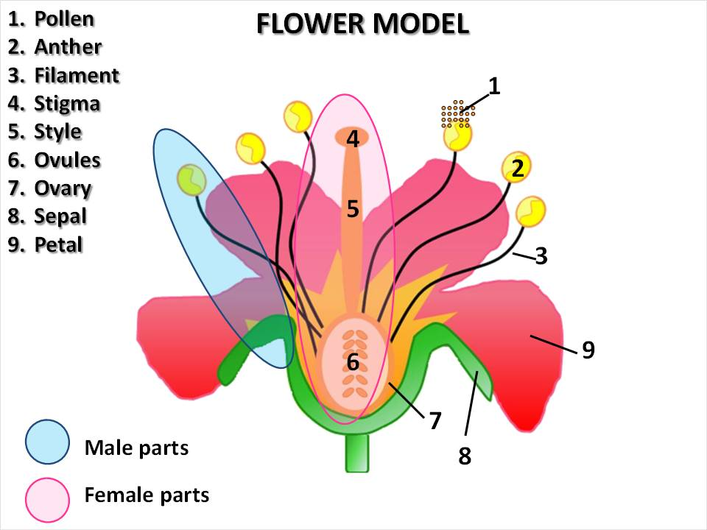
3
Study 20

Slide 4
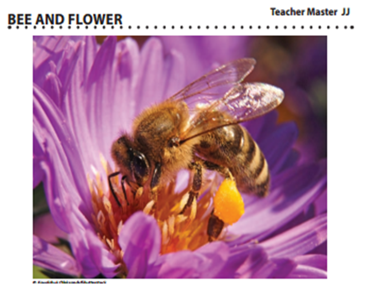
LAB: Part 4-Flowers and Pollinators
4
List five ways that pollen gets transferred from one flower to another?
___________ 2. _____________ 3. ______________ 4. ____________ 5. ______________
Pollinator | Response/Actions
Hummingbirds
Butterflies
Moths
Flies
What is the bee doing on the flower?
Why did the bee go to that particular flower?
What will the bee do when it leaves?
What might happen if the bee went to another of the same kind of flower?

Slide 5
Focus Question: What adaptations do flowering plants have to accomplish pollination?
5
Lab Part 4: Flowers and Pollinators
You are going to explore adaptations that flowering plants have evolved to make sure that pollination occurs. Think of the focus question. We will revisit it later, but jot down your initial answer here: ____________________________________________________________________________________________________________________________________________________________
Part 1: Teachers will gather several flower types for observation or pictures if flowers are unavailable. All of the flowers are different, but each of them have the same structures that you diagrammed on your Parts of a Flower Sheet #51 in Booklet 8 (p. 16). Look at Pollination Syndrome A Worksheet #56. Look through the questions in Part 1.
Getters will get 4 hand lenses for each group. Teacher will give two of the same kind of flower to each group. Students are not to dissect or destroy these flowers as they will be used in every class. Students will work in pairs, but will then discuss their findings with their table group. All students must record their answers on the worksheet for 4-5 minutes.
After the teacher calls time, groups will take turns reporting any flower characteristics that they think will attract pollinators.
List the class common answers here: ____________________________________________

Slide 6
Lab Part 4: Flowers and Pollinators
Part 2: Using the hard back science book as a resource, read “Flower Information” pages 82-85 as you do part 2. You should use this resource to make more detailed observations of your flowers. You should look for a flower that is similar to yours and look carefully at the diagram of the internal structures, specifically start thinking about where the nectar and or pollen are located. If a flower has nectar, it is found in a structure called the nectary.
Part 3: Using Notebook Sheet #57 Pollination Syndrome B, students should think about what pollinator might be attracted to their flower.
What kinds of structures would a pollinator need to reach a particular flower’s nectar?
What kinds of structures would a pollinator need to carry pollen?
What size might a pollinator be for your flower?
What part of a pollinator’s body (the back, the legs, the head, mouthparts, etc.) would most likely come in contact with and collect pollen?
Read the hard back science book Flowers and Pollinators page 86-92 and read the first section.
What do pollinators get out of their relationship with flowers?
What do flowers get out of their relationship with pollinators?
6

Slide 7
Part 4: The Pollination Syndrome
The characteristics that a flower employs to attract a particular pollinator are collectively called a pollination syndrome. The pollination syndrome of a flower can be used to predict the type of pollinator that will help the flower successfully reproduce.
Turn to Part 4 on your Notebook Sheet #57 Pollination Syndrome B and read the rest of the Flowers and Pollinators article. Predict what kind or kinds of pollinators would be attracted to your flower and record your response in the table on part 4.
Groups will share findings when complete:
Groups should show the class their flower, say what kinds of pollinators would visit it and why.
Preview Database: Pollinator Collection and practice matching pollinators to flowers.
Teachers will access the online activity: “Pollinators Game” and play a few rounds with you.
Revisit Focus Question: What adaptations do flowering plants have to accomplish pollination?
Lab Part 4: Flowers and Pollinators
7

Slide 8
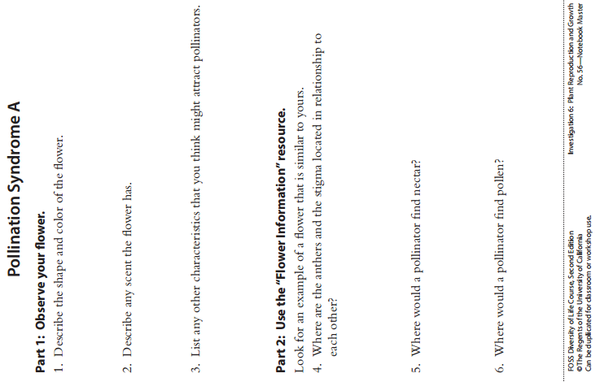
LAB: Part 4-Flowers and Pollinators
8

Slide 9
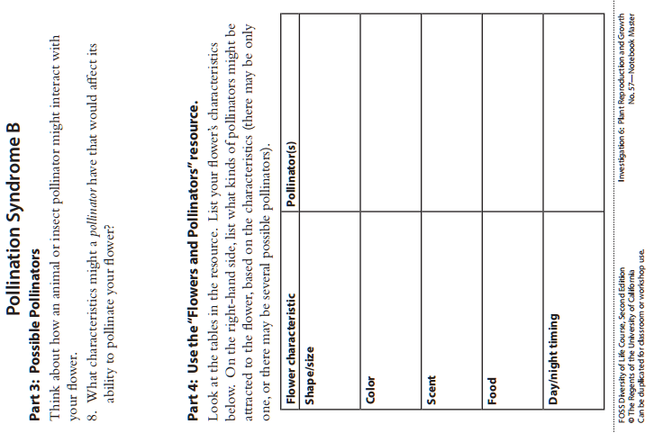
LAB: Part 4-Flowers and Pollinators
9

Slide 10
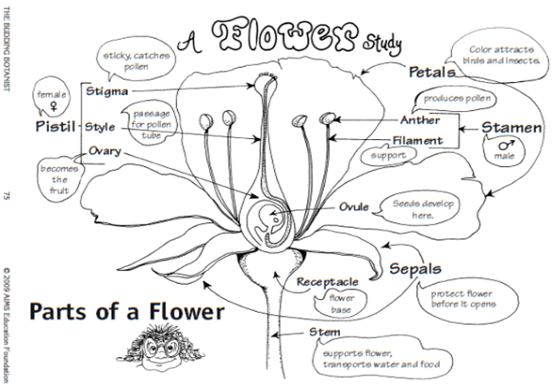
10

Slide 11
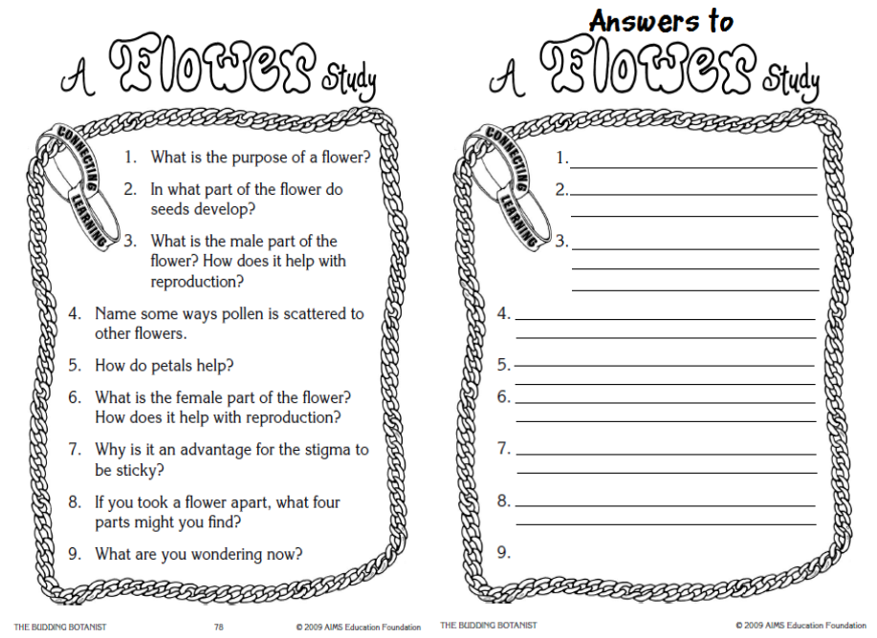
LAB: Part 4-Flowers and Pollinators
11

Slide 12
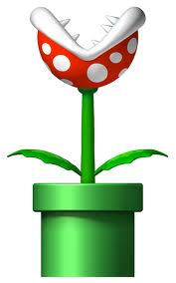
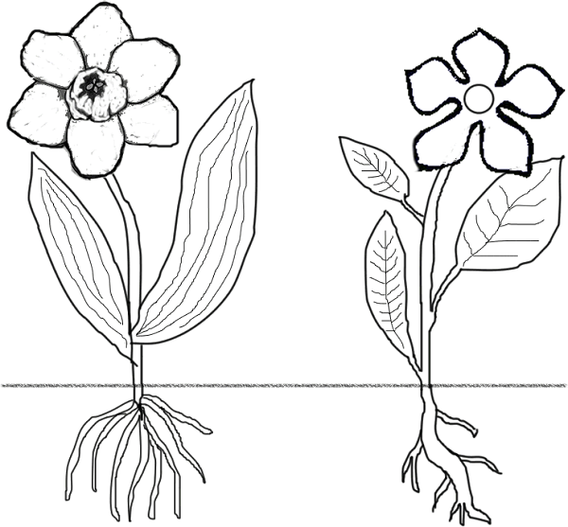
Organisms that make their own food: ______________
Organisms that must find an external source of food: __________________
The largest group of plants: ________________
Group of plants that do not have true root, stems, or leaves: _________________
Vascular Plants-vascular tissue: 1. _______ carries ______ 2. ___________ (carries ______)
Flowerless plants reproduce by ___________.
12
PLANT REVIEW
Plant Processes
Photosynthesis
Respiration
Transpiration
Pollination
Germination
Fertilization
Label the characteristics of the monocots and dicots.
P_______
R_______
T________
Processes in the Leaf: (Define each briefly in the circles)
Stem:
Stem:
Study 20

Slide 13
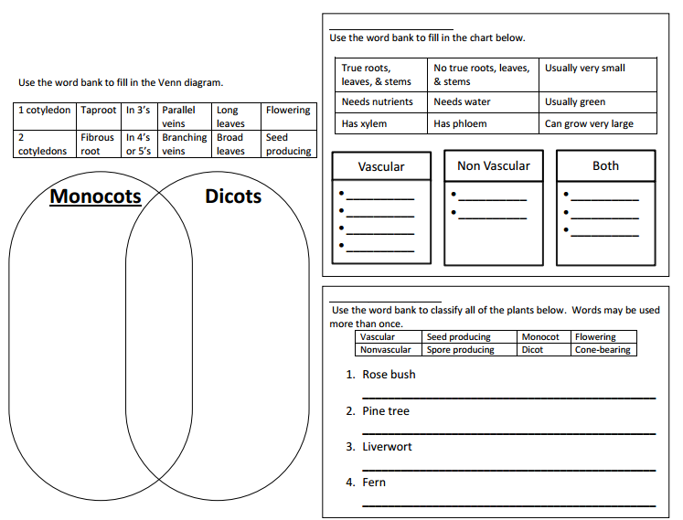
Challenge Review
13
Study 20

Slide 14
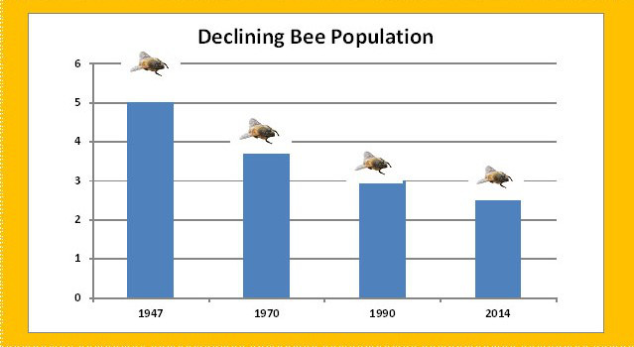
Scientific Argument: Claim, Evidence, Reasoning
6.E.2A.2
Using the graph, use your scientific argument skills to make a claim, find evidence and reasoning about the declining bee population and possible causes for this today.
Claim:_____________________________________________________
Evidence: _________________________________________________________________________________________________________________________________________________
Reasoning: _________________________________________________________________________________________________________________________________________________
14
Find a fact: What is the trend according to this graph?
Answer:_______________________________________________

Slide 15
How to Solve One-Step Dimensional Analysis Problems
#1 A family hot tub holds 500 gallons of water. How many cubic meters is this?
#2 A mother filled up a bathtub with 45 gallons of water to give her child a bath. How many cubic meters is this?
Conversion
264.2 gal = 1 cubic meter
15

Slide 16
Review
16
The male organ of a flower that has an anther on a stalk (filament).
The part of the flower that protects the bud before the flower blooms (often green and leaf-like) that enclose a developing bud.
The female organ of the flower that contains the stigma, style, ovary and ovules.
The sticky top where pollen grains land.
A stalk down which the pollen tube grows after pollination has taken place on the female pistil.
When sperm cells enter an egg creating an embryo.
When a seed pops out and begins to grow.
Fertilized eggs become seeds and are protected in the ovule which becomes this later until seeds can be dispersed.
The fertilized egg (embryo) from which new plants are formed are found here. Contains the ovules where the egg cells are produced.
Contains the sperm cells.
A long stalk that supports the anther on the male stamen.
L. Poisonous fruit and leaves, thorns and thigmotropism.
Fancy word for eggs.
Attracts pollinators to the flower with color and scent.
Long tubes that allow the pollen to travel from the stigma to the ovary.
When pollen is carried to the sticky stigma by pollinators.
Produces the pollen that contains the sperm cells.
1. _____ pollen
2. _____ anther
3. _____ filament
4. _____ stigma
5. _____ style
6. _____ ovules
7. _____ ovary
8. _____ sepal
9. _____ petal
10. _____ pollen tubes
11. _____ pistil
12. _____ germination
13. _____ pollination
14. _____ fertilization
15. _____ plant defenses
16. _____ stamen
17. _____ fruit
Study 20

Slide 17
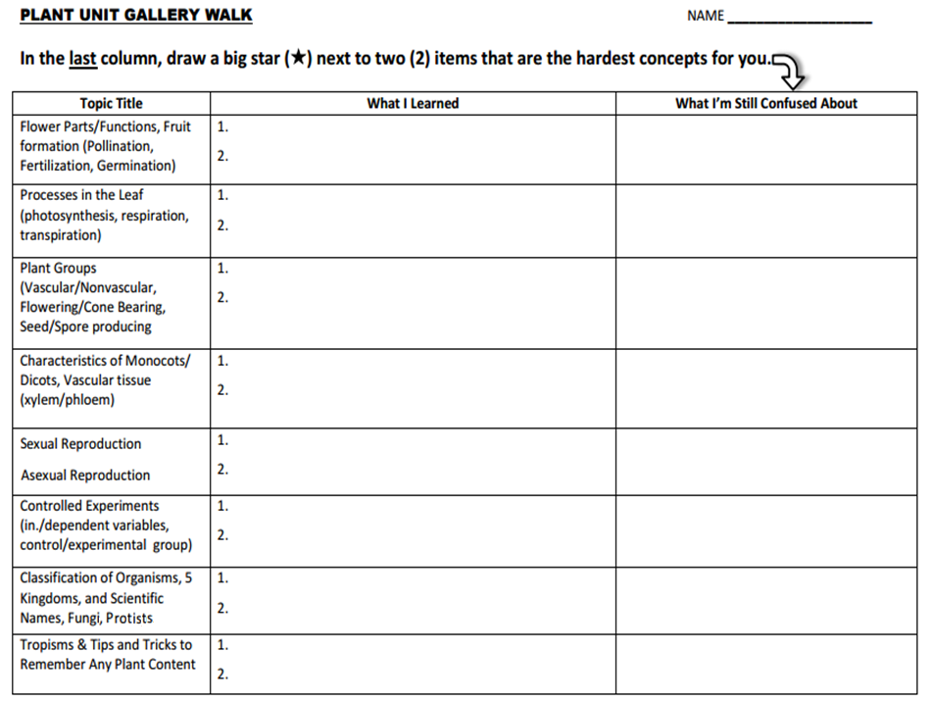
17
Teachers will pull groups based on your weaknesses.

Slide 18
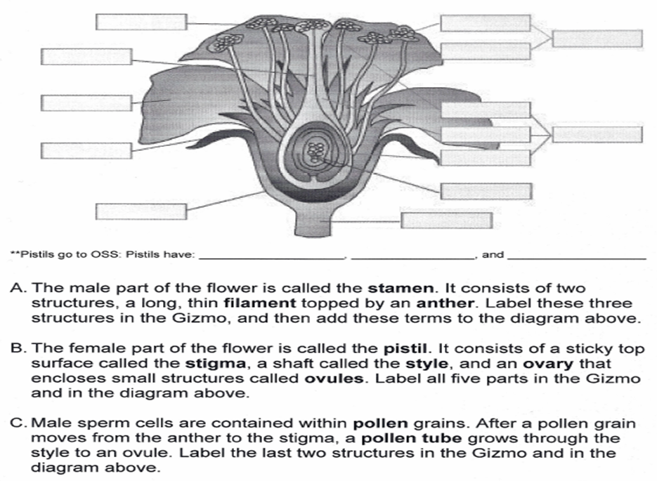
FLOWER GIZMO & REVIEW
18

Slide 19
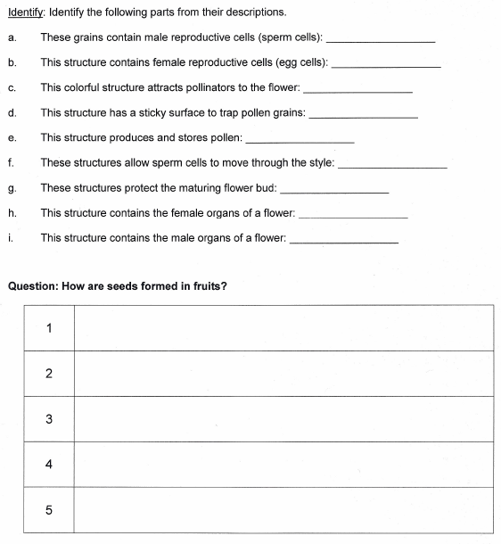
19

Slide 20
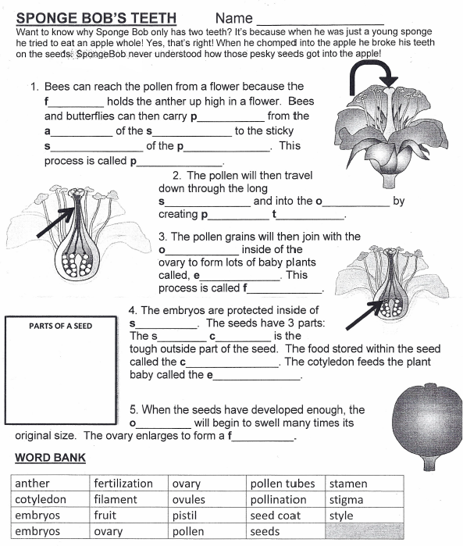
20

Slide 21
STRUCTURAL ADAPTATIONS/PROCESSES FLOWERING PLANTS USE FOR DEFENSE, SURVIVAL & REPRODUCTION
6.L.5B.3 Develop and use models to compare structural adaptations and processes that flowering plants use for defense, survival and reproduction.
Structural Adaptations for Reproduction Parts of the flowering plant that function in reproduction include: Flowers ● Flowers produce seeds. ● Many flowers contain both male and female organs needed to produce new flowers. ● Flower petals are often colorful or have a scent to attract insects and other animals. Stamen ● The male organ of a flower that has an anther on a stalk (filament). ● The anther produces the pollen that contains the sperm cells. Pistil ● The female organ of the flower that contains ○ The ovary, which contains the ovules where the egg cells are produced, ○ The stigma, which is the sticky top where pollen grains land, and ○ The style, which is a stalk down which the pollen tube grows after pollination has taken place. Seed ● The ovule that contains the fertilized egg (embryo) from which new plants are formed. ● A fruit that is formed from the ovary often protects them.
Extended Knowledge Plants use a variety of parts to produce new plants such as: Tubers, bulbs ● These are all types of underground stems. ● The “eyes” or buds of tubers, for example potatoes, grow into roots and shoots to produce a new plant. ● Bulbs, for example onions, are big buds made of a stem and special types of leaves.
21

Slide 22
STRUCTURAL ADAPTATIONS/PROCESSES FLOWERING PLANTS USE FOR DEFENSE, SURVIVAL & REPRODUCTION
6.L.5B.3 Develop and use models to compare structural adaptations and processes that flowering plants use for defense, survival and reproduction.
Structural Adaptations for Reproduction Runners ● These are all types of stems that run along the ground. ● New strawberries or some ivy grow from the tips of runners. ● Many lawn grasses grow from runners. Stem Cuttings ● When a piece of cut stem is planted, roots may form from the cutting, and then a full plant develops. ● Sugar cane and pineapple are examples of plants grown from stem cuttings. Roots ● Some fruit trees and bushes send up “suckers” or new shoots from the roots. ● Some plants have roots that can produce new plants from root pieces, such as a sweet potato. Plant cells have larger vacuoles compared to animal cells to store more food and water. This helps plants to store up the water they need in order to perform the process of photosynthesis. ​ Assessment Guidance The objective of this indicator is to develop and use models to compare structural adaptations and processes that flowering plants use for defense, survival and reproduction. Therefore, the primary focus of assessment should be for students to construct models that represent (or use simulations to investigate), compare, and contrast structural adaptations and processes flowering plants use for survival. This could include but is not limited to students creating models to describe how various structures of flowering plants help them to grow, develop, reproduce, and survive. In addition to develop and use models, students should ask questions; plan and carry out investigations; analyze and interpret data; use mathematics and computational thinking; engage in argument from evidence; construct explanations; obtain, evaluate, and communicate information; and construct devices or define solutions.
22

